Slide 1

CORE
Creating Opportunities for Recovery Employment

Slide 2







Slide 3

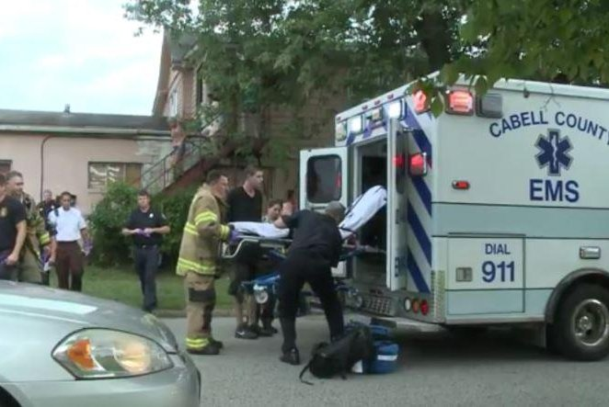


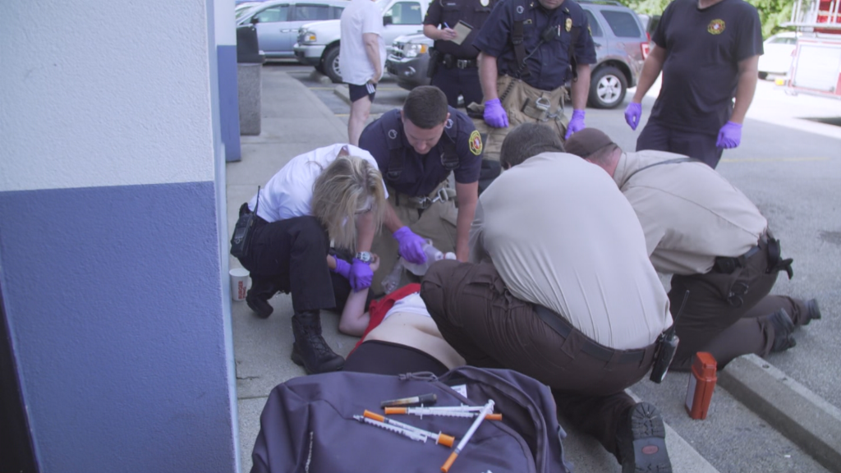



Slide 4
Understanding CORE

Slide 5
CORE Goal
To create a ready workforce among individuals in recovery by improving education, knowledge, and skills for workforce re-entry.
Whole-person wellness approach to support overall health through coordination of wrap-around supports.
Focuses on screening and quality matching of individuals to employment opportunities.

Slide 6
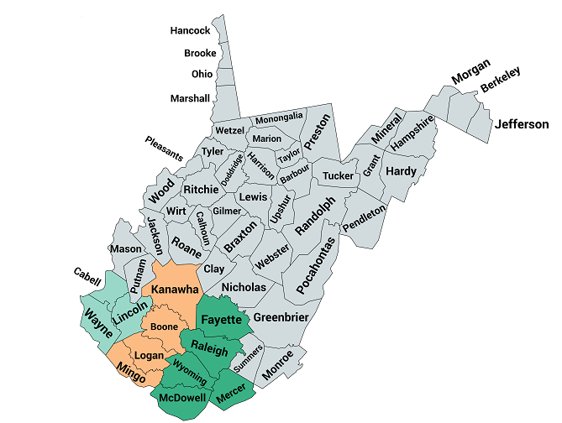
Service Area
CORE has established a 12-county recovery employment infrastructure to create a ready workforce.
The 12-county area is comprised of subsets of service area hubs
  Hub 1 serves Cabell, Wayne, & Lincoln counties
  Hub 2 serves Kanawha, Boone, Logan, & Mingo counties
  Hub 3 serves Fayette, Raleigh, Wyoming, Mercer, & McDowell counties

Slide 7
CORE Pillars
Participant Engagement
Employer Engagement
Community Resources
Engagement
Social Enterprise Development

Slide 8
The CORE Experience

Slide 9
Participant Engagement
Person-centered approach to identify an individualized and collaborative pathway into education or the workforce
Partnership with employers to provide a ready workforce
Community collaboration addressing barriers to employment

Slide 10
Participant Enrollment Requirements
Must be 18 years or older
In recovery for a minimum of 30 days
Possess a motivation to work
May not possess a pattern of violent behavior or violent criminal activity

Slide 11
Referral Process
CORE receives referrals from a variety of agencies and organizations as a result of community collaboration.
  Treatment providers
  Recovery housing
  Drug courts
  Family & friends
  Individuals
Referral and consent forms are completed by the referring agency/individual and the referred individual.

Slide 12
Intake Process and Service Delivery
CORE uses a comprehensive intake assessment to effectively coordinate services
  Demographic information
  Work experience
  Education & training
  Skills & interest
  Medical conditions including medications
  Barriers to employment (childcare, transportation, legal issues)
  Oral health
  Physical Wellness
  Hygiene

Slide 13
Job Development Plan
Using the intake assessment, CORE staff and the participant develop an action plan
  Identifies participant strengths
  Identifies areas of opportunity
  Establishes goals
  Lists service coordination next steps including the responsible party

Slide 14
Service Activities
CORE staff coordinate services on an individualized basis including opportunities for workforce development during on-going meetings with participants.
  Resume’ writing
  Professional email
  Interview and employment attire
  Interview preparation
  Interview follow-up communication
  Job application assistance
  Employment advocacy

Slide 15
Employer Engagement
Persons are screened and skill-matched with local employers.
Recovery focused education, training and supports for best practices when hiring.
Quarterly regional collaboration for continued quality improvement of the program.

Slide 16
Providing On-going Support
Job Coaching
Participant Check-ins
Employer review of participant progress
Education and Training
Recommendations to assist participants

Slide 17

WVChamber.com

Slide 18
Community Resources Engagement
Treatment/Recovery Housing
Education & Training
Childcare
Transportation
Clothing
Food Assistance
Medical/Dental
Legal Aid
Credit Counseling & Money Management

Slide 19
Social Enterprise Development
Assist in the development of business start-ups to provide additional means of workforce development and access to meaningful employment or entrepreneurship.
Explore social enterprise development to address critical health, social and economic challenges and unmet needs within communities.
Ensure a recovery-supportive work environment.

Slide 20
CORE Social Enterprises
Williamson Health and Wellness Food Service
  Focused on healthy food options
  Located in Hub 2
  Rural community
  Greatly impacted by downturn of coal production
  Hired four individuals in recovery
Routes to Recovery
  Focused on reducing transportation barriers to treatment and recovery
  Located in Hub 1
  City of Huntington
  Greatly impacted by opioid epidemic as “Ground Zero”
  Hiring two drivers in recovery

Slide 21
CORE IMPACT

Slide 22
CORE Impact
Outputs | Total Served
Workers/Trainees Enrolled | 1,071
Workers/Trainees Placed into Employment | 436
Jobs Retained (at least 90 days) | 175
Business Served | 420
2021 Average Wage | $11.58/hr.
*July 2022

Slide 23
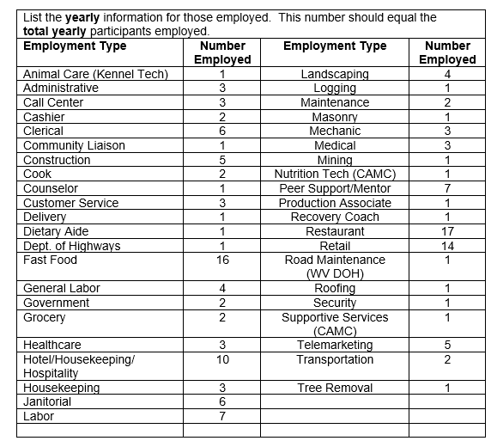
2021 CORE Industry Types

Slide 24
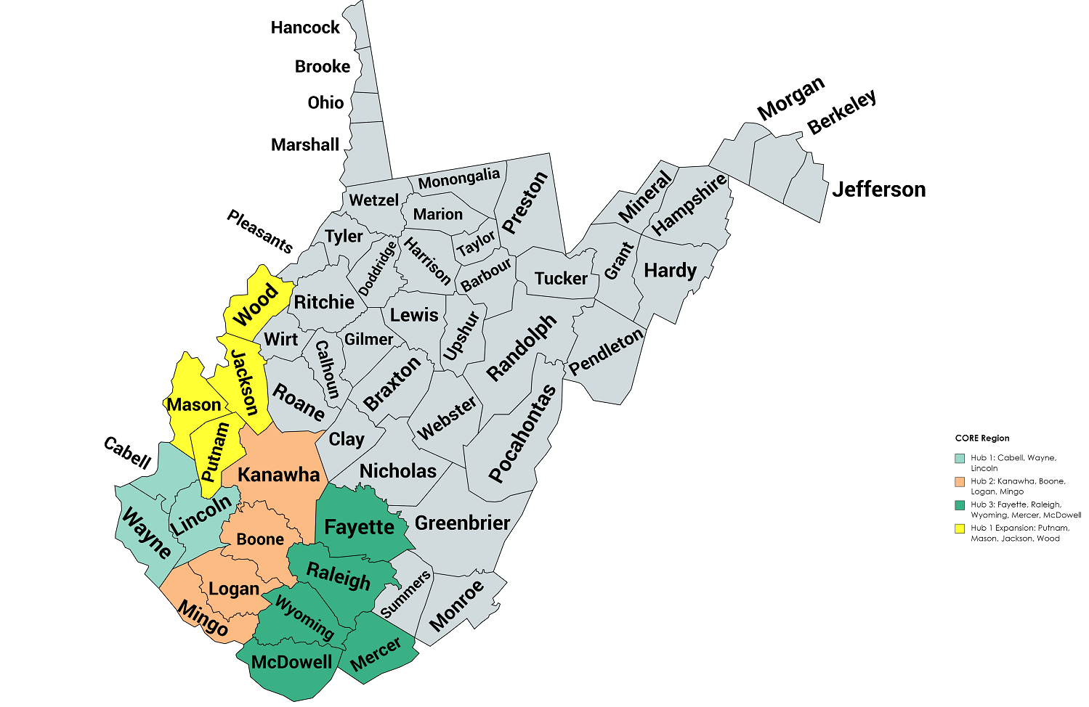
CORE Expansion Plan

Slide 25
CONNECT WITH CORE

Slide 26


Slide 27

COREWV@Marshall.edu

Slide 28
Ashley M. Shaw, M.S., M.B.A.
CORE Director
(304) 691-1995
shawa@marshall.edu

