Slide 1

Overview of IEP Process
What is the Process of an Individual Education Program?
Presented by:
Notes:
You may present an “ice breaker.” You judge your audience.

Slide 2


West Virginia Parent Training and Information, Inc.
West Virginia Parent Training & Information (WV PTI) is a non-profit agency that operates the statewide federally funded Parent Training Center for WV, and is the Family Voices State Affiliate Organization for West Virginia. The programs and services of WVPTI are based on the concept of parents helping parents.
Notes:
Introduce yourself.
Tell about WVPTI:
The West Virginia Parent Training and Information, Inc. (WV PTI) is a non-profit organization that operates the statewide federally funded Parent Training Center for WV and is the Family Voices State Affiliate Organization for West Virginia. The programs and services of WVPTI are based on the concept of parents helping parents. WVPTI, Inc. is committed to empowering parents and families of children and youth with disabilities and special healthcare needs as advocates and partners in improving education, transition and healthcare outcomes for their children from birth to age 26.

Slide 3

Overview of IEP Agenda
Introduction
What is an IEP?
Parts of the IEP Process
Wrap-Up and Questions
Notes:
Introduction:
What do you imagine when you think of special education? You might picture children with disabilities spending the day tucked away in a different kind of classroom, separated from most of the kids their age. This may have been the norm in the past. But as the field of special education has moved forward, much has changed.
Special education today is still focused on helping children with disabilities learn. But this no longer has to mean placing children in special classrooms all day long. In fact, federal law requires that students who receive special education services be taught alongside their peers as much as possible.
If your child qualifies for special education, he or she will receive an individualized teaching plan and other key resources at no cost to you, the parent. Your child will have an IEP.
Our purpose today is to introduce you to what is an IEP. "IEP" stands for "Individualized Education Program". We're also going to talk about the relationship between an IEP and instruction in an inclusive classroom in the “Parts of the IEP”, and finally, we're going to talk about how an IEP can really be a road map to providing a high- quality educational program to students with disabilities.

Slide 4
Acronyms in the Process
IEP – Individual Education Program
IFSP- Individual Family Service Plan (this is for children birth through age 3)
IDEA- Individual with Disabilities Education Act
Notes:
In special education, there seems to be a love initials of long terms, and so first let's describe or define some of these acronyms that we'll be using throughout the presentation. As I said earlier, "IEP" stands for "Individualized Education Program". Children who qualify for special education ages three and above have an IEP.
"IFSP" is an Individual Family Service Plan. This is for children who qualify for special education services up to age three, so it's birth through age three, so on your child’s third birthday, your child may or may not graduate to an IEP. We're not going to really talk about IFSPs today either, although they're many similarities between those and IEPs. (I will not be discussing this plan in this presentation.)
And then finally, "IDEA" is the Individuals with Disabilities Education Act, IDEA, and that's the federal law that entitles children with disabilities to receive special education. IDEA defines and regulates special education. That's an important thing for us to remember, every child with a disability in the United States, three and above, is entitled to a free and appropriate public education. Children, under three, are also entitled to early intervention services.

Slide 5

What is an IEP (Individual Education Program)?
An Individualized Education Program (IEP) is a written statement of the educational program designed to meet a child’s individual needs. Every child who receives special education services must have an IEP. That’s why the process of developing this vital document is of great interest and importance to educators, administrators, and families alike.
Notes:
Thanks to this powerful and important federal law called the Individuals with Disabilities Education Act, or IDEA, children with disabilities are entitled to a “free appropriate public education” (often called FAPE). This means that schools/head start schools must provide eligible children who have a disability with specially designed instruction to meet their unique needs at no cost to the children’s parents. This specially designed instruction is known as special education. The written statement or document of the educational program designed to meet a child’s individual needs.

Slide 6

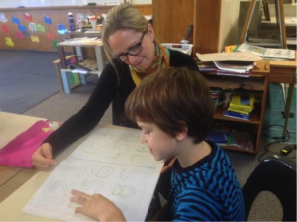
What is the Purpose of an IEP?
Notes:
The IEP has two general purposes:
to set reasonable learning goals for a child, and
to state the services that the school district will provide for the child.

Slide 7

Who Develops the IEP?
The IEP is developed by a team of individuals that includes key school staff and the child’s parents. The team meets, reviews the assessment information available about the child, and designs an educational program to address the child’s educational needs that result from his or her disability. Want the specifics of who you’ll find on an IEP team will be a variety of people?
Notes:
School districts have a process in place to determine which students are eligible for special education. It involves a comprehensive evaluation that looks at the way your child thinks. It also looks at other aspects of his/her development. It's really important to remember that an IEP, although it's initiated by the school district or the parent may write a letter requesting evaluation of his/her child, is a document that's developed by the team -- all members of the team (parents, Head Start/general education teachers, speech language pathologists, special education teachers, etc.) give input. Everyone's input is valued.

Slide 8
Who is on the “IEP” Team ?
Required Membership:
Parent(s)
General Education Teacher or Head Start Teacher
Special Education Teacher and/or
Special Education Service Provider or
related service provider
Representative of the District
Individual who can interpret the instructional implications of evaluation results
Others with knowledge or special expertise at the parent or district discretion
Notes:
Policy 2419: Regulations for the Education of Students with Exceptionalities states:
The primary purpose of an IEP Team meeting is to design and IEP that will meet the unique needs of an eligible student/child. The IEP Team plans the special education and related services designed to provide access to and progress in the general curriculum. The IEP Team members come prepared to participate in an open discussion regarding the student’s individual needs and how those needs affect the student's mastery of the content standards and objectives.
The members are: Parent(s)
General Education Teacher or Head start teacher
Special Education Teacher and/or Special Education Service Provider or
related service provider
Representative of the District
Individual who can interpret the instructional implications of evaluation results
Others with knowledge or special expertise at the parent or district discretion
The Student when appropriate, but required during transition meetings
A Representative of any Participating Agency
Part C Coordinator if necessary
A representative of the Private School or Facility

Slide 9

Who writes The IEP?
Notes:
The educational team which we just described, including you, the parents, are all important as a part of them to create and approve the IEP.
Head Start teachers/ general education teachers are important IEP team members.
Teachers and other professionals may write the first draft, but parent input is very, very important. Please speak up at the meeting because you know your child the best of all.
Assessment data should identify areas that need to addressed on the IEP.
(In Head Start, Within 45 days of the beginning of the program, developmental and sensory must be completed, visual/motor, language and cognition, gross motor/body movement, sensory (vision and hearing), behavioral screening. If the child enrolls later in the year, screening must be completed 45 days after enrollment.)
What do you have to offer to the IEP process? Parent input is essential because you know your child best. So, don’t hesitate to speak about your child in the meeting.

Slide 10
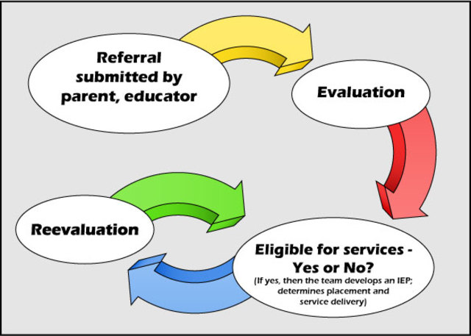
When is the IEP Developed?
An IEP meeting must be held within 30 calendar days after it is determined, through a full and individual evaluation, that a child has one of the disabilities listed in IDEA and needs special education and related services. A child’s IEP must also be reviewed at least annually thereafter to determine whether the annual goals are being achieved and must be revised as appropriate.
Notes:
The IEP is developed or created if the team finds the child has special needs which need to be addressed or helped. An IEP meeting is held within 30 calendar days after a full evaluation has determined that child either needs some help or not. The child must have one of 13 disabilities listed in IDEA and needs special education to qualify for an IEP. In West Virginia, there are 14 categories due to the fact gifted is counted in the list. These categories include autism, hearing impairment, and intellectual disability. A specific learning disability most often affects skills in reading, writing, listening, reasoning, and doing math.
There is an option plan called 504 but we have another presentation which tells you about this plan.

Slide 11

What are the Parts of an IEP?
Present Level
of Performance
Child’s needs
Child’s strengths
Types of services
the child will receive
Notes:
An IEP has many parts that are required by the law. They include the child's present level of performance -- and in that present level of performance, the team wants to get a snapshot of the child. "What can the child do, what areas does the child needs help in, which areas do the child excel in?" So it's important to note children's strengths as well as the areas of need. The IEP team also wants to talk about the kinds of services they'll receive, so, for example, does the child need speech services? Do the child needs occupational or physical therapy that is motor support? Does the child need special education services? Will the child receive transportation?

Slide 12

What are the supports needed in an IEP?
Special
Education
Services?
Transportation?
Occupational Therapy?
Notes:
Does the child need special education services? Will the child receive transportation? All the kinds of services that the child will receive need to be outlined in in the IEP. The educational team, including the parents and the general education (Head Start) teacher, write the IEP. In the Kindergarten and upper grades, the IEP team works together. As a group, they up come with the idea... with the strategies that they'll be using and the topics that they'll be covering in this IEP. Again, general education teachers/ Head Start teachers are an important part of the IEP team. However, parent input is essential, and in fact parents have the final say in approving the IEP.

Slide 13

IEP contains (but not limited to):
the child’s present levels of academic achievement and functional performance, describing how the child is currently doing in school and how the child’s disability affects his or her involvement and progress in the general curriculum
Goals and objectives
the special education and related services to be provided to the child, including supplementary aids and services (such as a communication device) and changes to the program or supports for school personnel
Types and amount of services or modifications and how often they are provided
Notes:
Parent input is essential as I have stated, and in fact parents have the final say in approving the IEP. We also need to remember that assessment data is very important when the IEP is developed. The team uses assessment data to.. not just to demonstrate that a child needs special education services, but assessment data is needed in order to determine which areas need to be worked on, and within an area, which skills and or maybe behaviors need to be addressed.

Slide 14

I = Individualized
Notes:
Head start message:
So there're different parts of an IEP: present level of performance, and in this area, there is a description of what the child can do, and also areas in which the child needs extra help. There's also a part of the IEP about different kinds of accommodations and modifications that may be required. For example, if the evaluations stated a child needs to have a lot of visual supports in a classroom. Then, visual supports such enlarged print on all materials would be added to the IEP. If the child needs extra time to complete assignments or complete activities, this would be placed in the IEP. Whatever kinds of support and modifications to the ongoing curriculum that are required for the child to be successful would be placed in the IEP.
Another part of the IEP is the timeline. There will be an amount of time needed for the services provided. So, for example, the team might say that the child receives special education for 200 minutes a week, and that means for 200 minutes, the child would receive specially designed instruction. Now it's important to remember that those 200 minutes can be this child can receive services in a Head Start classroom, and it could be that the Head Start teacher or staff in the Head Start program are providing those services. They may develop those services in consultation with a special educator. Finally, we have goals and objectives, and the goals and objectives outline very specifically exactly what behaviors and skills the child will be working on, and how parents/teachers will know when the child has achieved or has learned the target behavior or goal. So, for example, the IEP might have an objective that sounds like, "Jamie will listen to a story and answer three 'wh' questions with 100% accuracy." The most important thing about an IEP is to remember that "I" means "Individualized". The IEP needs to be tailored to the specific child and the priorities. "I" means "Individualized", and that's the “take-home message” about IEPs.
General education message: I = Individualized. The IEP is about the needs of the child and should be tailored to meet the needs of the specific child. There are items such as:
Present Levels of Performance: What can the child do at this moment in time.
The evaluations might have areas of need. Then, the IEP will have services or accommodations/ modifications needed for the child listed. For example, if the evaluations stated a child needs to have a lot of visual supports in a classroom. Then, visual supports such enlarged print on all materials would be added to the IEP.
Timelines:
Another part of the IEP is the timeline. There will be an amount of time needed for the services provided. So, for example, the team might say that the child receives special education for 200 minutes a week, and that means for 200 minutes, the child would receive specially designed instruction. Now it's important to remember that those 200 minutes can be this child can receive services in the classroom or pulled out for special instruction maybe with a speech teacher.
The most important thing about an IEP is to remember that "I" means "Individualized". The IEP needs to be tailored to the specific child and the priorities. "I" means "Individualized", and that's the “take-home message” about IEPs.

Slide 15
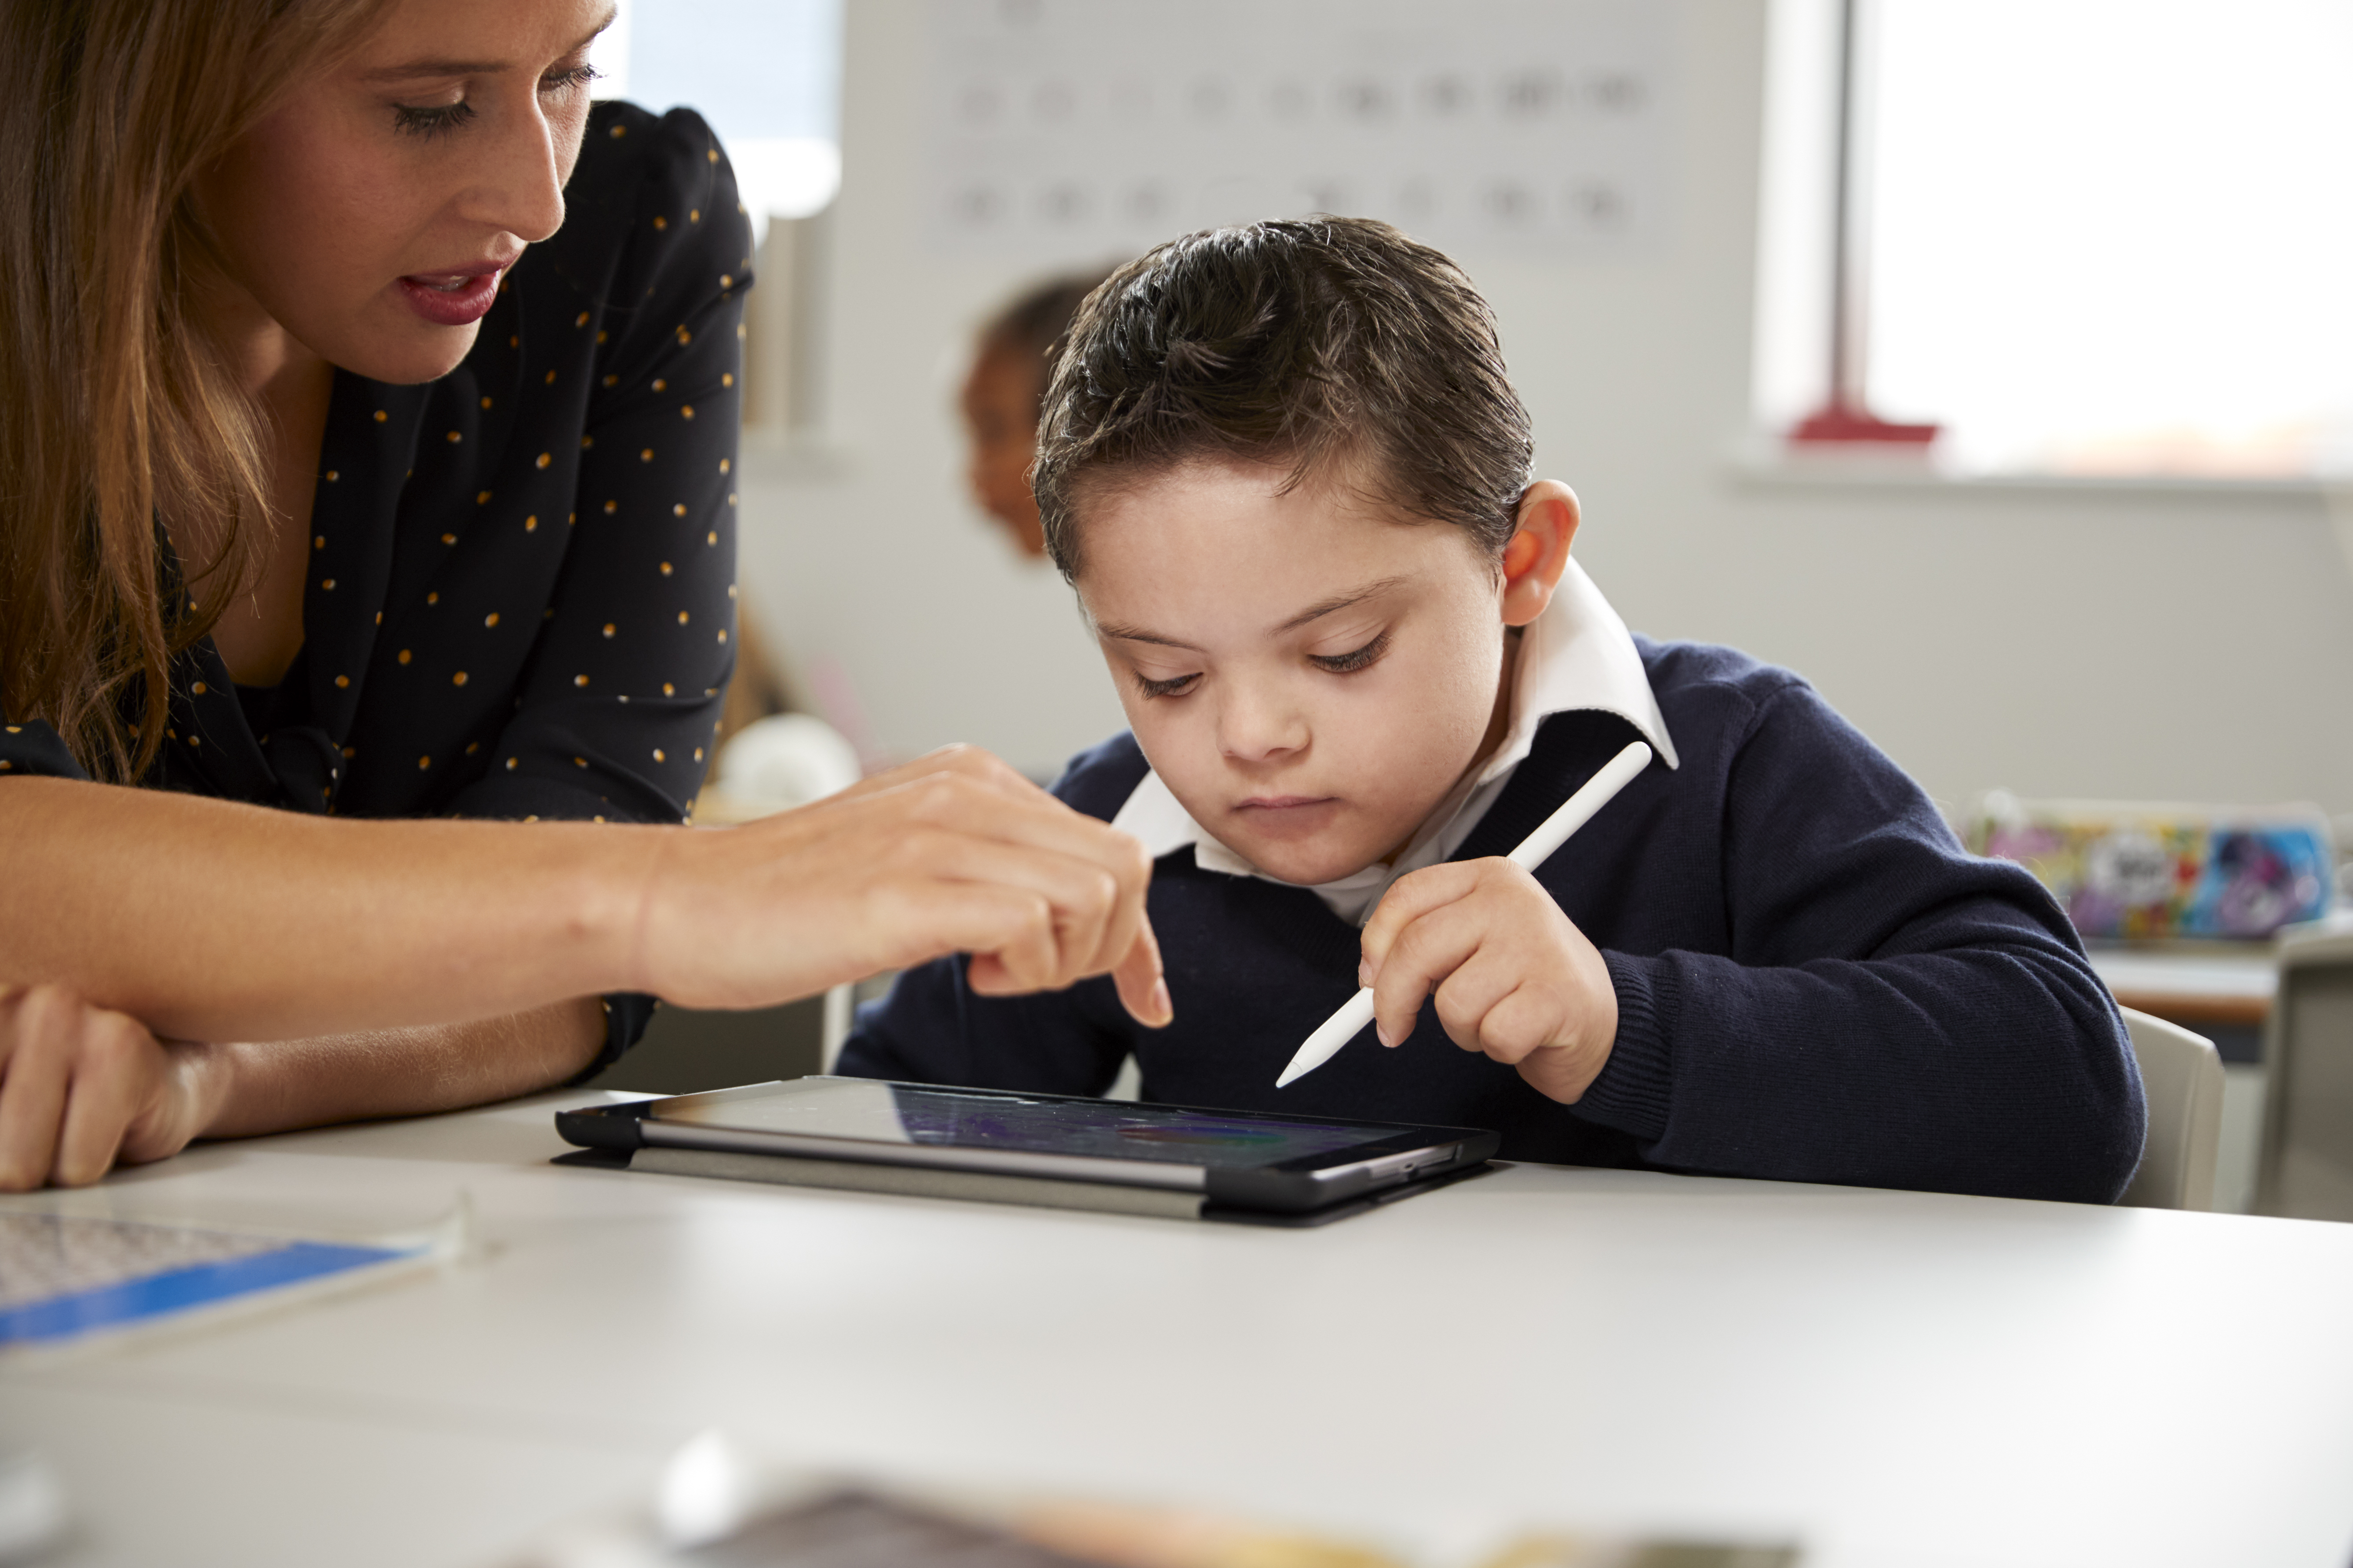
What Does “least Restrictive Environment” Mean?
Notes:
In the IEP, there will be a decision about “least restrictive environment” (LRE). This means the starting point for discussion about the supports your child needs to succeed in the general education classroom. Schools have a special term for deciding to place a child in one type of classroom or setting rather than another. Schools refer to this as “placement.” General education classrooms are the most common placement for kids with learning disabilities.
Options include self-contained classroom which is taught by a special education teacher and typically has far fewer students than a general education classroom.
Another option: Inclusion classroom which is a mix of students who do and do not have receive special education services. A special education teacher and a general education teacher share equal responsibility for teaching the class. They weave in lost of learning supports with different learning styles and skill levels.

Slide 16


What are Accommodations?
Notes:
Accommodations are a key component in special education’s IEP. Much like a wheelchair ramp allows more people to access a building, classroom accommodations in the IEP allow more students to access the general curriculum. For example, if a child has dyslexia (slow reading and mixing up words), text-to-speech software that reads aloud the words on a computer screen can help the child access the material than reading it own his/her own.
There might be accommodations for taking tests. For example, if a child has a reading disability, the teacher might have the test questions read questions aloud.
Another example, a child could have trouble making transitions during circle time in Headstart or preschool. This child might need a picture schedule and transition signals with visual cues from the teacher.
Accommodations refer to HOW a students learn.

Slide 17


What are modifications?
Notes:
Modifications in an IEP refer to how much a student is expected to do or learn.
For example, some students may be given fewer math problems or provided shorter stories to help the child succeed.
Students may have both modifications and accommodations in an IEP while other students might not need either one. Remember, it all depends upon the child’s needs.

Slide 18
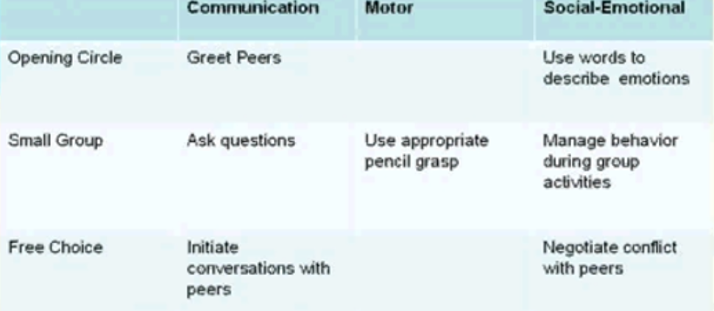
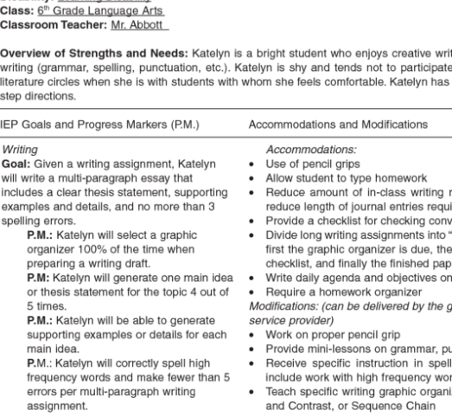
How do the teachers use the IEP?
Headstart/Preschool Sample
Notes:
So, how does a teacher use the child’s IEP document?
Headstart Example:
IEPs can be used to develop classroom plans. An example, when headstart children who are learning to listen to stories and to answer "wh“ (who, what, when, and why) questions, the IEP will provide for more than one opportunity a day to listen to a story and set up different ways to provide it. This means, in addition to teacher’s large group, where they read a story and ask questions, there might have two or three other opportunities during the day where teacher would have someone reading a story to a very small group of children... ...and answering and asking questions about one page or two pages of the story at a time. If there is a child who's learning to follow a process chart (to follow a schedule, to do an activity), the teacher may have several activities that has multiple steps in them across the classroom which has been written as an objective in the IEP.
An IEP is used to develop an activity plan for the day. This plan is used to outline the instruction for additional specific activities. Here on the left side of the slide is what an activity plan looks like. So when teachers use an activity plan (matrix), what you can see here is that down the side, we have the schedule of the classroom: Opening Circle, Small Group, et cetera. Across the top, we have the domain areas of the IEP -- Communication, Motor, Social Emotional -- and in the boxes of the activity matrix which is plugged in the different objectives in the child's IEP.
General Education Sample is on the right side of the slide.
Here is an upper grade level example, you can see that for this child, who (he or she) is working on using an appropriate pencil grasp. One of the IEP’s accommodations is the child will reduce the amount of in-class writing by reducing the length of the journal entries. There are several accommodations and modification which might be needed by the child to be successful in the learning experience.
This is just a snapshot to give you an idea of how the teacher uses the IEP in the classroom. This picture may include other services from providers such as occupational therapy or speech therapy.
Teachers have classroom goals that they know everyone in the classroom is working on, and an activity or lesson, and the teachers say, "Okay, within that activity/lesson, how are we going to make sure that we address this goal, that the curriculum outlines, is important for ALL of the children in our classroom?"
When a teacher has a child with a disability who's receiving special education services, they have another layer that goes on top of classroom goals. With this additional layer, teachers may have the variety of activities or additional equipment or lessons written in the IEP. So, there will be the IEP’s individual child goal, and that individual child goal has been broken down to "objectives", which are smaller pieces, and into instructional programs. You can see this kind of objectives in the right side of our slide.

Slide 19

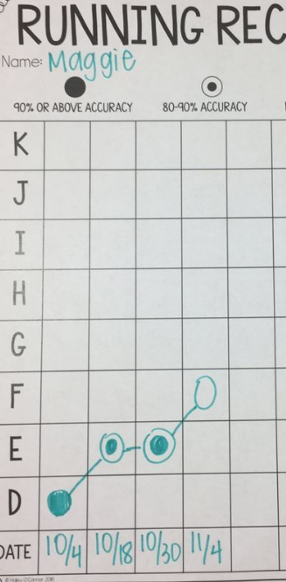
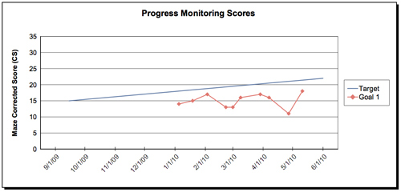
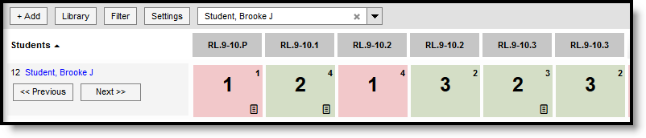
How do Parents Know how their child is Progressing?
Notes:
An IEP requires that teachers/service providers monitor progress and report progress at a certain time period. They (teachers and providers) collect information regularly, to make sure that children are making progress on the important goals and objectives that, as a team agreed needs to be on the child’s IEP.
Teachers may do that by watching a child perform a skill or a behavior and see how independent they are and then comparing that to where they were a week ago and a month ago.
Teachers in the upper grades do this data assessment by collecting the child progress information from tests or procedures assessment. It is important that the child is learning the skills that the team says are necessary for that child to learn.

Slide 20
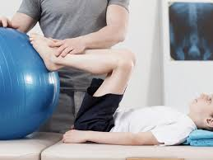
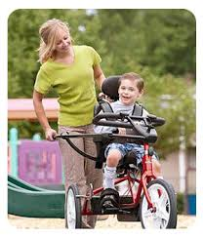
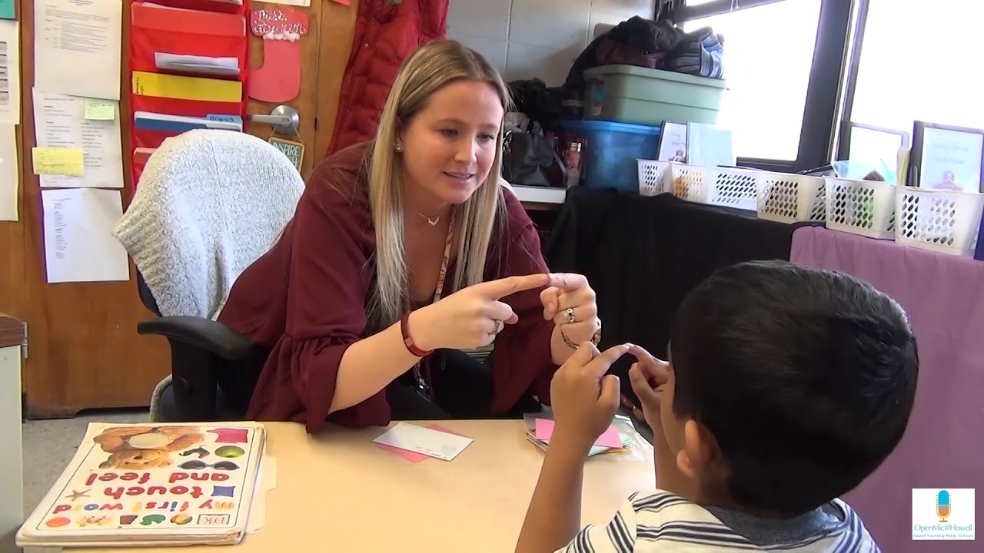
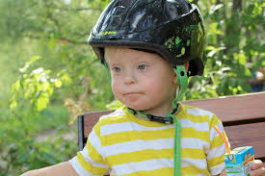
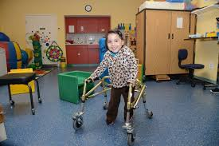
What does “Related Services” Mean?
Notes:
In an IEP, there might be a need to provide certain kinds of services that aren’t strictly educational but are needed so students can benefit from special education. These are called related services.
For example, a child who has dyspraxia (difficulty with hand-eye coordination, balance and fine motor skills) might need one-on-one sessions with an occupational therapist to improve the hand-eye coordination.
Other examples of related services may include:
Mental health counseling for children and parents
Social Work to provide support to children and families and assist in developing positive behavioral interventions.
Speech-language therapy to improve communication skills which affect learning.
Another term you may hear is “supplementary aids and services.” These include adapted equipment such as a special cushion that can help children with attention or sensory processing issues stay seated and focus for longer periods of time.
Other examples of supplementary support include the assistive technology and training for staff, student/children, and parents.

Slide 21


Can students be involved in developing their own IEP?
Notes:
As the child ages, YES, they certainly can be! IDEA actually requires that the student be invited to any IEP meeting where transition services will be discussed. These are services designed to help the student plan for his or her transition to adulthood and life after high school.

Slide 22
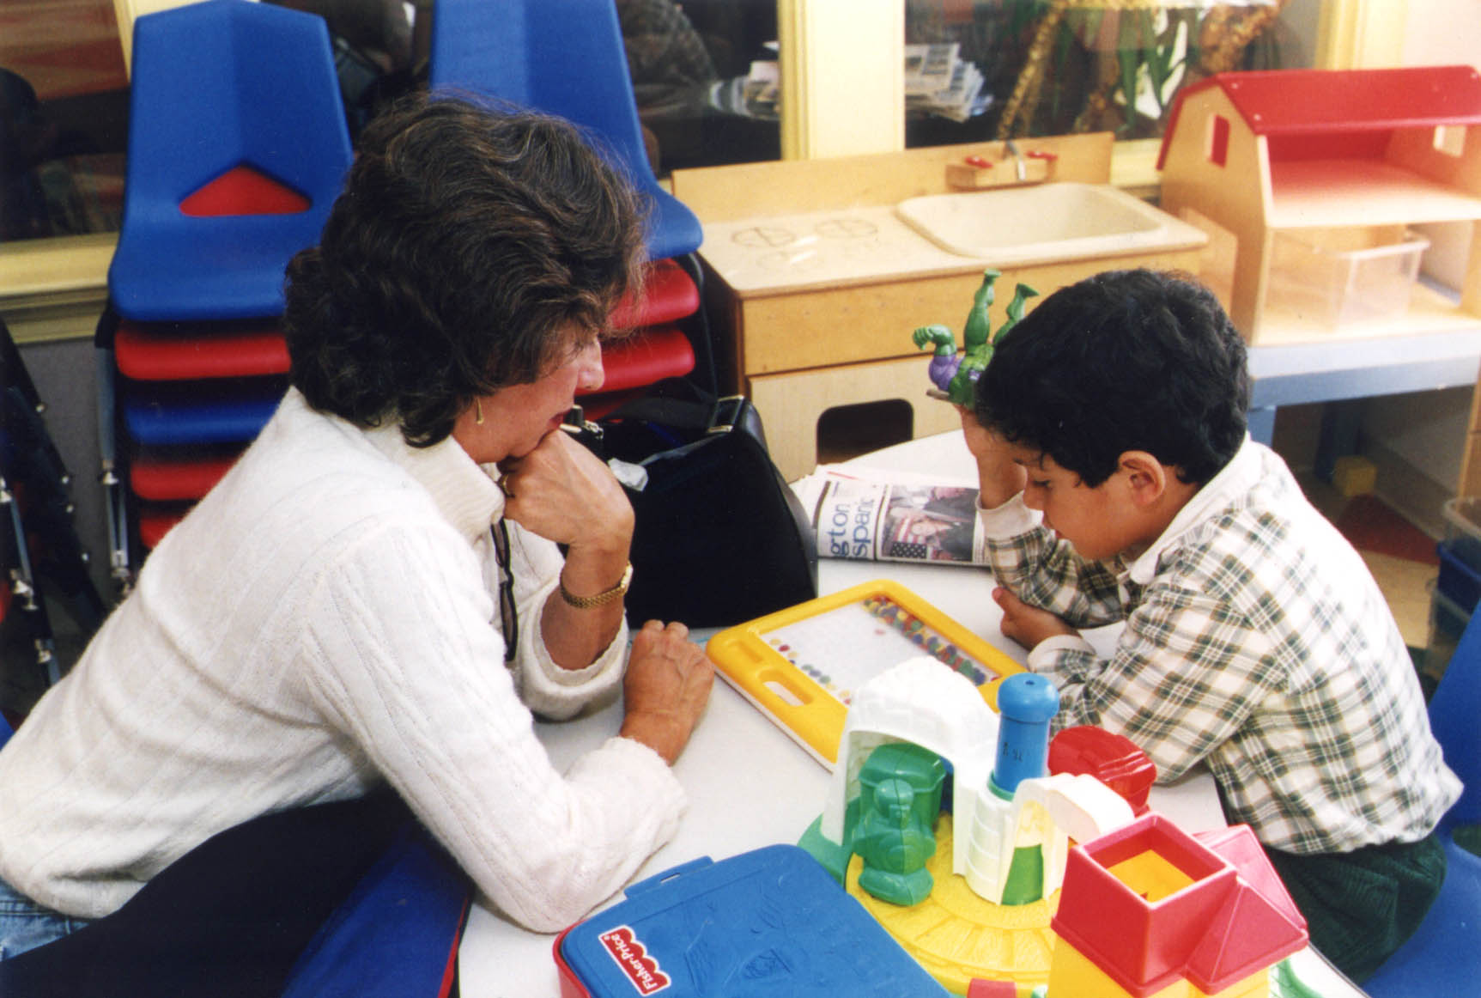
In Summary, for an Individualized Education Program:
Referral for evaluation
When your child is struggling and a learning or thinking difference is suspected, you or the school can ask for an evaluation. Your request may be accepted or denied but the reason why must be explained why this decision was made. The school or district can’t evaluate your child unless you give written permission.

Slide 23
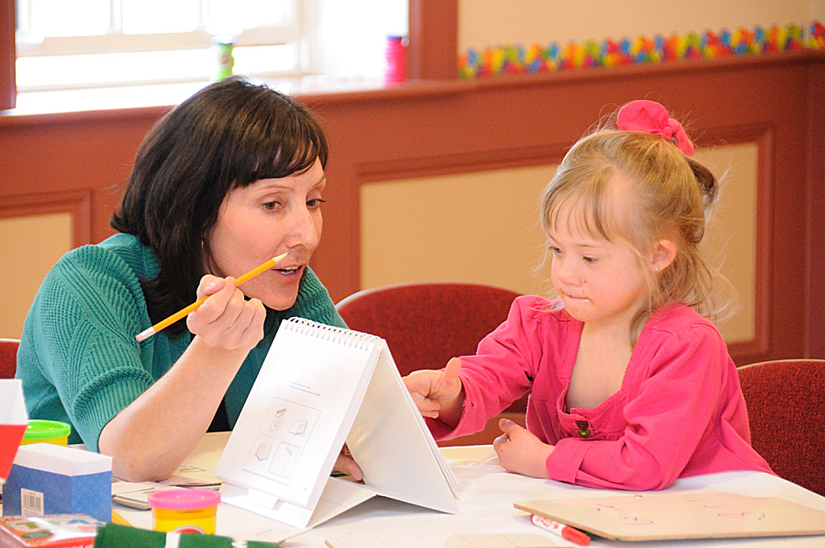
Summary Steps with an IEP
Evaluation
If the school agrees to evaluate your child, the school psychologist and other specialists will give your child various tests.
They may observe your child in the classroom.
These evaluations will identify whether your child has one of the 13 disabilities covered by IDEA. The evaluations provide information about your child’s educational needs.
Notes:
Medical conditions such as ADHD are diagnosed by a physician or another medical professional. However, the federal law does not necessarily require a medical evaluation to identify a child with ADHD. Most WV school districts have policies that allow school psychologists to diagnosed ADHD as part of the special education evaluation.

Slide 24


Next Step in the IEP Process
Determining of Eligibility
The Meeting
Notes:
Eligibility means that once all of the evaluations have taken place, the team members write their reports and determine together whether your child qualifies for services. According to the Individuals with Disabilities Education Act (IDEA) in order to be eligible for special education or related services, your child must be determined a “child with a disability” – which can mean anything from an articulation issue to ADD to a hearing impairment and many others. If your child isn’t found eligible for services, you may disagree, it is your right to challenge the decision if you decide to do this option.
The Meeting: The IEP meeting is scheduled by the school district, and it’s the coordinator’s job to contact you well in advance (at least 5 day before) and attempt to accommodate your schedule. On the call, the coordinator is required to list the meeting’s attendees and invite you to bring anyone you fell would be an advocate for your child, such as a teacher or therapist. At the meeting, your child’s IEP will be written, including the specific services your child receive, how many times per week and for how many minutes your child get them, and whether they’ll be one-on-one or with a group. If you disagree with the IEP, you have the right to request a due process hearing and mediation.

Slide 25
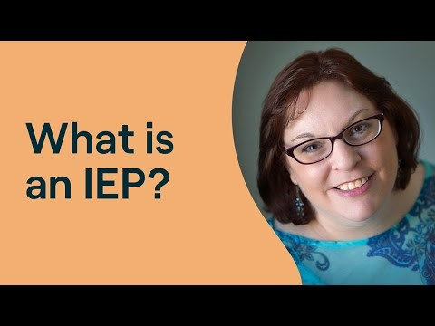
Services, Progress Reports, and Review
Notes:
Once the IEP is written, your child’s school is responsible for making sure it’s followed. Your child’s teacher, service providers, and you will be given copies of the IEP. Often, you will meet at the beginning of the academic year with the school’s coordinator to discuss how the program will be carried out. As often as your child’s report cards are sent out, you should receive official IEP progress reports, though usually you’ll be given less formal updates on a more frequent basis. At least once a year, the IEP will be reviewed. At the meeting, you may request changes or make suggestions, and if you disagree with the results, you can ask for additional evaluations or a hearing or mediation.
Reevaluation: According to the U.S. Department of Education, children/youth/students with IEPs have to be reevaluated every three years to determine whether they’re still eligible for services. If you or your child’s teacher requests it, however, reevaluations may be completed sooner or more often.

Slide 26

Questions?
Notes:
Remind the participants to complete the workshop evaluation.
Also, ask if anyone did not sign the “Sign-In” sheet.
Thank the participants for allowing you the opportunity to present to them.

Slide 27
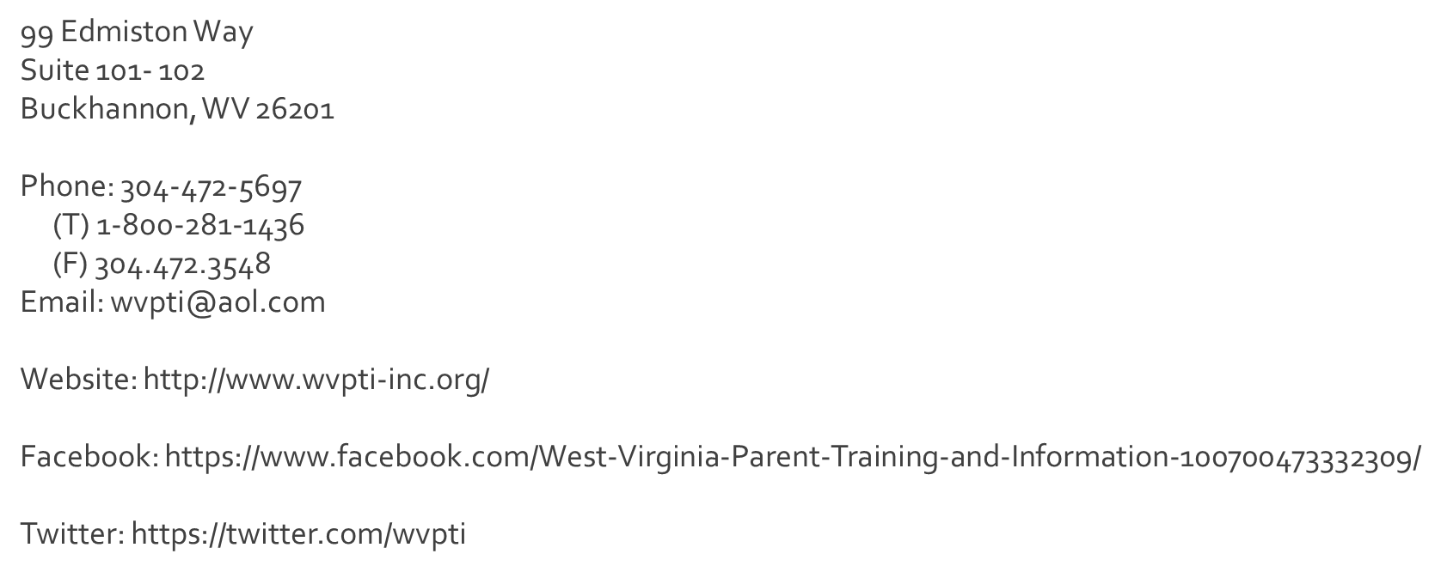

Contact Information
Notes:
Give out business cards if you have not done so.

Slide 28

WVPTI Notice:
West Virginia Parent Training and Information, Inc. is not a legal service agency and cannot provide legal advice or legal representation. Any information in this presentation is not intended as legal advice and should not be used as a substitution for legal advice.
Thank you!

Slide 29

Credit:

Slide 30
Thank you for Attending!

