Slide 1
Perinatal Mood Disorders
A brief overview for IMPACT WV

Slide 2
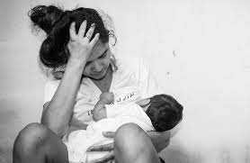
Objectives:
Definition of Infant Mental Health
Gain a basic understanding of Perinatal Mood Disorders (PMD) and the impact on child and caregiver
How PMD may present in homes, visits and elsewhere
Referrals and resources

Slide 3
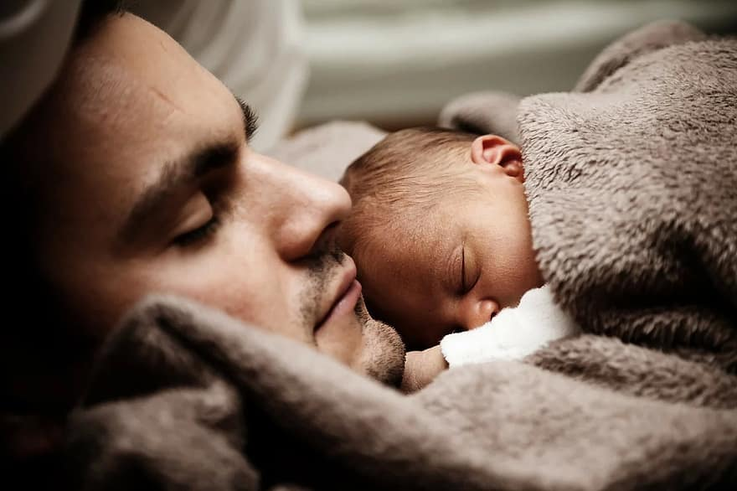
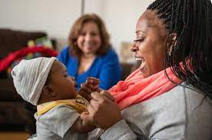
Infant Mental Health
The developmental, social and emotional well-being of children birth to age three
-Zero to Three

Slide 4

What are Perinatal Mood Disorders?
Anxiety and/or depression that is negatively affecting the ability to care for and/or attach to the fetus or child

Slide 5
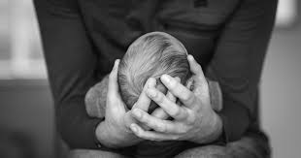
What are Perinatal Mood disorders?
Baby Blues
Occurs in ~80% of moms
Feeling sad/crying a lot, angry/moody, feeling overwhelmed
Symptoms last up to 2 weeks after delivery

Slide 6
What are Perinatal Mood disorders?
Depression and or Anxiety
Occurs in ~20% of moms
Symptoms occur during pregnancy or up to 12 months following delivery
Typically in regards to, are not limited to: the delivery, attachment with the baby, parenting roles.
Symptoms include:
Depression:
Withdrawn
Distant
Flat affect
Possible disinterest or lack of apparent bonding
Anxiety
Repetitive fears and questions
Overprotective
Appearing “too put together”
Exhibiting overwhelming fears
Other frequently used words for PMD
Postpartum Depression
Maternal Depression
Perinatal Depression
Postpartum regret

Slide 7
What are Perinatal Mood Disorders?
Psychosis
Occurs in ~ .1- .2% of moms
Symptoms are sudden and occur within the first 2 weeks of delivery
Delusions/strange beliefs
Hallucinations
Extreme irritation
Hyperactivity
Decreased need for or inability to sleep
Paranoia
Rapid mood swings
Difficulty communicating at times

Slide 8
Risk Factors for PMD
Previous PMD
Hormones- breastfeeding, weaning, etc.
Past trauma or mental health disorders
Difficult delivery or feeding experience
Low social support
Lack of resources
Under age of 18
Unknown

Slide 9

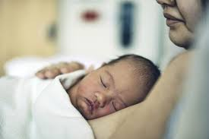
Impacts of PMD
Pregnancy
Difficulty attaching
Inadequate prenatal care
Poor nutrition
Risk of substance abuse
Fear and anxiety
Unrealistic expectations
Delivery
Premature labor
Low birth weight
Maternal hypertension
increased rates of miscarriage

Slide 10
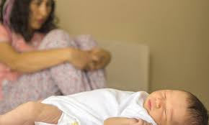
Impacts of PMD
Postpartum
Impaired bonding and attachment
Isolation
Negative maternal identity
Depressed and anxious moms smile, talk and touch infant less
Babies tend to experience more colic, feeding, sleeping and developmental challenges
Other children within the home may experience loss of parental support
Increased family conflict

Slide 11
How PMD may look in mom within your settings:
What you may hear from Mom:
“They hate me”, “I’m not a good mom”, “ they’d be better off without me”, “I have to do everything or she’ll get sick/hurt…”
What you may notice between caregiver and child:
Lack of eye contact during the Battelle/Bayley or during engagement times
Increase anxiety regarding child’s movement (i.e. inappropriately hovering while child is learning to walk)
What you may notice in the child:
Difficulty with attachment (seeking attention, avoiding attention, not crying when appropriate)

Slide 12
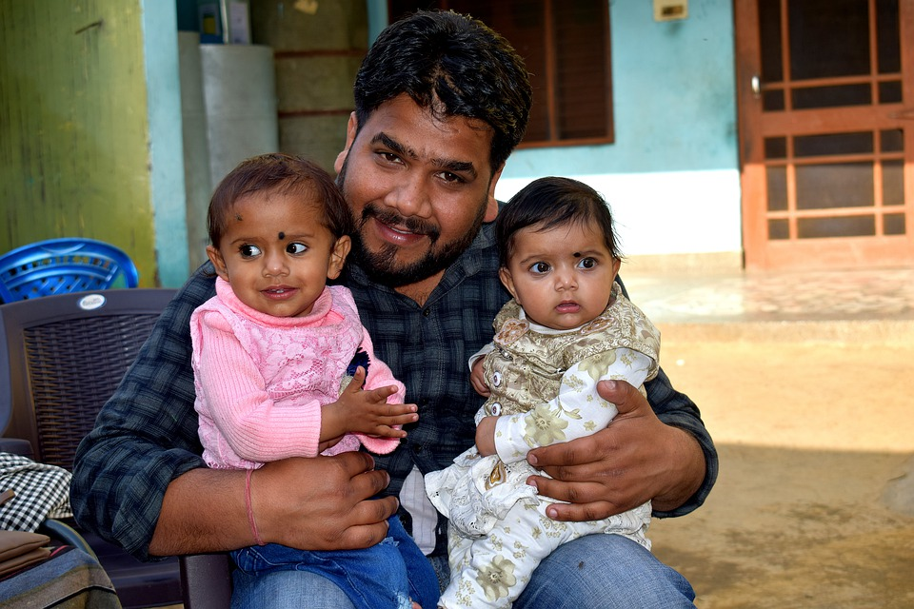
Impact-attachment
Attachment is a lasting psychological connectedness between human beings- Bowlby
Healthy attachment can be evidenced by:
Being comforted by caregiver
Can separate and engage following a separation
Social skills are beginning to be learned (sharing, give and take etc.)
Responsive to discipline
What you may notice in child with unhealthy attachment:
Doesn’t smile
Child is not comforted by caregiver
Defiance/anger
Cries inconsolably or doesn’t cry when appropriate
Isn’t interested in interacting
Aversion to physical touch
What you may notice between caregiver and child:
Child in car seat, crib etc. unnecessarily
Basic needs aren’t met (or go unnoticed)
Lack of eye contact or communication
Inconsistent parenting/responding

Slide 13

Trauma in children
Traumatic Event
A traumatic event is a frightening, dangerous, or violent event that poses a threat to a child’s life or bodily integrity- NCTSN
Traumatic Stress
Children who have been exposed to one or more traumas over the course of their lives and develop reactions that persist and affect their daily lives after the events have ended-NCTSN

Slide 14
How trauma may look within EI
What you may hear from caregiver:
Concerns regarding:
Nightmares
avoidance of certain people, places or things
increase separation anxiety
sudden changes in behaviors
Discussions regarding:
domestic violence
violence being witnessed
aggressive talk
grief
What you may notice in the child:
On guard demeanor
Cannot handle touch or small spaces
Inability for self soothing or complete lack of emotion
Strong emotional or physical reactions
Physical reactions (potty training issues, avoidance of person or eye contact..)
Playing out or talking about non age appropriate topics
New fears and or nightmares that are not age appropriate

Slide 15
What you can do…
Praise what caregiver is doing well
Promote positive interactions
Discuss importance of:
Self care
Supportive relationships
Sleep
Nutrition
Breaks
Movement
Referral to outpatient mental health

Slide 16


