Slide 1


Slide 2
Neonatal Abstinence Syndrome
Impacts on Development and Learning
Presented by Cindy Chamberlin MSPT
August 3, 2021

Slide 3
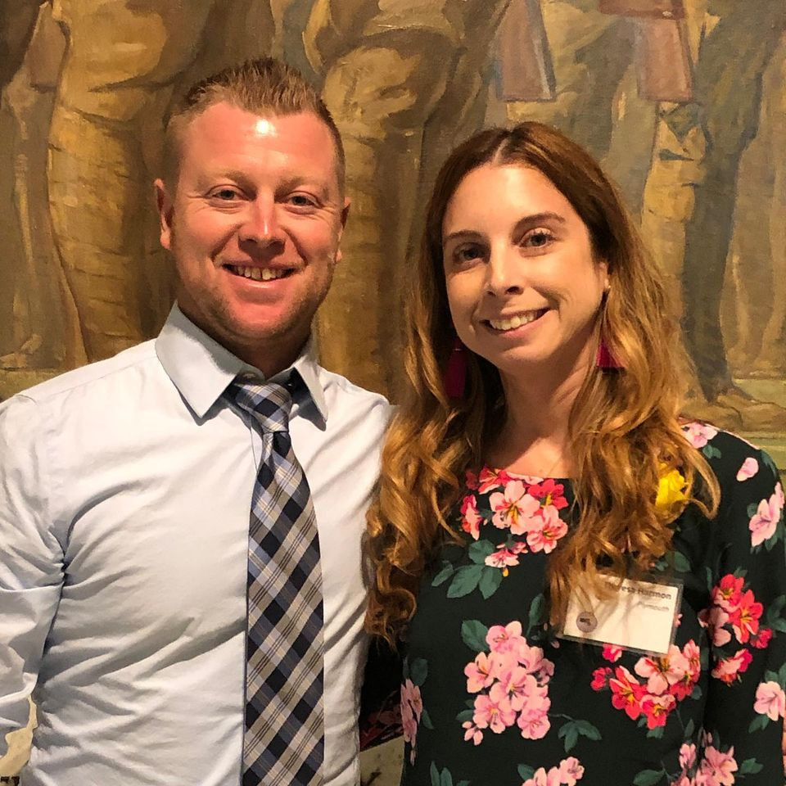
To The Moon And Back was founded in 2017 in Plymouth MA
By Theresa and Andy Harmon
They are leaders in providing support, education, and advocacy for
the littlest victims of the opioid epidemic
https://www.2themoonandback.org/

Slide 4
Disclaimer
These are my professional opinions as a Physical Therapist:
I have come to these conclusions through research
and experience over the last 25 years but that doesn’t
necessarily mean they are the only solution!
Some topics I am speaking in generalities:
Remember ALL children are unique and ALL children have potential!
Every family, their dynamics, and experiences can be different
Always consult a child’s pediatrician and/or B23 team before
changing/implementing anything new:
If we don’t openly communicate then we won’t be able to figure out what works and/or what doesn’t work
Notes:
Remember if we do not engage the family, a mother will never let us work with her child or trust us!

Slide 5
To make sure we are all on the same page:
ACES: Adverse Childhood Experiences
B23: West Virginia Birth To Three Program
EI: Early Intervention (what B23 is in other states)
IFSP: Individualized Family Service Plan (B23)
IEP: Individualized Education Plan (school system)
MAT: Medical Assisted Treatment
NAS: Neonatal Abstinence Syndrome
SUD: Substance Use Disorder
Notes:
There are always new acronyms coming in and I just want to make sure that we are all on the same page with regards to this presentation. If I

Slide 6
What is Neonatal Abstinence Syndrome?
“Neonatal Abstinence Syndrome (NAS) includes neonatal withdrawal from many substances, not just opiates. It is exposure with clinical symptoms and it is not limited to those cases that requires pharmacological treatment”
-WVDHHR & WV Bureau for Public Health, April 2018
Infants whose mothers were on Medical Assisted Treatment (MAT: Suboxone, Methadone) also can experience NAS and require treatment (Methadone & Buprenorphine)

Slide 7
Myth #1: Babies are born “Addicted”
Fact: Babies cannot be “born addicted.” In fact, babies can’t even develop addiction.
Addiction is a disorder characterized by pathologically pursuing reward or relief through the use of substances which a newborn can not do.
When we call babies “addicted,” we shame the mothers, stigmatize the children, impact the family, and there are public health implications too.
LET’S HELP CHANGE THE STIGMA:
They are NOT addicted
“They are born drug/substance exposed”
“They experience are diagnosed with NAS”
Notes:
Lets change the stigma, the media still writes articles talking about the addicted babies.
DISCLAIMER: There is a lot of “TALK” everywhere about what different drugs are doing to babies
What stress/trauma/drug use in parents/neglect is doing to children
We even have a board that we have put together to break it down
This presentation is based on my work in the NICU, Birth to Three, and the school system in WV over the last 20 years. As the # of those struggling with SUD are giving birth, we have seen a steady increase in challenging development and behaviors. The focus over the years has been on the person struggling with SUD
Keeping the family together
But what about the Safety and security of the child?
In the last 1-2 years there has been a steady increase in advocating for the innocent victims of this crisis, the children but some are still saying “But where is the research”. There are many qualified individuals gathering that data but I in good conscience can not continue to watch children slip through the cracks while we are waiting for that data to be published so I am sharing my clinical observations, experience, and the research (If you look before 2017, there isn’t a lot out there)

Slide 8
Myth 2: NAS ends when a baby comes home from the hospital/
The baby is fine: no more challenges
FACT: That is when the challenges are just getting started for the family
Only a handful of studies have attempted to quantify the education outcomes of children born to opioid-addicted parents. One study, published in the Journal of Pediatrics, tracked 7,256 Tennessee students between 2008 and 2011, and found that those born in drug withdrawal — a condition known as neonatal abstinence syndrome (NAS) — these children were 15% more likely to be diagnosed with a disability requiring special education.
**They appear to have ADHD like symptoms BUT the meds don’t work!!!**
There are current studies looking at the impacts of different drugs occuring but I am a strong advocate for working on addressing the symptoms we are seeing
Notes:
Lets change the stigma, the media still writes articles talking about the addicted babies.
DISCLAIMER: There is a lot of “TALK” everywhere about what different drugs are doing to babies
What stress/trauma/drug use in parents/neglect is doing to children
We even have a board that we have put together to break it down
This presentation is based on my work in the NICU, Birth to Three, and the school system in WV over the last 20 years. As the # of those struggling with SUD are giving birth, we have seen a steady increase in challenging development and behaviors. The focus over the years has been on the person struggling with SUD
Keeping the family together
But what about the Safety and security of the child?
In the last 1-2 years there has been a steady increase in advocating for the innocent victims of this crisis, the children but some are still saying “But where is the research”. There are many qualified individuals gathering that data but I in good conscience can not continue to watch children slip through the cracks while we are waiting for that data to be published so I am sharing my clinical observations, experience, and the research (If you look before 2017, there isn’t a lot out there)

Slide 9
Myth 3: NAS is Trauma
Fact: Neonatal Abstinence Syndrome is a condition where a baby’s brain and body are exposed to substances crossing the Placenta during critical times of neurological development while in utero
An NAS brain/neurochemistry will not look the same as a child born not drug exposed......
It doesn't mean they don't have the potential to survive and thrive but hard wiring and executive functioning are going to look different than a child's brain that didn't have those substances cross into their brain during critical development in utero and we need to honor, educate and remember that exposure during development milestones and educational expectations
NAS actually makes a child MORE susceptible/sensitive to Trauma (some studies say up to 50%)
*All traumas are shown to impede brain development & learning*
NAS and this trauma can create disruptive behavior that can affect entire classrooms.
Notes:
We all react to trauma differently
I am a firm believer that there are NO bad children; just different and we MUST meet them where they are and guide them to where we want them to be: success
Understanding that these children are more sensitive may explain why some children act out more than others
It is also why I argue that NAS is Trauma…..when we have children who have gone from the NICU into a foster home and still experience the challenges of NAS
Children born with NAS have had substances crossing the placenta into their body/brain during critical times of development. Their nervous system is not the same as a child’s that didn’t not have that
Recognizing and honoring that is critical and may explain why some children

Slide 10
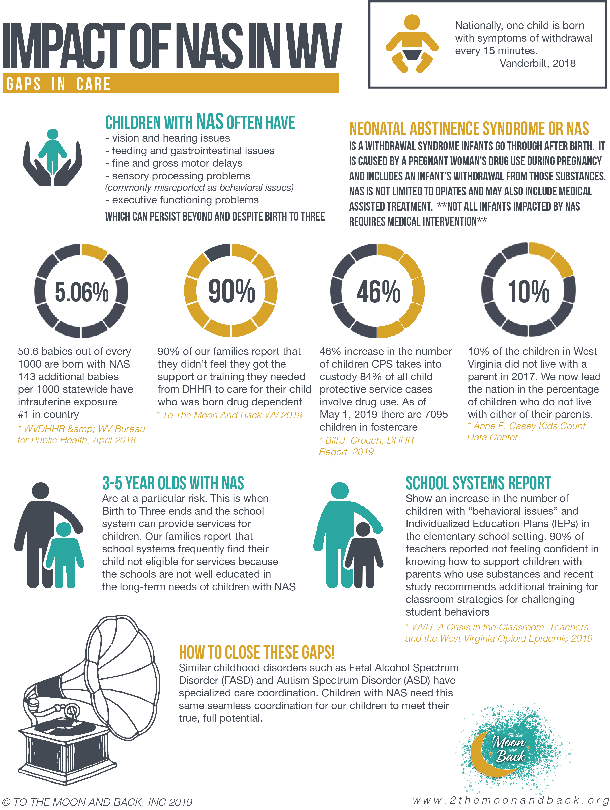

Slide 11
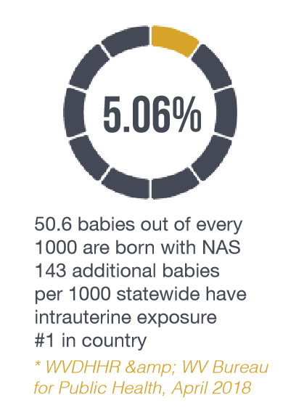
During the 4th quarter of 2018, ↑ to 5.46%
54.6 babies out of every 1000
We also must consider the number of children born with substance exposure in utero who do NOT exhibit signs of withdrawal at birth
143 out of every 1000
That is at least 197 babies of every 1000
CHALLENGE: Once birth scores are reported, future medical providers can only access the score and NOT what a child was exposed to (lose critical medical information). They are dependent on the family being willing to self-report this information IF they even know it.
Due to stigma and shaming many families do NOT share this critical information
CHALLENGE: This critical medical information is currently not consistently following the child if they move homes/change caregiver/medical providers. Even if it is available, not all facilities use the same electronic medical record systems so there are inconsistent/breaks in care
PROBLEM: when a child gets older and experiences challenges transitioning into school setting, it can lead to improper medical management (i.e. ADHD medications prescribed for symptoms of SPD/NAS)

Slide 12

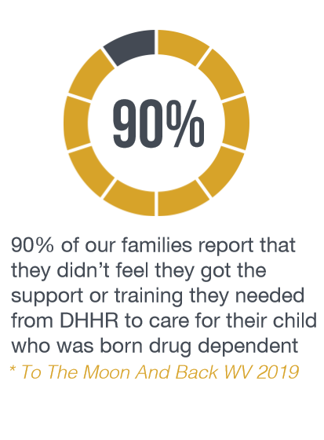

Slide 13
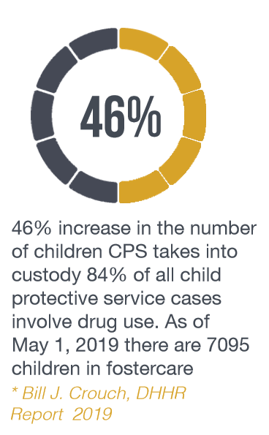
In Addition to that:
In 2018, West Virginia’s poverty rate was 17.8% (4th in country)
Among children, it was 24.9 %
14.9 % West Virginians are food insecure.
(Over 113,000 households)
According to the Legislative Foster Report:
April 2020 there were 7401 children in foster care
May 2021 there were 6939 children in foster care
*Remember CPS referrals have dropped because of Covid

Slide 14
“One Child is Born Every 15 Minutes with NAS”
(Vanderbilt, 2018)
Early studies looking at the long-term needs of children born with NAS suggest that they are more susceptible to:
Vision & Hearing Issues (i.e. chronic ear infections)
Fine & Gross Motor Delays
Sensory Processing Disorders (vestibular & proprioceptive)
Cognitive Issues Related To Executive Functioning
(often these children have normal to high IQs)
GI tract/Tummy issues (i.e. reflux)
Impaired Pain Sensation (hyper or hyposensitivity)
* These Issues can and often do persist beyond B23 Services
Notes:
It is imperative to understand typical development so we can recognize these sometimes subtle differences at a time when many don’t have a lot of expectations of an infant
An extremely fussy child or a baby that never cries are both red flags
The old adage of They are just a boy so they are busier: That is true BUT if a child has been borned exposed, it is related to the drug exposure NOT the “boy” in them

Slide 15
“Neonatal Head Circumference in Newborns With
Neonatal Abstinence Syndrome”
(Pediatrics, January 2019)
Chronic opioid use during pregnancy sufficient to cause NAS was associated with smaller Head Circumferences at birth.
87% of participants were mothers on MAT,
which is currently the recommended treatment option during pregnancy.
30.1% had a Head Circumference less than or equal
to the 10th percentile
8.2% had a HC less than or equal to the third percentile
Notes:
This Study is HUGE to me: it validates what we have suspected for so long
But also hit home what we are already doing! We can never undo the exposure in utero BUT we can FOCUS on BONDING and TYPICAL development
We can double a baby’s brain size with bonding with a caregiver during their first year of life! Preferably that is with a parent but if not its important to find a family member/foster family to work on this
Despite my belief that tummy time can cure the problems of the world, TYPICAL Development can organize our brain and sensory systems and MAKE A POWERFUL IMPACT

Slide 16
So what does this all mean?
What can we do? Why are we overwhelmed?
Preemies/Medically Fragile babies VS Substance Exposed Babies
Why are we not treating them the same?
Treat what we are seeing
FOCUS on TYPICAL DEVELOPMENT

Slide 17

“We need to stop just pulling people out of the river, we need to go upstream and find out why they’re falling in”
(D Tutu)
Birth to Three/Early Intervention/Home Visitation Services!!!
Trainings and communication across programs

Slide 18
According to Birth Scores during 2017 & 2018,
1530 babies were born & diagnosed with NAS
ONLY 35% of these children were referred to Birth to Three (549 referrals)
ONLY 28% of referred babies were found ELIGIBLE for B23 services with initial eval (156 babies)
ONLY 10% of NAS babies in WV are receiving B23/early intervention services before age of 1
Data from WVDHHR/B23

Slide 19
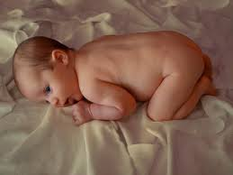
When a baby pushes/kicks out in mother’s womb, they hit the walls of womb and rebound back into flexion/midline getting proprioceptive input
Physiologic Flexion
Notes:
We must understand what happens when a woman is pregnant and then after a baby is born: GRAVITY

Slide 20
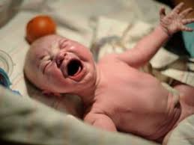
When a baby is born medically fragile/ prematurely/with NAS and is in NICU, gravity makes it hard to maintain that flexed midline position and they now get that proprioceptive input from the bed if they arch into it, they also get pulled into extension and arch/ to help maintain an airway and protect belly/GI system
The Innocent Victim
of the Drug Crisis
Notes:
We must understand what happens when a woman is pregnant and then after a baby is born: GRAVITY

Slide 21
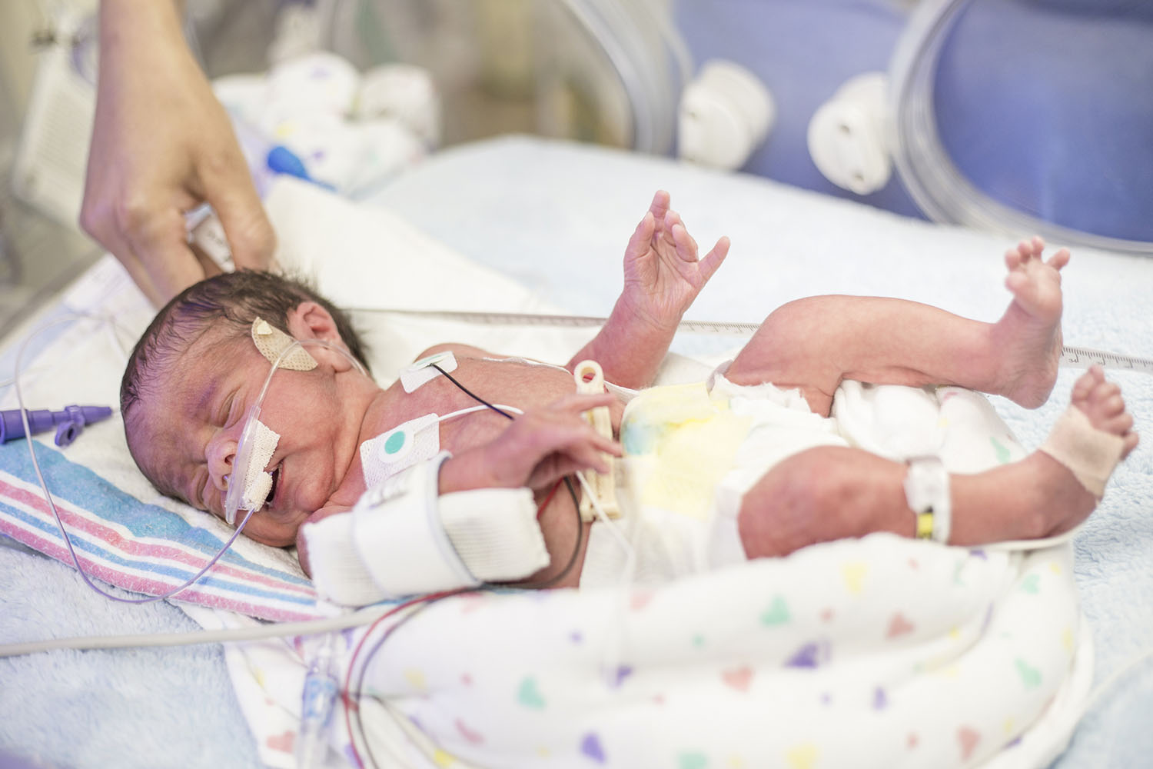
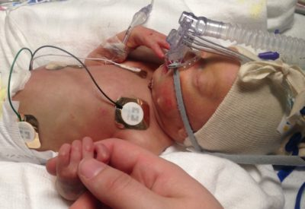
NAS & Medically Fragile children will arch their neck & back into the surface they are lying on and can’t come into midline because of gravity
They arch to protect their airway and gut
NICU staff works hard to position and reposition to facilitate midline/flexion but these early survival strategies can last the rest of their lives if we don’t intervene early and support self-calming skills in a midline flexed position
Notes:
Finnegan scoring and Eat Sleep Console are both ways hospitals decide to medicate/not

Slide 22
Overstimulation Stress Cues
Jaw jitters or jittery movements
Hiccups
Sneezes
Finger Splaying
Arching/stiffening up
Excessive Crying
Shut down or excessive sleeping (This is actually a HUGE red flag)
What do you do?
LIMIT STIMULATION:
Lighting: pull blinds/turn off lights
Sound: turn down/off TV, lower voice when talking, limit electronics
Activities: limit visitors, number of people talking/moving in room, etc
Can help sooth: Rocking (Side to side motion)
Firm touch versus light touch
Firm pat versus a light tap
Notes:
During the early days of being home with a medically fragile or NAS baby these are some stress cues

Slide 23

So what does this mean?
So what does that mean for a caregiver?
So what does that mean for a Birth to Three Provider
Educate & Empower family about impact of NAS, development, & WHY we are doing it!
We can’t undo the drug exposure BUT we can do so much to promote typical development and help families develop parenting skills
Tummy Time, Baby Wearing,
Bonding/Snuggling/Playing Reading at least 1 book/day
PUT THE PHONES DOWN & PLAY
Notes:
BIRTH TO THREE REFERRAL
Put the phones down and get down and PLAY on same level as your child!!!!

Slide 24
Back to Sleep, Belly to Play
1 hour collectively throughout the day starting at birth (yes birth)
90 minutes collectively throughout the day starting at 3 months
Babies should crawl for approximately 4.5 months before walking
****Tummy time becomes even more important with a premature/medically fragile/NAS baby: they have learned all about extension (and its often how they calm themselves down) and we must now remind them about flexion
They world we interact in/with is in front of us at midline NOT on the ceiling over our head****
It is NEVER too late to work on tummy time (Core strength)!!!
Notes:
Back To Sleep Program: we saw a decrease of 750 cases of SIDS/year but developmental delays went up by over 400,000 year…..all these years later we still don’t know what causes SIDS but we have generations of children that aren’t getting tummy time because families are scared of SIDS

Slide 25
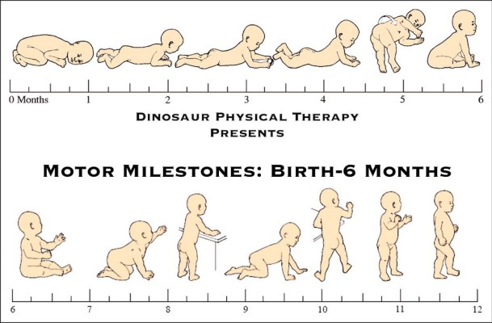
Tummy Tummy Tummy
Dinosaur Physical Therapy

Slide 26
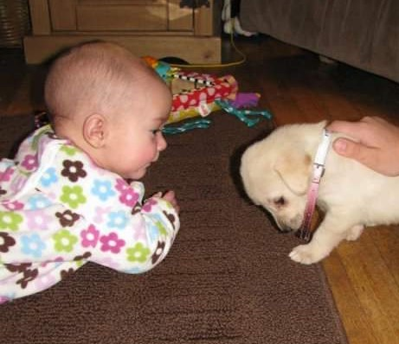


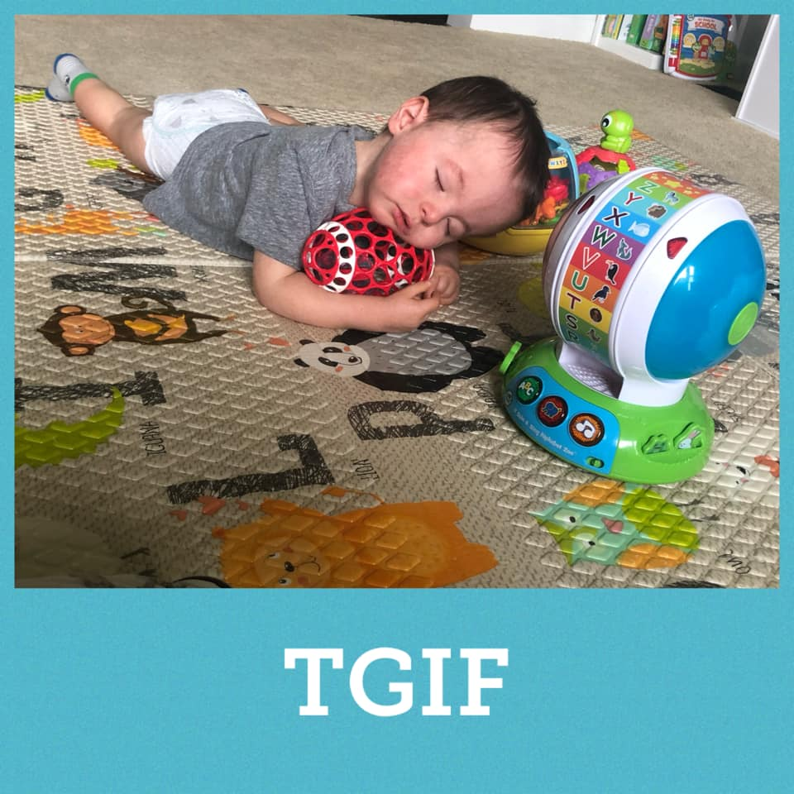
Floor & Tummy time is Best
Firm surface helps with proprioceptive awareness
Parents & Providers should be on the
floor interacting/playing too

Slide 27
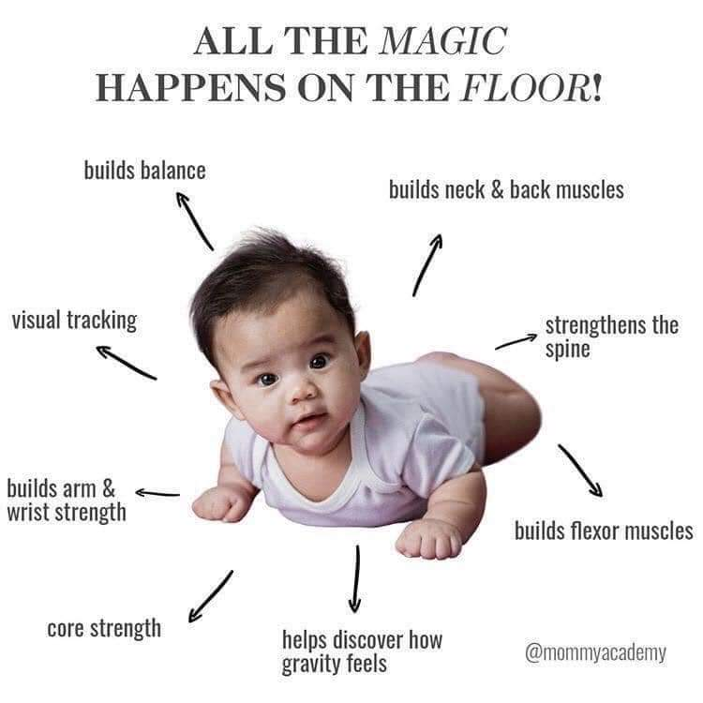

Slide 28
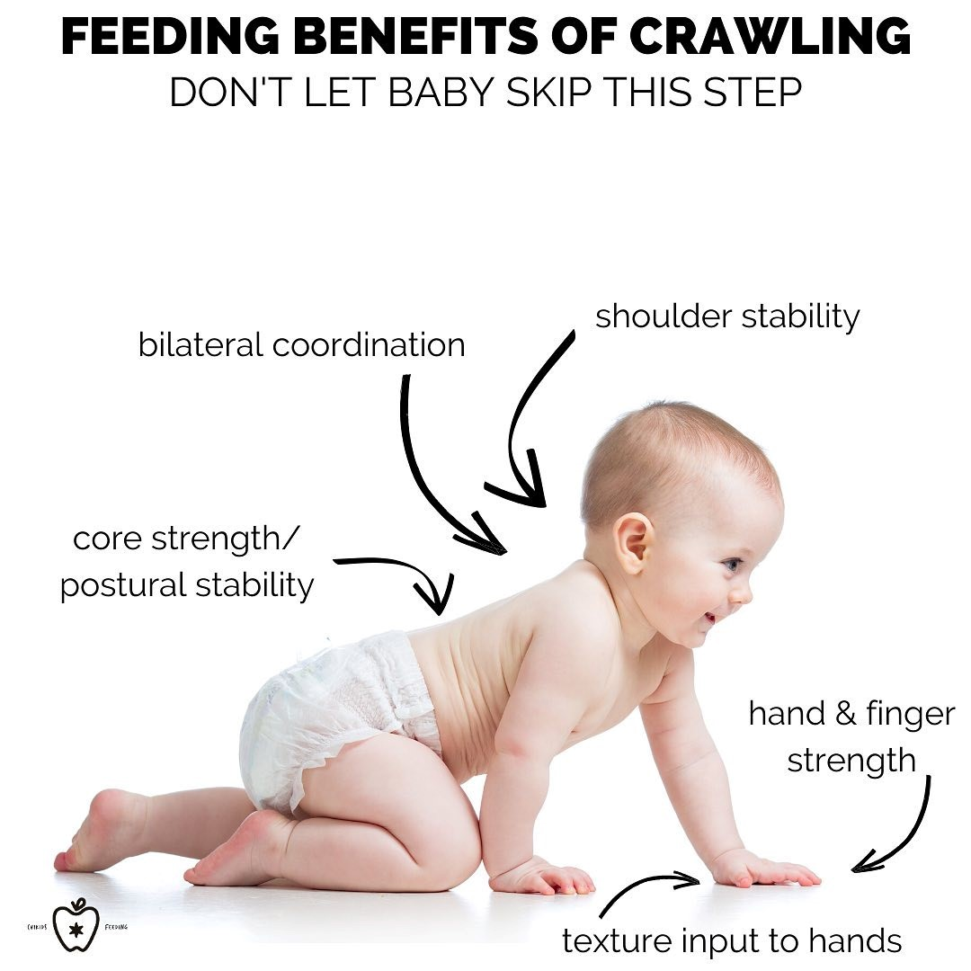
: critical for fine motor
and visual motor skills
↙ Eye Convergence/
Divergence/Binocular Vision: used to calculate distances helps us catch a ball, drive a car and copy things from a blackboard.
↗ Arch development: helps with handwriting
Crawling Benefits

Slide 29
Benefits of Crawling (continued)
·Works on prone extension which is one of the two most important movement
patterns for sensory integration
· Activates the brain stem which promotes self-regulation
· Works on shoulder stability which is critical for fine motor and visual motor
skills
· Works on balance, core strength, and lower body proximal stability
· Facilitates upper and lower body weight shifting
· Promotes bilateral integration (the ability to use both sides of body together in
a coordinated way)
· Facilitates body awareness and motor planning
· Provides proprioception input which is calming and organizing for the brain
· Promotes weight bearing on the joints which facilitates motor development
and body awareness, and normalized muscle tone
Adapted from: https://www.kidspot.com.au/baby/baby-development/milestones/six-reasons-why-crawling-is-important/news-story

Slide 30
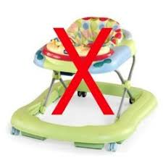
Just Say NO!!!
American Academy of Pediatrics does NOT recommend them and children who use them are actually later Independent walkers
The walker helps the child feed utilize
Extension, which a child with NAS is already
predisposed to. A child can move the walker without engaging core muscles

Slide 31

You don’t know what you don’t know
Now YOU know how to help substance exposed children
We MUST engage and empower parents to bond and play

Slide 32
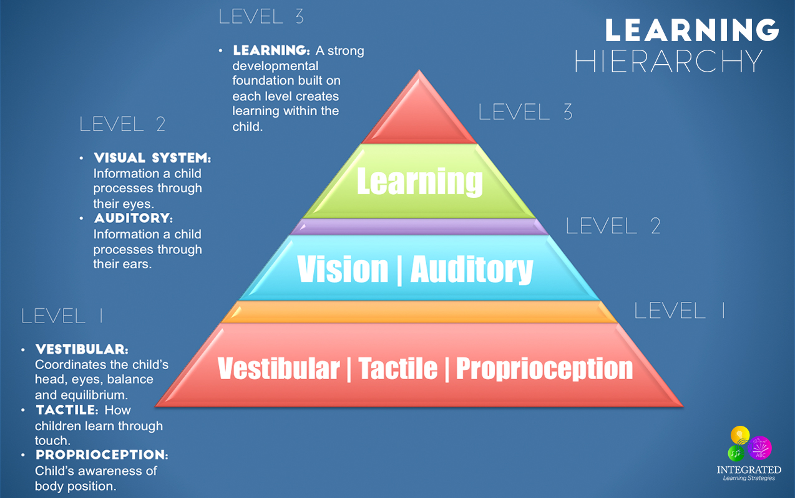
Pyramid for Learning was originally conceptualized by Kathleen Taylor & Maryann Trott (1991) and adapted by Williams & Shellenberger.
Notes:
September 2nd Handle with Care Presentation about Regulating Before Education
Lara Kain, Lara Kain Consulting & Regional Community Facilitator at ACEs Connection
Emily Daniels, Founder of Hear This Now

Slide 33

So what is currently happening?
Preschool Transition
If children do not qualify or are able to go to school: no services or support for the family. Child Driven Activities: Parents are busy, Kids are busy and into things so what do all kids love? ELECTRONICS
Child turns 4 or 5 and its time to go to school: All of a sudden there are a lot of expectations (Adult driven world)
The world from a child’s perspective quickly goes from a child driven routine to a teacher led routine….How do you think the respond?
Middle School: HORMONES HIT and all of those challenges can show back up!!!!

Slide 34
Early Intervention is Critical
When intervention is delayed it takes FOUR TIMES as long to intervene in the fourth grade as it does in kindergarten
because of brain development and because of the increase in content for students to learn as they grow older
(National Institute of Child Health and Human Development)
Current Challenges: Stigma, Shaming, Access to Care, Follow through of care, Accurate Medical Records and sharing of information, Lack of resources, Limited programming or different programming in different counties/areas of state, Limited Education/Understanding, Transportation issues, Poor or inconsistent communication across agencies/programs, Different standards in different areas (staff, courts, families interpreting laws differently), CAPTA guidelines, fear, healthcare providers unsure how to help care for families, misguided workers wanting to help families by looking the other way at red flags, healthcare workers own bias’, etc
Notes:
What I just described was typical development for ALL children but is especially important for those kids who have learned to calm utilizing extension
Hopefully families will help keep B23 services going when CPS is no longer needed in homes
Right now most families close out services when CPS is closed (a loss for the child
So remember what I have talked about: typical development, stable environment, structure
MOST kids are not getting it: including NAS children
THEN they come to school…..I want to THANK YOU for being vocal about your challenges because we in EI have known for years about the problems but no one was
Brave enough to address it; You are in the trenches of ground zero but the state is working hard to put together useful trainings and resources not only for families but educators

Slide 35

We only have ONE Brain
We need to approach the entire child not just one aspect. Trauma Informed Care will help these children, but they often need additional motor/sensory supports.
Teachers need trainings with classroom
strategies and support !

Slide 36

We need to think about their care as a marathon
not a sprint race to help these children not only survive but THRIVE
We MUST meet these children/families where they are
and support them while working on where they need to be

Slide 37
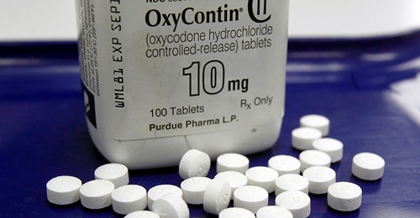
“The Jefferson County Board of Education is suing McKinsey and Company on behalf of Kentucky's 171 school districts in a suit filed in federal court Wednesday that seeks class-action status. West Virginia also filed a similar suit the same day.
Opioid addiction caused a spike of kids with learning disabilities attributable to in utero opioid exposure, the suit contends, leading to an uptick in Kentucky students needing special education services and supports — costing districts estimated billions across the country
https://www.courier-journal.com/.../jcps.../4959791001/
https://www.wvgazettemail.com/news/education/wv-public-schools-seek-to-recover-costs-created-by-opioid-crisis/article_92f298aa-4dca-56b2-b397-b6a502e6e7f0.html?fbclid=IwAR1QzSQ-Es1A0_fSLkZVZcibAdqgHL3onZkrhvDu4CYSQ3aylBZt7CKjGMw#utm_campaign=blox&utm_source=facebook&utm_medium=social
Both Articles from May 5, 2021

Slide 38
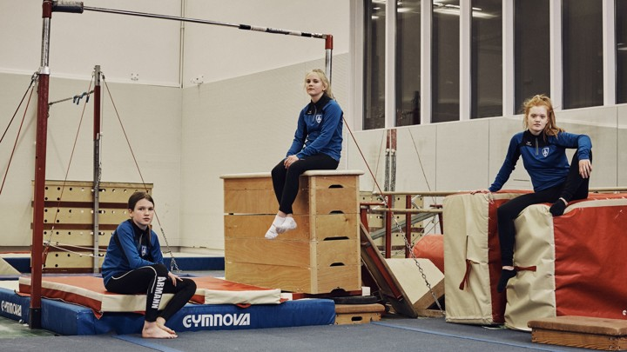
PREVENTION
How Iceland Got Teens to Say No to Drugs
Article in The Atlantic by Emma Young on January 19, 2017
Dr Álfgeir Kristjánsson is currently working at West Virginia University and they have a collaborative 5-year grant through the CDC to implement similar program in Fayette and Wyoming Counties
“A national program along the lines of Youth in Iceland is unlikely to be introduced in the US, however. One major obstacle is that while in Iceland there is long-term commitment to the national project, community health programs in the U.S. are usually funded by short-term grants.”

Slide 39
Infant Mortality Associated With Prenatal Opioid Exposure
JoAnna K. Leyenaar, MD, PhD, MPH^{1,2}; Andrew P. Schaefer, PhD²; JaredR. Wasserman, MS²; et al
JAMA Pediatr. Published online April 12, 2021. https://jamanetwork.com/journals/jamapediatrics/article-abstract/2778433
Study looked at: What is the risk of mortality in opioid-exposed infants, and is mortality associated with neonatal opioid withdrawal syndrome?
"the mortality odds in opioid-exposed infant who didn’t have a neonatal opioid withdrawal syndrome diagnosis was 72% greater than the reference population"
The study concluded Interventions to support opioid-exposed maternal-infant dyads are warranted, regardless of the perceived severity of neonatal opioid withdrawal.
We MUST do better!!!! These children deserve a fighting chance too!

Slide 40



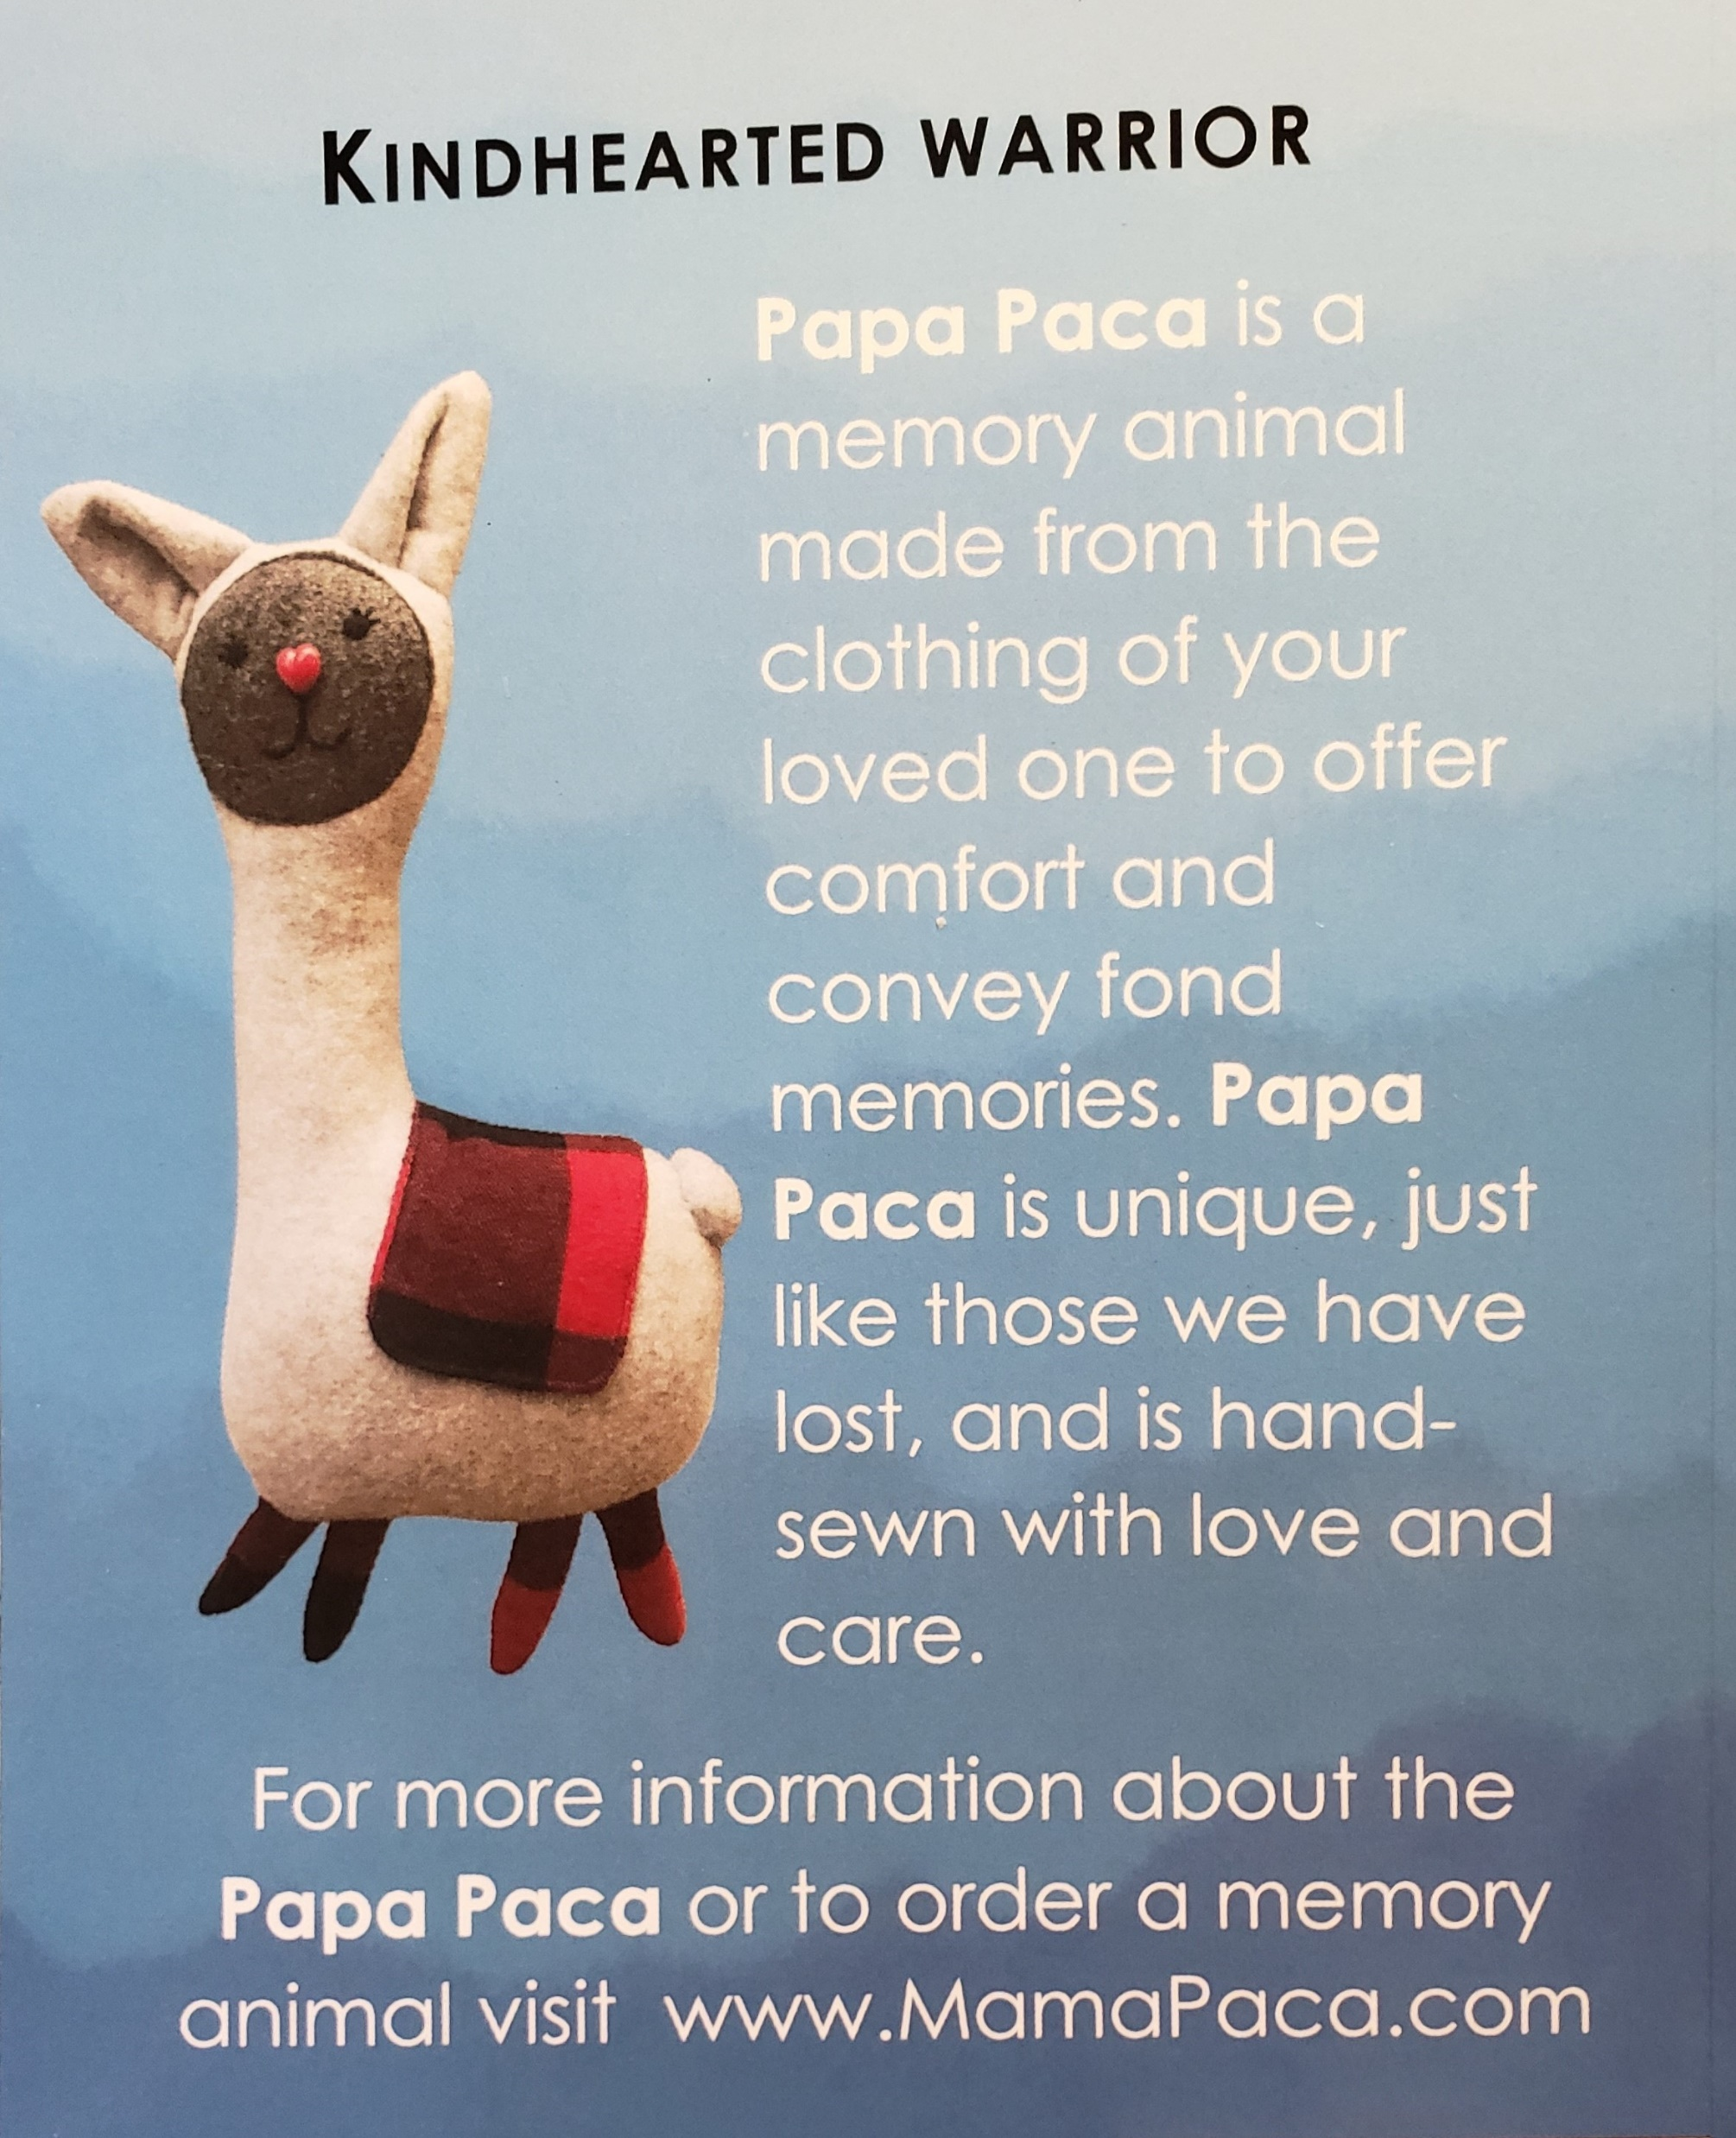
Sam the Superhero and His Super Life
By Kathryn F. Pearson & James T Pearson
About a boy who was born with NAS and is being raised by his grandparents
Mama and Papa Paca Books
By Sarah Cloud
The first two in a series helping children
who have lost parents to overdose
Children’s books about NAS and Overdose
All available on Amazon

Slide 41

imaginationlibrary.com
Dolly Parton Imagination Library:
1 book/month mailed to family
at NO charge until child turns 5
In 2021, all WV counties are eligible
The Million Word Gap: children read to at home vs not
Reading Aloud to Young Children Has Benefits for Behavior & Attention
New York Times, Perri Klass, M.d., April 16, 2018
The key take-home message to me is that when parents read and play with their children when their children are very young — we’re talking about birth to 3 year olds — it has really large impacts on their children’s behavior,” Dr. Mendelsohn said. “

Slide 42
My Go To Resources Online for Information:
Websites:
To The Moon and Back: www.tothemoonandback.org
OT Sensory web site: Integrated Learning Strategies: www.ilslearningcorner.com
Understood (for learning and attention issues) www.understood.org
PT/OT based web site, Inspired Treehouse: https://theinspiredtreehouse.com/
On Facebook:
To The Moon and Back - WV
Cindy’s Physical Therapy Ideas
Integrated Learning Strategies
The inspired Tree House
Stages and Ages Resources for Families Raising Individuals with Special Needs
** WV Birth to Three: http://www.wvdhhr.org/birth23/
1-866-321-4728

Slide 43
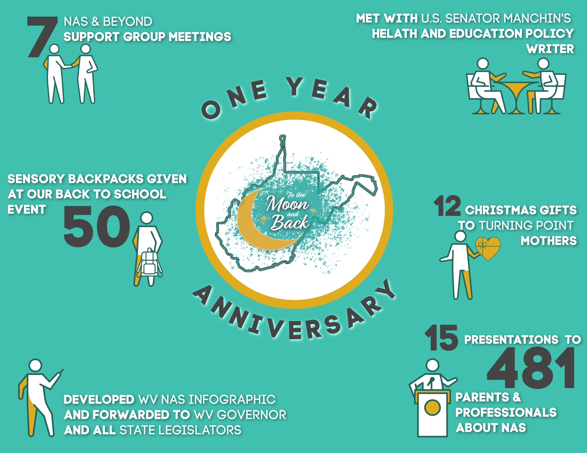

Slide 44
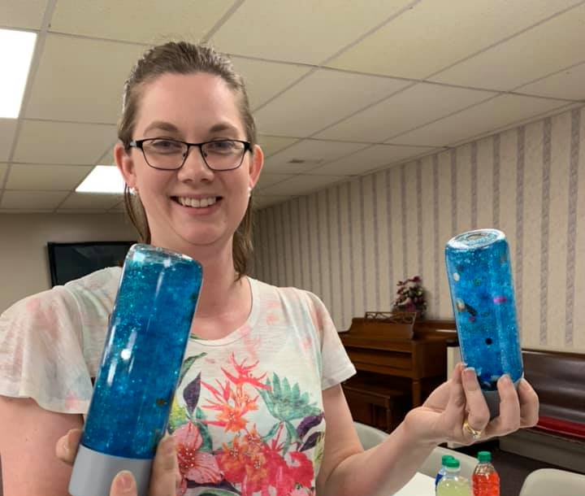
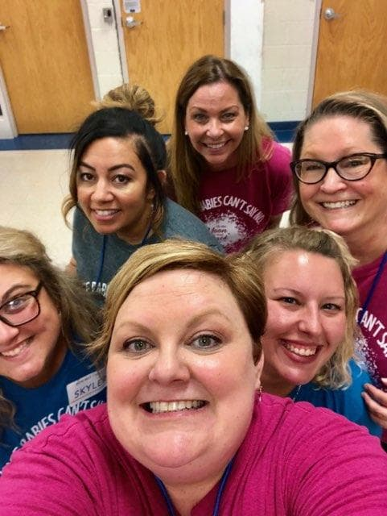
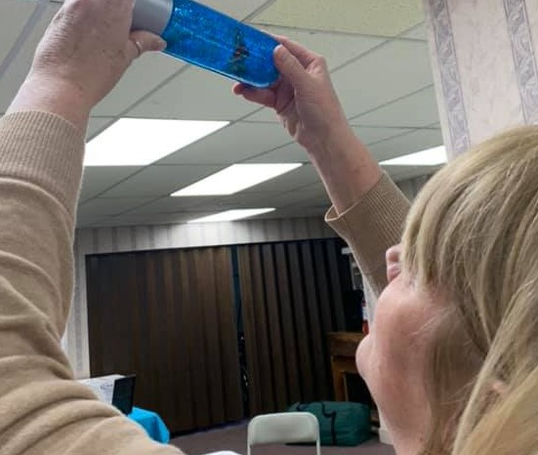
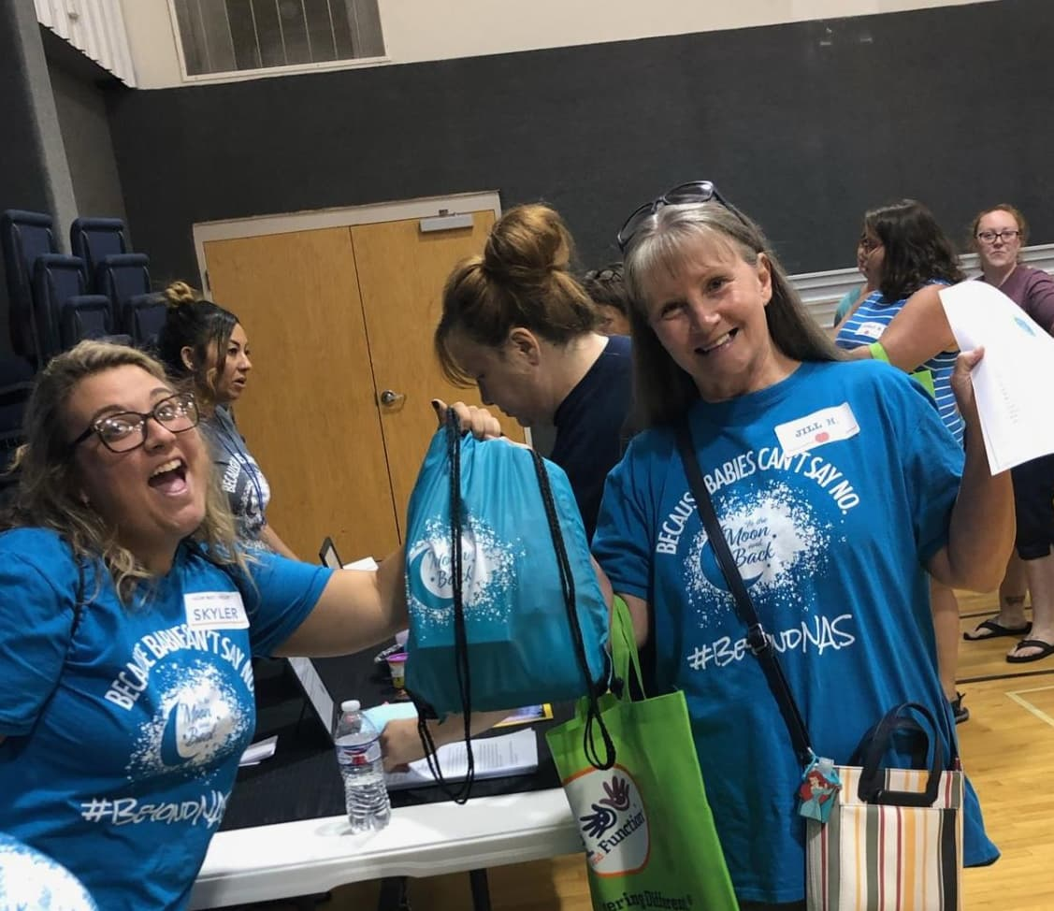
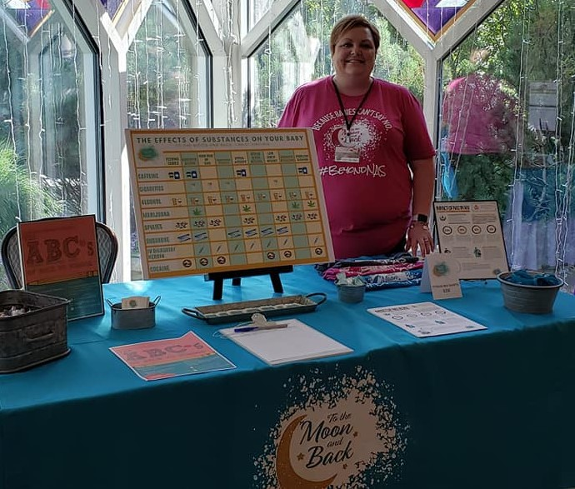

Slide 45
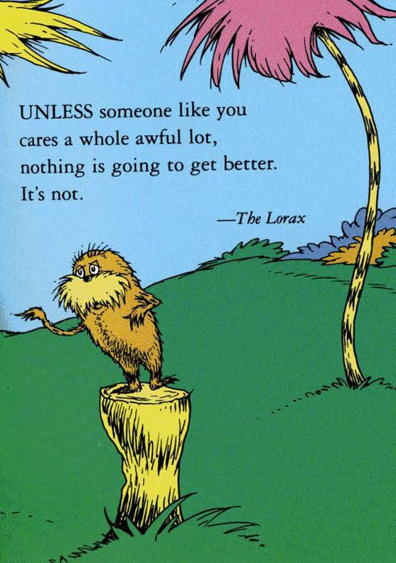
Questions?
Thank you!

Slide 46

Cindy Chamberlin MSPT
Cindy@2themoonandback.org

