Slide 1

Community of Practice: Engaging At-Risk Fathers in Home Visiting Services Effects on Program Retention and Father Involvement
Sandra McGinnis, Center for Human Services Research, SUNY Albany
Joe Paté, HFNY – Jefferson County

Slide 2
Healthy Families New York (HFNY)
HFNY is an evidence-based, voluntary home visiting program matching parents with knowledgeable and caring workers who provide support and information during pregnancy and early childhood
Families who participate are offered long-term, in-home, supportive services until the child enters school or Head Start

Slide 3
Healthy Families New York (HFNY)
HFNY’s goals are to:
Promote positive parenting skills and parent-child bonding and attachment
Prevent child abuse and neglect
Promote optimal prenatal care and child health and development
Enhance family self-sufficiency

Slide 4
Healthy Families New York (HFNY)
HFNY services include:
Educating families on parenting and child development
Connecting families with medical providers for prenatal/well-baby visits and immunizations
Assessing children for developmental milestones
Providing referrals for early intervention
Staff also assist families with goal setting, problem solving, and accessing community resources and services

Slide 5
HFNY Fatherhood Component
Prior to 2007, discussions with program managers and examination of program data suggested that father engagement in home visits was minimal
The HFNY Fatherhood Component was launched in 2007 to improve program outreach to fathers in a variety of ways.
Rates of father involvement increased following the start of the Fatherhood Component.

Slide 6
% Home Visits with Father Present (by Year)

Slide 7
Status at Intake
Notes:
Sample was families with intake between January 1, 2013 and September 17, 2014 because new information collected as of 1/1/2013
It’s not completely clear in what situations father information is reported as unavailable, because in many instance the father information is reported unavailable, yet the father is reported as having some involvement with the child

Slide 8
Study Sample
Analyses limited to fathers with information available (n=2,463)
Of these fathers:
29% present at assessment
27% present at intake
53% present at one or more home visits subsequent to intake

Slide 9
Characteristics of Families

Slide 10
Characteristics of Families
Notes:
Remind audience that this analysis only included families where OBP information was available

Slide 11
Research Questions
The goal of this analysis was to gain a better understanding of how father involvement in home visits affects the likelihood that:
the family will leave the program;
the father will remain with or join the family household;
the father will maintain emotional involvement with the child.

Slide 12
Methods
Regression analyses (Cox and logistic)
Controlled pertinent characteristics
Maternal age, education, race/ethnicity, nativity, Kempe score; paternal employment; pre- vs. post-natal intake

Slide 13
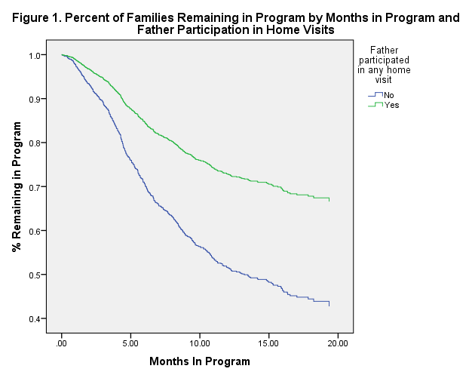
Father participated in any home visit
Father did not participate in home visits

Slide 14
Family Retention at 6m and 12m

Slide 15
Father Co-residence 6 months Postpartum
(Demographics and Other Characteristics Held Constant)

Slide 16
Father Emotional Involvement 6 Months Postpartum
Notes:
Not clear what “emotional involvement” means to the mother or the FSW; will revisit that question at end

Slide 17
Conclusions
There are benefits to engaging fathers in home visiting
Families are more likely to be retained in the program
Fathers are more likely to stay involved with families

Slide 18
Next Steps
Understand more about what home visitors do with fathers during home visits and what fathers see as the value of participation in home visiting
Learn more about how programs successfully engage fathers both in and out of the home
Facilitate sharing of successful strategies between programs serving similar populations

Slide 19

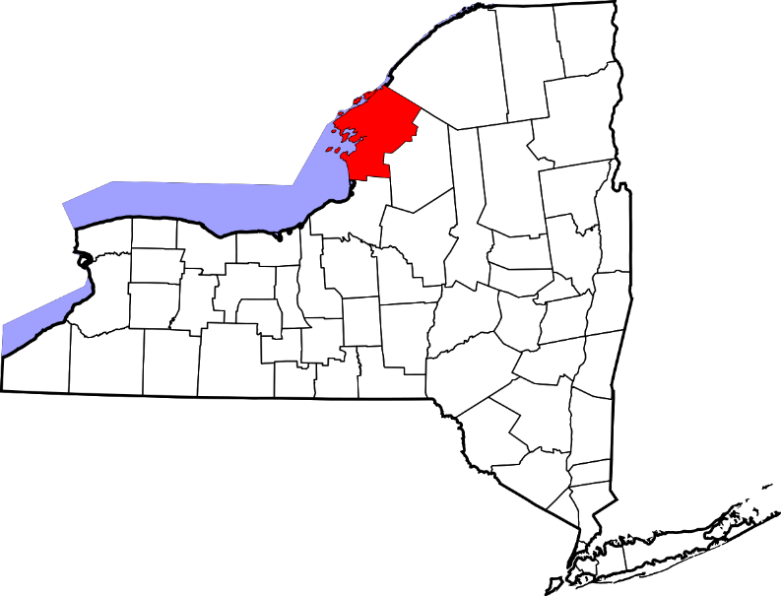
Started partnering with families in August 2017
Program capacity 84 families
60 families currently enrolled
Located in Northern New York State, near the Canadian border
Mostly rural county, with a population of 110,000
Home to the Fort Drum Army base

Slide 20
Father Involvement (Resident and Non-Resident)
Father present at: | Inception to Date (August 2017 – April 2021) | Pre-COVID (3/1/2019 – 2/29/2020) | Year of COVID (3/1/2020 – 2/28/2021)
Assessment visit | 40% | 41% | 44%
Intake visit | 27% | 30% | 30%
Any prenatal visit | 24% | 29% | 26%
Any postnatal visit | 59% | 63% | 57%
10 or more postnatal visits | 17% | 20% | 23%
(or father figure) in at least 1 visit | 63% | 61% | 52%
Received service referrals | 29% | 35% | 34%

Slide 21

Approaches Used
Getting everyone on-board
Promote fathers
Recognize and share specific benefits fathers bring to their family and children
Recognize and support specific challenges fathers experience

Slide 22

Approaches
Getting everyone on-board
Ongoing discussions during supervision sessions
Brainstorming during team meetings
Establishing acceptance at home visits

Slide 23

Approaches
Promote fathers
Using father specific language (e.g. in-person, marketing materials, forms)
Use materials and resources that show fathers and address their role as a caregiver
Learn about the fathers you are working with (resist the tendency to default to stereotypes, work to recognize implicit bias and automatic reactions)

Slide 24

Approaches
Recognize and share specific benefits fathers bring to their family and children, and themselves
Guide fathers in ways they can be supportive and present for their partners and children
Help fathers see the impact they’re making
Celebrate their involvement

Slide 25

Approaches
Recognize and support specific challenges fathers experience
Be patient (a lot of father aren’t used to being actively engaged)
Be understanding (a lot of fathers may be reluctant to participate or share, their disconnection may be a coping or defense mechanism)
Be supportive (provide space and time to listen, offer resources and referrals)

