Slide 1

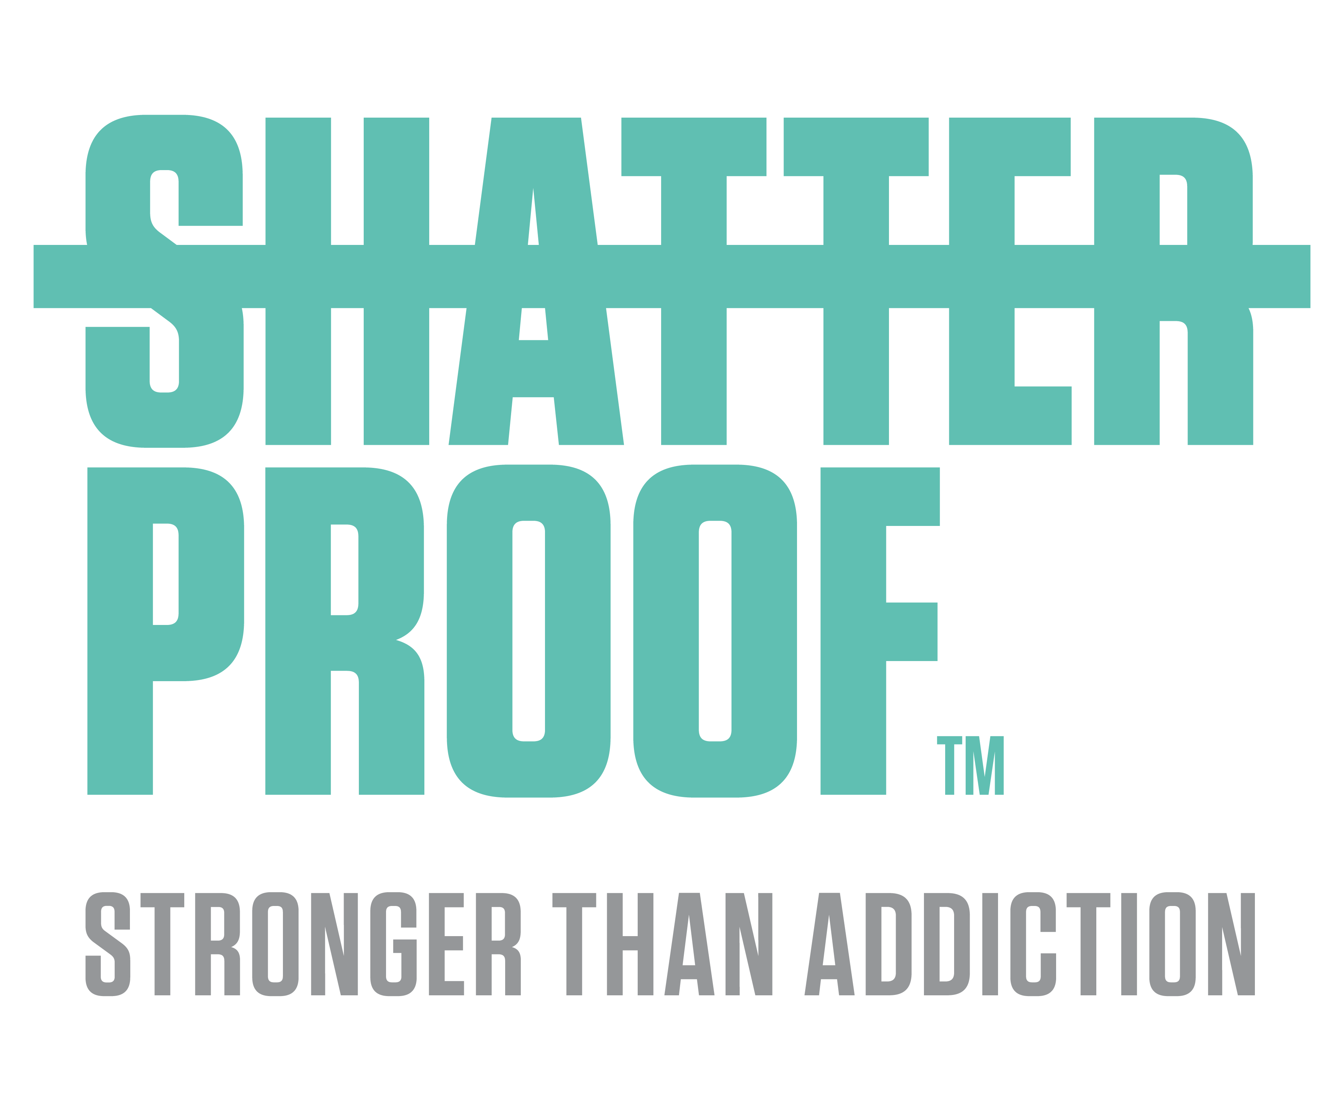
Creating a movement to End Addiction Stigma

Slide 2
COVID-19 Will Exacerbate the Impact of the Opioid Epidemic
Current impact in lives
  4M individuals with opioid use disorder, according to a report by Milliman
  In 2018, there were ~47,000 opioid overdose fatalities, a 490% increase since 1999
  Approximately 400,000 lives have been lost to drug overdose since 1999, 7x the number of US military deaths in the Vietnam War
Current impact in cost
  Every segment of society is impacted; in 2018, healthcare ($65B), economic productivity ($28B), and the criminal justice system ($12B) absorbed most costs
  Other estimates suggest the total cost is even higher: The Council of Economic Advisors estimate a cost of $696B in 2018, 3.4% of United States GDP
People with OUD are highly vulnerable
  OUD is correlated with greater rates of infectious disease, homelessness, and unemployment—all of which will certainly be exacerbated by the COVID-19 crisis
  Compromised lung function from COVID-19 will put those who use opioids at greater risk for fatal overdose; those with chronic respiratory diseases have increased risk of overdose when using opioids therapeutically
Substance use and “deaths of despair” will increase due to COVID-19
  The Well Being Trust estimates that – due to COVID-19 – “deaths of despair,” which include overdose and suicide, will increase by ~75,000 people in the coming years
  Traumatic life events including sudden job loss, loss of family and friends, etc. will increase due to COVID-19 – these are all well known to increase substance use
Despite the understandable amount of attention being paid to COVID-19 response, the addiction crisis – which was actively raging pre-COVID-19 – continues to attack communities, many of which will be hit even harder due to the collision of these crises
2

Slide 3
The Issue
Based National Framework to Reduce the Stigma Associated with Opioid Use Disorder
d-Based National Framework to Reduce the Stigma Associated with Opioid Use Disorder

Slide 4
Key Drivers of the Epidemic
  Marketing of prescription opioids as non-addictive and overprescribing of opioids
  Increasing access to heroin and fentanyl
  Shame and social isolation; for those addicted, reduces a “whole” person to someone who is “broken,” with little or no self-esteem; less than 20% of Americans are willing to associate closely with someone who is addicted to prescription drugs as a friend, colleague, or neighbor
  Individuals not seeking help for their addiction – around 20% of those addicted cite stigma as a reason for not seeking treatment
  Insufficient treatment capacity - less than 50% of Emergency, Family, & Internal Medicine providers believe opioid addiction is treatable; 24% of EM and FM/IM doctors report “if my practice treats for OUD, it will attract undesirable patients”; ~40% of US counties do not have a physician licensed to prescribe buprenorphine.
  Health care coverage and reimbursement disparities relative to other chronic conditions making payment for the disease cost prohibitive to many
  Non-evidenced based treatment - less than 20% of doctors use an evidenced based tool to screen for OUD; less than 40% of treatment programs offer even one of the three FDA approved medications and only 2% of programs offer all three
  Criminalization of people with SUD - instead of compassionate evidence-based treatment; less than 1% of prisons offer medications for OUD
  Social and structural barriers to recovery – loss of housing, employment, and social isolation; only ~60 of employer’s cover medications for OUD
Seven of the nine key drivers of the epidemic are driven by pervasive stigma
4

Slide 5
Our Nation’s Response
  Improved public health surveillance of the epidemic
  Increased funding for addiction research
  Increased efforts to reduce the importation of illicit drugs to the U.S.
  Improved pain management practices and use of prescribing guidelines
  Increased availability of non-opioid alternatives to treat chronic pain
  Increased prescribing and distribution of naloxone
  Increased investment in broad efforts and targeted initiatives – including in evidence-based treatment
  Increased efforts to eliminate “step therapies,” “prior authorization,” and other “utilization management techniques” for MOUD
  Increased investment in recovery and wrap-around services for those with an OUD
  Less federal funding than other chronic diseases and public health issues (~$7 billion in 2018), with no guarantee it will be sustained
Tragic gap:
Missing a national, coordinated, well-funded, and evidence-based initiative to reduce stigma
5

Slide 6
Research & Findings
Based National Framework to Reduce the Stigma Associated with Opioid Use Disorder
d-Based National Framework to Reduce the Stigma Associated with Opioid Use Disorder

Slide 7



Our Approach
Shatterproof, McKinsey & Company and The Public Good Projects embarked on a six-month project rigorously reviewing and analyzing analogous movements to inform Shatterproof’s plans to significantly reduce the stigma associated with opioid use disorder initially while developing a roadmap for stigma reduction for substance use disorder and, ultimately, behavioral health more broadly
Assessed
Prioritized and reviewed
Conducted interviews
11 analogous social-change movements to understand how they shifted beliefs & behaviors
100 publications and reports
related to stigma reduction
48 experts in social change, mental health, and addiction
Tobacco smoking
HIV/AIDS
Sexual assault
Teenage drug use
Mental health
Obesity
Substance use
Cancer
Gender equality
Intellectual disability
Same-sex marriage
30 News/social media articles
25 Presentations/websites
24 Academic papers/journals
19 Book chapters
17 Public campaigns
7 Reports
2 Books
10 Academics/researchers
10 experts in specific behavioral change campaigns
8 Government offices/policymakers
7 behavioral change marketing/advertising experts
5 Nonprofit organization leaders
4 Healthcare experts
3 Criminal justice experts
1 Individual in recovery
7

Slide 8



Types of Stigma
  Public Stigma
  Structural Stigma
  Self-Stigma
  Society’s negative attitudes toward a group of people creating an environment where individuals feel unwelcomed, judged, and/or blamed
  Example: Less than 20% of Americans are willing to associate as a friend, colleague, or neighbor someone with an opioid addiction
  Systems-level discrimination caused by institutional policies and/or dominant cultural norms
  Example: Many SUD treatment programs in the U.S. do not offer MOUD, and only a small percentage offer patients a choice of all three
  Where individuals accept societal stereotypes and experience reduced self-esteem and self-efficacy
  Example: John, a young adult with OUD enters evidence-based treatment, however, he has internalized negative messaging from society making him feel unworthy of recovery and isolated from his friends and family
The opioid crisis uniquely faces stigma against medications for opioid use disorder (“MOUD”), an evidence-based treatment, across the three types of stigma described above; public, structural, and self-stigma. One common misconception about MOUD is that it involves “trading one addiction for another.”
8

Slide 9
Intersection with other forms of discrimination and bias
  Race and ethnicity
  Sexual orientation
  Racism has long fueled the criminalization of drug use and unequal access to evidence-based SUD treatment
  Example: Media coverage of opioid use also continues to contrast criminalized urban Black and Latino heroin use with sympathetic portrayals of suburban white prescription opioid use
  LGBTQ+ individuals are at higher risk for substance use disorders and often enter SUD treatment with more severe cases of SUDs
  Example: A significant number of counselors in treatment programs endorse negative attitudes towards LGBTQ+ clients
The above are just two examples where intersectional stigma related to OUD can contribute to worse outcomes for marginalized populations. It is critical to understand and address the co-existence of these issues.
9

Slide 10






6 Key Success Factors in Previous Movements
A well-funded, central actor or set of coordinated actors benefitted the creation of rapid change
Key actions taken in three categories: educating, altering language, and changing policies
Educational initiatives using contact-based strategies (messaging between those with a stigmatized condition and those without it) to humanize the disease and emphasize treatment is effective
Movements sequenced to first activate influential institutions and ultimately achieve mass adoption by the public
Positive and negative incentives employed to change relevant stakeholder behavior
Action was mobilized at both the “grassroots” and “grasstops”
10

Slide 11
Our Plan
Based National Framework to Reduce the Stigma Associated with Opioid Use Disorder
d-Based National Framework to Reduce the Stigma Associated with Opioid Use Disorder

Slide 12






Stakeholder Ecosystem
Communities
Coalition Members
Criminal justice
Healthcare
Allies
Government
Principals
Employment
Partners
+
Shatterproof
Media &
entertainment
12

Slide 13



Sample Action Items
Draft Action Items
Educate through empowerment
  Sharing Stories: Implement campaigns sharing stories using contact-based strategies connecting those with OUD and those without OUD
  Education: Implement education program (i.e., Just Five©) to educate on six specific topics related to addiction
Affirm through cultural change and norm-setting
  Language: Initiate standards to remove stigmatizing language across all communications
  Events: Participate in recovery-focused community events
Support through policy
  Sponsorship: Establish an executive level sponsor accountable for advocating for employees with OUD and improving their workplace environment
  Benefits: Align organization health benefits and guidelines to better support those with OUD
13

Slide 14
Coordinated Coalition to Catalyze Change
Shatterproof
Develop and continually improve evidence-informed Action Plans tailored to each segment
Recruit a core group of Principals and Partners, build momentum, and reach a “tipping point” of Action Plan adoption
Implement certification for the adoption of Action Plans
Ensure continuous improvement through research and measuring progress
Partners
Implement evidence-informed Action Items
Support with funding
Allies
Implement evidence-informed Action Items
Coalition Members
Recruit Partners / Allies to help establish critical mass adoption of Action Items
Principals
Support with funding
14

Slide 15
Plan for Mass Adoption
3. Tipping point for mass adoption
2. Broader coalition of Partners and Allies
1. Publicly launch movement
Reach a tipping point, whereby a majority of stakeholders in each of the six systems implement our Action Plans
Broaden outreach to a wider group of Partners and Allies who will implement our Action Plans
  Convening event publicizing leadership of founding Partners and Principals who have committed to the start of a movement to end the stigma of addiction
15

Slide 16
Language
Based National Framework to Reduce the Stigma Associated with Opioid Use Disorder
d-Based National Framework to Reduce the Stigma Associated with Opioid Use Disorder

Slide 17
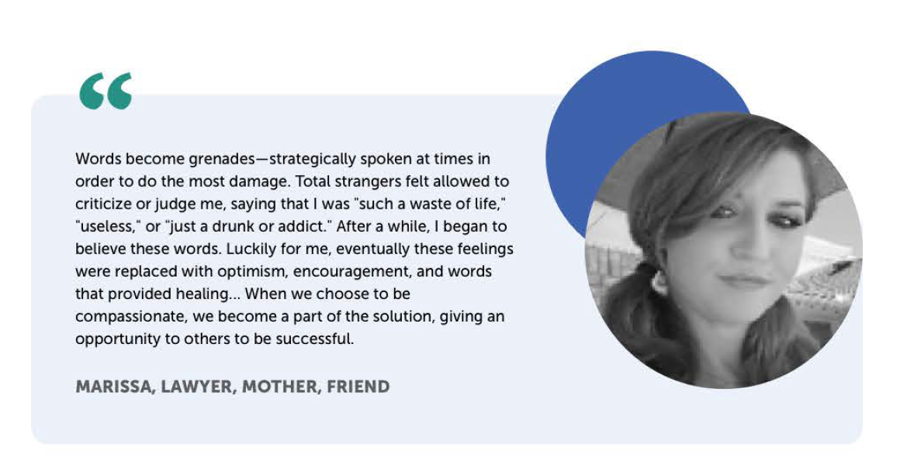
Why Language Matters
17

Slide 18
Words Matter for Professionals – Research & Studies
Here are two scenarios from a research study in which a hypothetical patient was described to two groups of mental health clinicians. Notice their different reactions based on how substance use is mentioned.
Mr. Williams described as a "substance abuser"
"His problem is caused by a reckless lifestyle and poor choices"
Mr. Williams described as an "individual with a substance use disorder"
"His problem is generic or inherited"
“…the judge should initiate more intensive treatment"
"He should be given a jail sentence as a wake-up call"
"He should be referred to a spiritual or natural healer"
"He should be prescribed medication"
Source: John F. Kelly and Cassandra M. “Does it matter how we refer to individuals with substance-related conditions? A randomized study of two commonly used terms.” International Journal of Drug Policy 21, no. 3 (May 2010): 202-207. https://doi.org/10.1016/j.drugpo.2009.10.010.
18

Slide 19
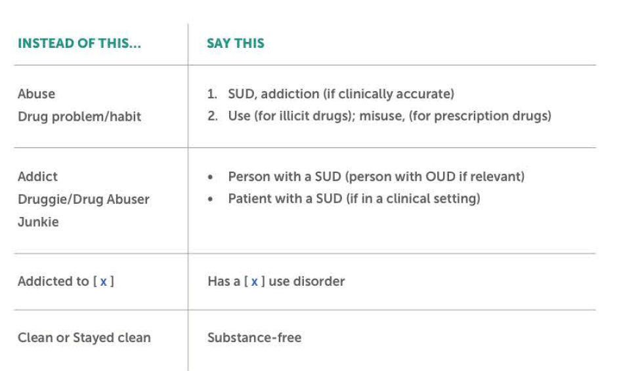
Recommended Language Change – Simplified
Source: Shatterproof’s Comprehensive Language Guide
19

Slide 20
Thank you – contact us for additional resources
endstigma@Shatterproof.org

