Slide 1

Communities of Practice:
“Person-Centered Care for Pregnant & Parenting Individuals with Substance Use Disorder”
October 6, 2020
M. Terplan, MD, MPH, FACOG, DFASAM & R. Schwartz, LCSW
C. Chu, MD, MSc
National Clinician Consultation Center (NCCC), Zuckerberg San Francisco General Hospital (ZSFGH)
Notes:
Voiceover: Developed through a partnership with IMPACT WV and the WV Home Visiting Program to help participants exchange technical information and share experiences about a variety of topics related to serving clients currently experiencing or who have past experiences with substance use

Slide 2
What we hope to share today…
Information on best practices for providing person-centered care for pregnant and parenting individuals with substance use disorder, including during the postpartum period.
Information on Team Lily, a multi-professional program for pregnant/parenting people who experience significant barriers to accessing clinic-based prenatal care.
Learn how the national Substance Use Warmline can offer support to clinicians regarding the evaluation and management of perinatal substance use disorder, including addressing questions on MOUD

Slide 3
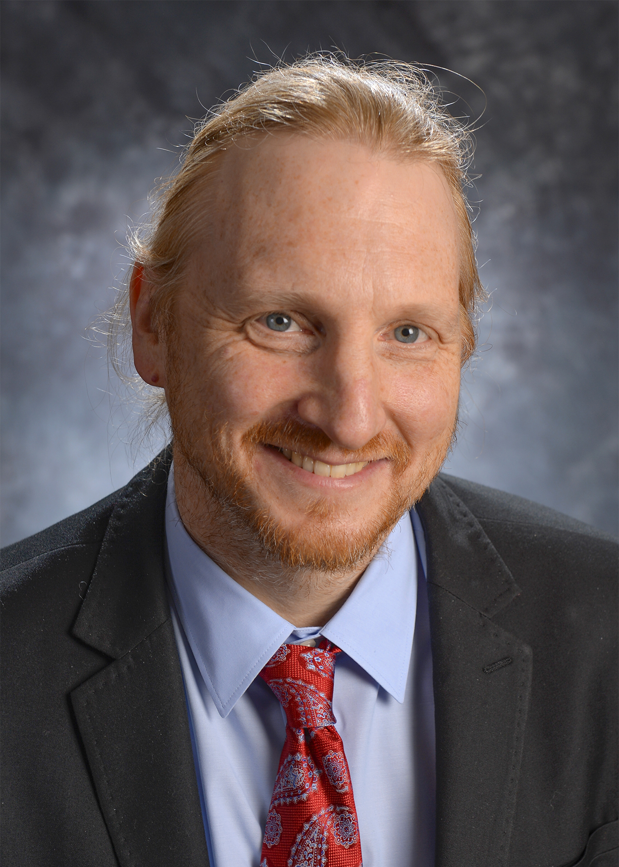

Today’s speakers
Mishka Terplan Becca Schwartz

Slide 4
Why would a pregnant person use drugs?
What happens when people who use drugs become pregnant?

Slide 5
National Survey Drug Use and Health 2013/2014 Past Month Use Data

Slide 6
Those who can’t quit or cut back – likely have a substance use disorder
All pregnant people are motivated to maximize their health and that of their baby-to-be
Continued use in pregnancy is pathognomonic for addiction

Slide 7
Addiction Life Course
Reproductive Health Life Course
The Pregnancy Box

Slide 8
Individuals with the disease of addiction need treatment
Prenatal Care
Medication
Behavioral Counseling
“Gold standard” is integration: comprehensive, co-located service delivery

Slide 9
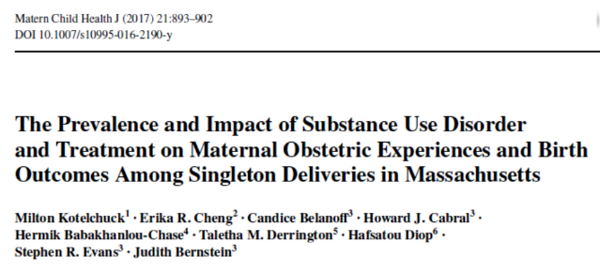
Treated vs Un-Treated Addiction
Optimizing Maternal Health = Core Principle of Care
 | No Addiction | Treated Addiction | Untreated Addiction
Preterm Birth | 8.7% | 10.1% | 19.0%
Low Birthweight | 5.5% | 7.8% | 18.0
Fetal Death | 0.4% | 0.5% | 0.8%
Neonatal Mortality | 0.4% | 0.4% | 1.2%
Post Neonatal Mortality | 0.05% | 0.03% | 0.1%

Slide 10
Two Considerations
1) Postpartum (The 4th Trimester)
2) Stigma and Discrimination

Slide 11
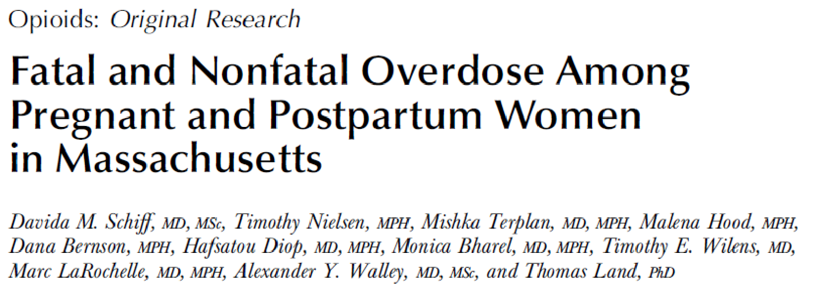
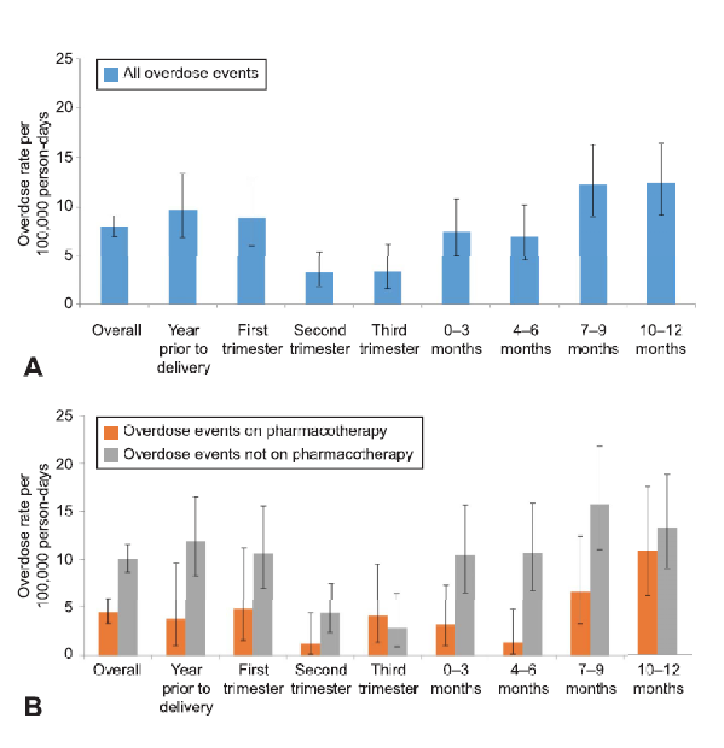

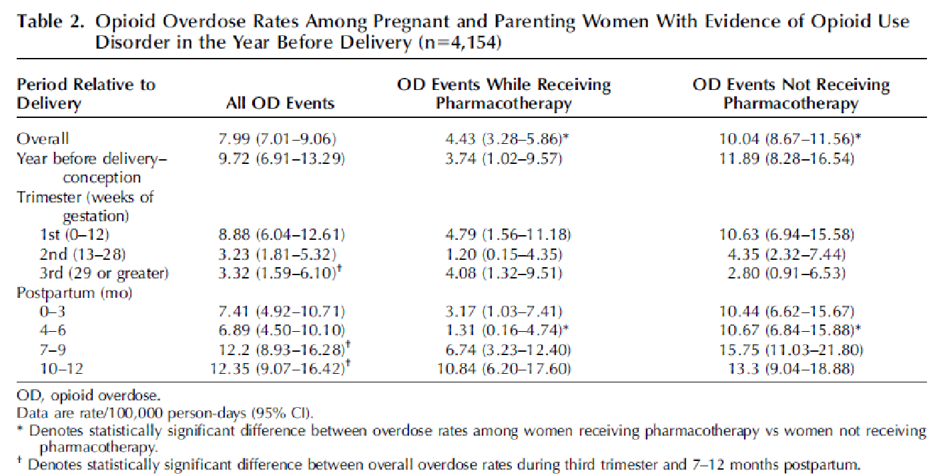

Slide 12
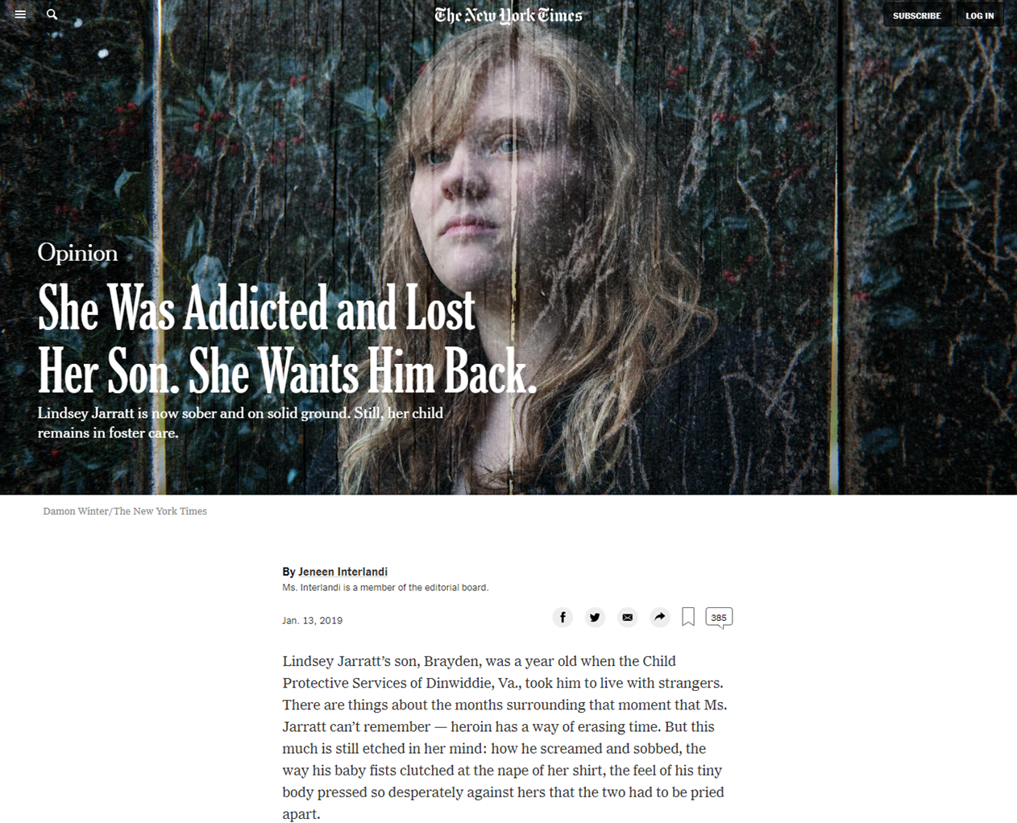

Slide 13

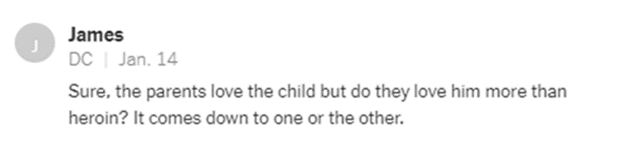
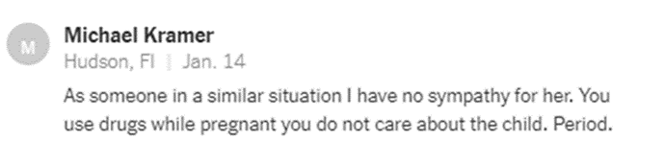
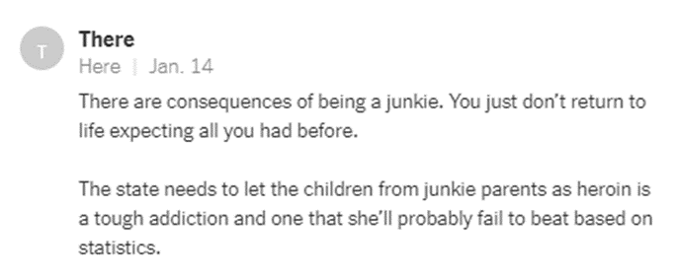

Slide 14
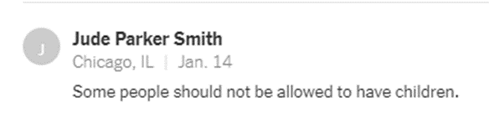

Slide 16
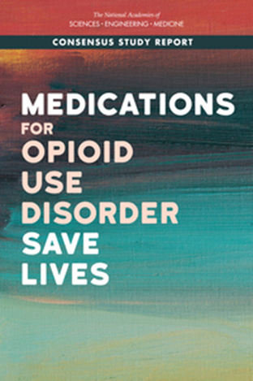
Conclusions of the National Academies Committee
Opioid use disorder is a treatable chronic brain disease
FDA-approved medications to treat opioid use disorder are effective and save lives
Long-term retention on medication for opioid use disorder is associated with improved outcomes
A lack of availability or utilization of behavioral interventions is not a sufficient justification to withhold medications to treat opioid use disorder
Most people who could benefit from medication-based treatment for opioid use disorder do not receive it, and access is inequitable across subgroups of the population
Medication-based treatment is effective across all treatment settings studied to date
Confronting the major barriers to the use of medications to treat opioid use disorder is critical to addressing the opioid crisis

Slide 17
Questions?

Slide 18
Team Lily: Mission Statement
Team Lily is a Zuckerberg San Francisco General Hospital-based multidisciplinary care team providing person-centered, trauma-informed, wrap-around services to pregnant and postpartum people. We support pregnant people experiencing significant barriers to accessing clinic-based prenatal care, primarily those experiencing homelessness, substance use disorders, incarceration, intimate partner violence, and/or mental illness. We strive for a pregnancy, birth or abortion, and postpartum experience that is filled with dignity, that is grounded in autonomy, and that uplifts individual or parenting goals. We are committed to dismantling structural racism and challenging the stigma and discrimination that drive Team Lily clients’ barriers to care, health, and well-being.

Slide 19
Team Lily: what we offer
Flexible appointments, meeting the needs of individual clients, off-site/home visits
Easy access to team members via phone and text
Pregnancy counseling - abortion, adoption, and pregnancy continuation
Pregnancy & postpartum care
Mental health services
Addiction services including buprenorphine / suboxone treatment
Navigation & case management to assist with access to housing and other resources
Support around navigating CPS and CPS reunification

Slide 20
Team Lily: “Origin Story“
Created in response to felt need among ZSFG OB/GYN trainees and providers specifically
Pregnant people with SUD and limited prenatal care delivering at ZSFG => traumatic birth experiences, pipeline to CPS/child removal
Team Lily was developed in the model of HIV care for pregnant people- multidisciplinary team, relationship-based, individualized care with social needs at the center
Healthcare trauma is its own barrier to care, needing attention
Notes:
# This set of outcomes- and specifically the disproportionate harm occurring to black families, a problem for those who were participating (providers) as well as those impacted (patients, families)
#3 This approach to care is longstanding in the treatment of HIV, acknowledging the heavy burden of intersecting systemic oppressions as well as the barrier of societal stigma and prejudice.

Slide 21
Team Lily approach: Trauma-informed care with relationship at the center
Belief that relationships can heal, that client autonomy and self-determination is crucial
Building the care of each patient around her strongest relationship connection- individual members of the team step up or step back
No gatekeeping- each patient has cell phone access to all members of the team, as much access to her doctor as to any other team member
Patients set the pace for disclosure and the priorities for each visit
Space is made for prior negative or traumatic experiences in health care settings
Notes:
My goal is to share some of the elements of the Team Lily approach that I think can be applied in any setting, understanding that not all of our institutions have a specialized care team.

Slide 22
Questions?
Contact me! Rebecca.Schwartz@ucsf.edu

Slide 23
National Substance Use Warmline
Operated by the National Clinician Consultation Center (NCCC), which also provides free, confidential tele-consultation on HIV & HCV
Program based at San Francisco General Hospital | University of California San Francisco
Funded by DHHS Health Resources & Services Administration
Bureau of Primary Health Care
HIV/AIDS Bureau (AIDS Education & Training Centers Program)

Slide 24
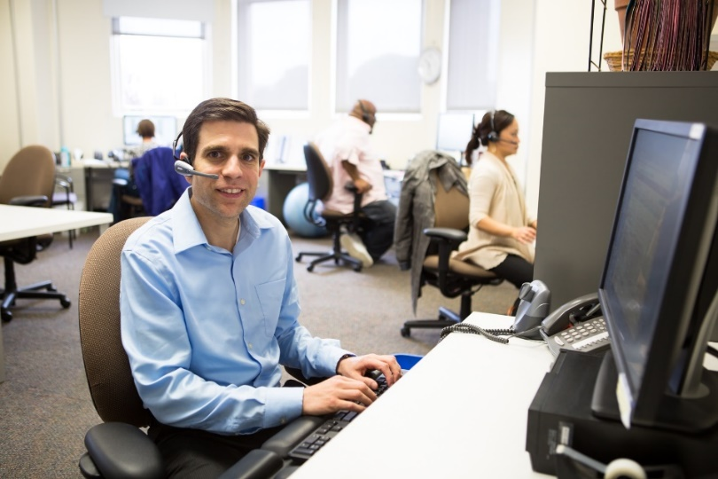
How to reach the Substance Use Warmline?
Any clinician, at any practice/location, welcome to request a personalized consultation:
Call 855-300-3595, 9am-8pm EST, Monday-Friday (leave voicemail outside of usual hours) – OR –
Submit cases/inquiries securely online: nccc.ucsf.edu

Slide 25
What to expect
Access to a multi-disciplinary team of professional, compassionate clinician consultants
Evidence-informed, practical guidance for opioid (and other substance) use disorder evaluation & management
Individualized decision support to help develop person-centered treatment plans
No special software or technology/equipment
necessary to speak with our team;
no PHI collected

