Slide 1
ReACT Clinic
Resilience After Complex Trauma

Slide 2
Agenda
Introductions
Nevine Estaphan, M.D.
Bridget Bailey, Ph.D., LICSW
The mission of and services available at the ReAct clinic
Psychoeducation regarding complex trauma and its effects on youth and families
Evidence-based treatments available for youth and families with traumatic experiences
*Slides are borrowed and adapted from the ARC Reflections Training Program developed by Margaret Blaustein, PhD and Kristine Kinniburgh, LICSW along with the Annie E. Casey Foundation

Slide 3
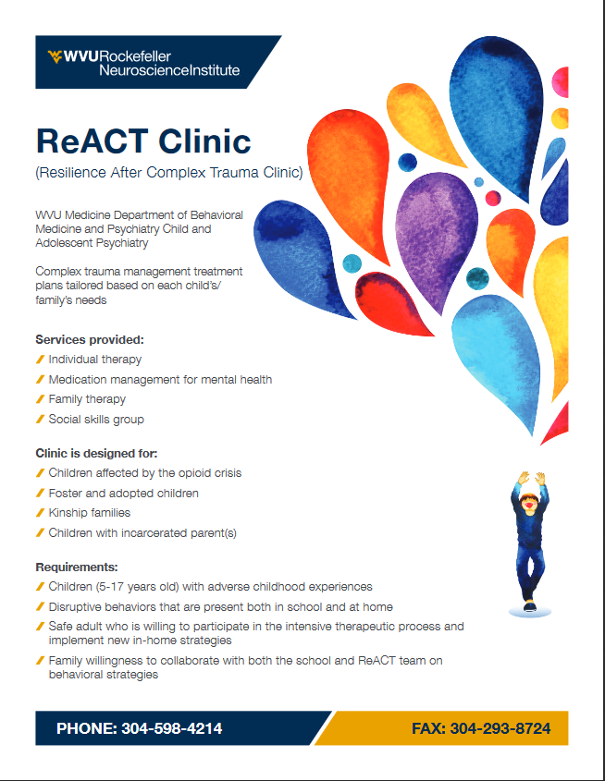


Slide 4
Comprehensive Outpatient Clinic
Psychiatric Evaluation; Medication management whenever needed
Evidence Based Trauma Informed Psychotherapy modalities including but not limited to:
Attachment Self-Regulation and Competency (ARC) Framework
TF-CBT (Trauma Focused Cognitive Behavioral Therapy)
EMDR (Eye Movement Desensitization and Reprocessing)
PCIT (Parent Child Interactive Therapy)
Play therapy
Social Skills Group
Caregiver Psychoeducation, Support, and Skills Group
Case Management

Slide 5

Location:
Regularly located at Collins Ferry, Research Ridge Center
Currently, services are available through ZOOM (for groups and the comprehensive multidisciplinary intakes) and MyChart Video visits.

Slide 6
Meet Our Team ☺
Nevine Estaphan, MD -- Child and Adolescent Psychiatrist, WVU Medicine Assistant Professor – ReACT Clinic Lead and Medical Director
Emily Finomore, LPC-- Outpatient clinic manager, licensed professional counselor, child and adolescent therapist
Bridget Bailey, PhD , LICSW – WVU Medicine Assistant Professor, Dialectical Behavior Therapy and Attachment Self-Regulation and Competency (ARC) Framework
Therapists (alphabetically arranged)
Ashley Garner, LGSW, EMDR-T -- Licensed Graduate Social Worker, Trained in Eye Movement Desensitization and Reprocessing, Clinical Therapist
Courtney Drake, PLC, EMDR-T -- Nationally Certified Counselor and with Master of Arts degree in Counseling from West Virginia, , Trained in Eye Movement Desensitization and Reprocessing, Clinical Therapist
Jenna Mosely Lohnes, LGSW – Licensed Graduate Social Worker, Clinical Therapist - PCIT
Kristen Boyce, LICSW -- Licensed Independent Clinical Social Worker, Trauma Focused Cognitive Behavioral Therapist certified, Dialectical Behavior Therapy certified, Certified Child and Adolescent Trauma Professional, PCIT
Ashley Summers -- Child and Adolescent Case Manager, Community services liaison

Slide 7
Clinical Goals
Initial plan for referrals and comprehensive treatment plan
COVID-19 and the adjustments to the original plan
Received 75+ referrals
Patients are as young as 2 years and up to 17 years old

Slide 8
TEACHING AND RESEARCH
TEACHING/TRAINING OPPORTUNITITES
CAP Fellowship elective rotation
Open opportunity for other training for different providers
Community training opportunities
Tuesdays team case discussion
April 2020 (National Child Abuse Prevention Month)
RESEARCH
Initial dataset on REDCap
Consideration for NCTSN grant application once available
Clinical trial

Slide 9
Referrals
All referrals are considered; will need intake package to be filled as well as the intake assessment scales:
ACEs/Resilience – Strengths and Difficulties Questionnaire Scores
(hopefully before their scheduled appointment)
Fax the referral or contact Ashley Summers at
Phone: (304)598-4214
Fax: (304)293-8724
EPIC Message
Using EPIC Order:
Please Specify and add “ReACT” or “Trauma clinic” in the comment of your order
OR

Slide 10
Understanding Trauma
Research shows that nearly half of children from birth to 17 have experienced at least one type of trauma — it is not as rare as you might think

Slide 11
Understanding Trauma
Research also shows that all sorts of adversity — things that don’t leave a bruise — can have a negative effect on children and teens
Many of the stressors that shape children’s and teens’ lives are chronic and pervasive, such as neglect, racism, poverty and frequent moves
Trauma can also include events, such as being hit or experiencing rape, an accident or an earthquake

Slide 12
Understanding Trauma
Feelings are complicated. You might think that children and teens are always happy to get away from an abusive parent. But many identify leaving a parent, even an abusive one, as the hardest experience they have had

Slide 13
Understanding Trauma
Trauma can profoundly influence a child or teen, even when it takes place during infancy — and even when he or she has no memory of what happened

Slide 14
Understanding Trauma
Being in a safe environment, even with the most well-intentioned and loving caregivers, does not mean a child or teen feels safe

Slide 15
Understanding Trauma
Chronic trauma shapes nearly every aspect of a child’s or teen’s life
There are many different things that are important to a child’s or teen’s healing. One of the most important is having long-lasting, supportive relationships

Slide 16
Understanding Resilience
Particularly with the right supports and resources, children and teens have a remarkable ability to thrive, even when they have experienced multiple hard things in their lives
There are many factors that can support resilience, some of which we will talk about in this group. These include:
a safe home
supportive, lasting relationships
the ability to manage hard feelings
feeling positive about yourself
Notes:
New slide

Slide 17

Meet Olivia

Slide 18
Olivia’s Story
Olivia is a 5-year-old girl of mixed ethnicity. Her parents used substances (primarily heroin, alcohol and marijuana) and there was frequent violence in their relationship.
The family moved four times during Olivia’s first two years and was homeless once. Often Olivia’s mother would leave her with friends or other relatives for brief periods.

Slide 19
Olivia’s Story
Olivia and her mother moved into a shelter when Olivia was 3 years old, but her mother returned to Olivia’s father after six months.
Two months later, dad was incarcerated because of a domestic violence incident and multiple intent-to-distribute charges.
He was arrested in front of Olivia.

Slide 20
Olivia’s Story
Olivia was removed from her mother’s custody three months later after allegations of neglect and physical abuse.
In the past year, Olivia has lived in three different foster homes. She was just placed in her current home.
Olivia’s mother has been unable to comply with service plans requiring treatment of her diagnosed bipolar disorder and substance abuse.

Slide 21
So What Is Trauma?
What in Olivia’s experience would you consider traumatic?
Why?

Slide 22
How Has This Influenced Olivia?
What do you think Olivia has learned about relationships? How do you think she might react to other people?
What do you think Olivia has learned about herself in the past five years?
How do you think Olivia got through her experience? What survival skills might she have learned?

Slide 23

What Is the Lens?

Slide 24
What Is the Lens?
Attachment is the lens for relationships

Slide 25

What Is the Lens?
Who is in the room?

Slide 26
What Is the Lens?
Labels we are given influence the lens for self

Slide 27

The Cutter
The Hoarder
Too Noisy
Impulsive
Foster Kid
Manipulative
The Quiet One
The Liar
Stupid

Slide 28
What Is the Lens?
Self-preservation becomes the lens for experience

Slide 29
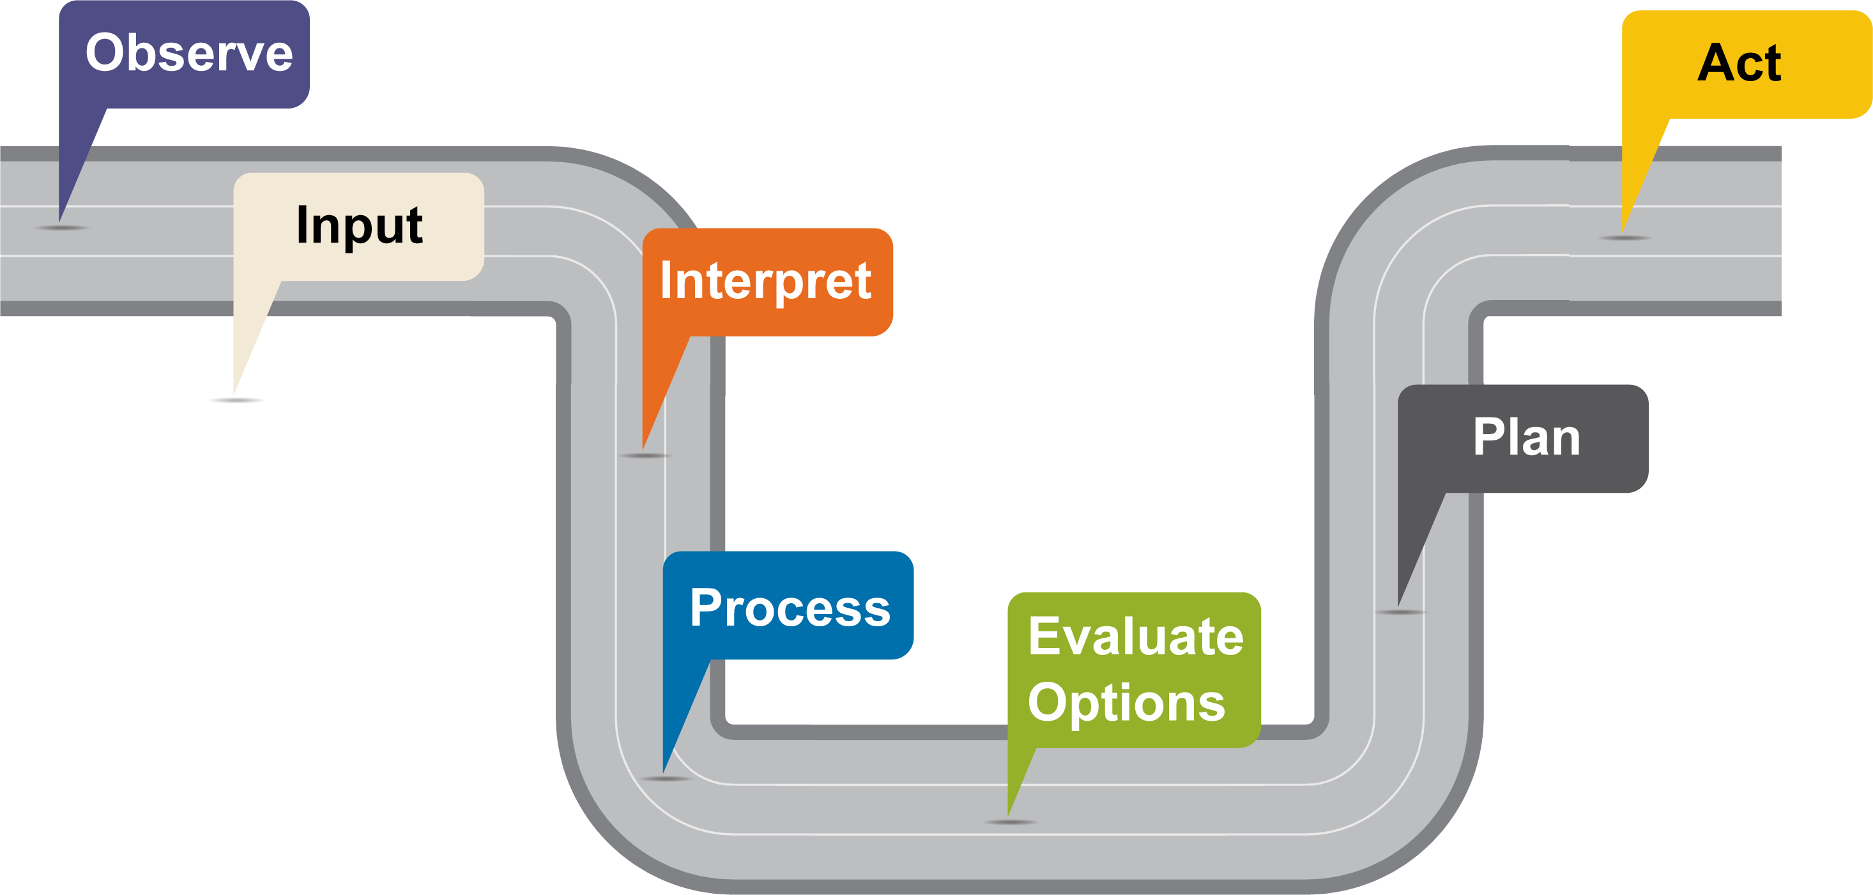
Brain Process Under Typical Conditions
Based on content developed by Joshua Arvidson

Slide 30
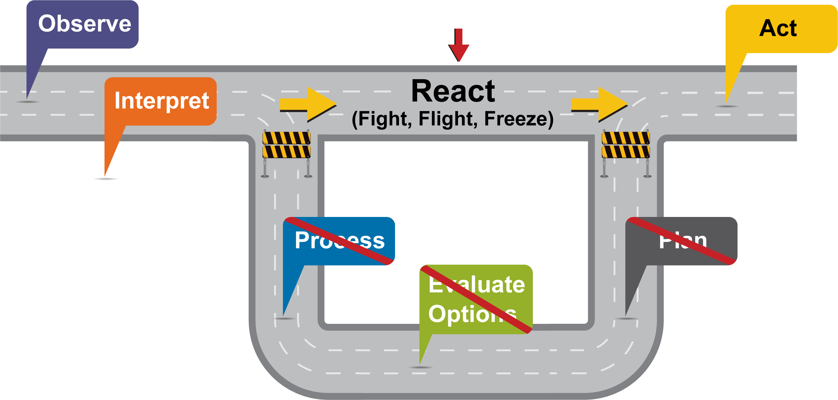
Alarm System ”Express Road”
ALARM SYSTEM “EXPRESS ROAD”
Based on content developed by Joshua Arvidson

Slide 31
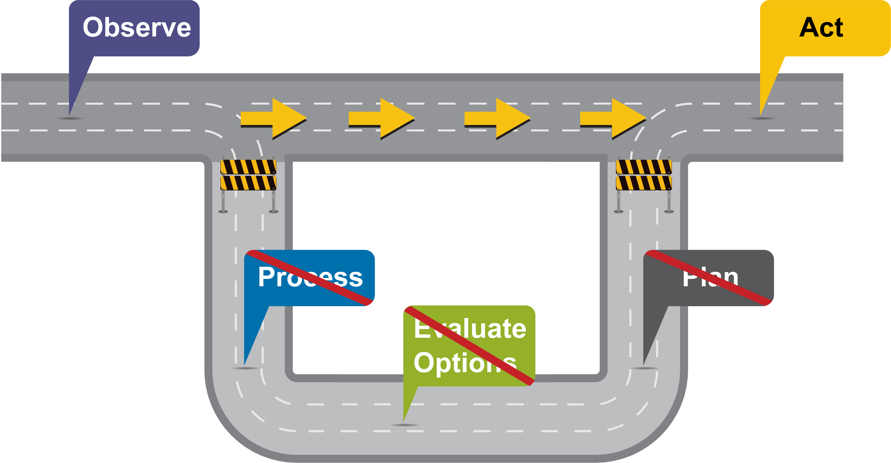
With Repeated Stress, the Alarm System “Express Road” Becomes the Main Road
ALARM SYSTEM
Based on content developed by Joshua Arvidson

Slide 32
Where Does This Leave Olivia?
What happens:
When you expect people to be dangerous, untrustworthy or unavailable?
When you believe you are unworthy of care?
When you expect the world to be dangerous and view even safe experiences as frightening?
When you have limited capacity to cope with any of that and you believe you have no one to turn to?

Slide 33
Psychoeducation on Trauma
Many different things may be experienced as traumatic
Trauma can profoundly influence child development
Trauma shapes the child’s or teen’s lens for self, for relationships and for danger
Trauma responses are designed to help the child or teen protect him- or herself and survive

Slide 34
Caring for a Child with Traumatic Experiences
Caring for a youth with complex trauma may challenge all you thought you knew about parenting.
Think of your strategies as experiments. Understand that one strategy will not work for all kids all the time
Multiple strategies can be used to address the same behavior at different times
Over the next several slides, we will discuss three possible behavioral strategies and how they may be used differently with youth with traumatic experiences

Slide 35
Praise and Reinforcement
Why use praise and reinforcement?
To build children’s and teen’s awareness of their successes and positive capacities
To focus on a child’s or teen’s strengths and potential for success rather than focusing on their bad behavior
When to use praise and reinforcement?
Any time a child or teen is engaging in a behavior you want to increase (often, the opposite of what you want to decrease)

Slide 36
Praise and Reinforcement: Trauma Considerations
Praise can be a trigger for some children or teens who have experienced trauma
If a child or teen rejects or ignores praise, caregivers should try not to take it personally and don’t engage in a power struggle
If a child or teen seems triggered by praise, caregivers should try focusing on the positive behavior instead of the whole child (“You worked so hard on that drawing” vs. “What a good artist you are”)
Keep noticing the positives. Even for a child or teen who seems distressed or unresponsive, over time the positives will matter

Slide 37
Problem Solving
Why engage children and teens in problem solving?
To build children’s and teens’ awareness of having and making choices — and learn that they can get in front of, not just react to, some challenges
To help children and teens feel more in control of and powerful over their lives
When can children and teens be engaged in problem solving?
When children and teens are calm, before or after situations in which challenges are likely or have occurred
When the child or teen is asking you for help
Regularly. Build children’s and teens’ skills by practicing and addressing the many small challenges that arise day to day

Slide 38
Problem Solving: Trauma Considerations
A child’s or teen’s ability to engage in problem solving depends on:
Whether he or she feels powerful enough to make a choice, or believes he or she has one
Which part of the brain is online
His or her stage of development
A caregiver’s ability to be calm and use this approach at appropriate times — and provide ongoing support — are crucial. Very few children or teens can problem solve independently

Slide 39
Limit Setting
Why use limit setting?
To establish an understanding of boundaries, expectations and a safe world
To help children and teens contain and shift negative behaviors and identify positive alternatives
To help children and teens learn where the lines are with inappropriate behaviors
When should you use limit setting?
When a child’s or teen’s behavior crosses established boundaries related to safety, harm to others or harm to the child or teen
Thoughtfully and not for every behavior

Slide 40
Limit Setting: Trauma Considerations
Any limit can be a potential trigger for a child or teen who has experienced trauma
Choose consequences carefully. Time-out may not be the right approach for a child or teen with a neglect history; yelling may trigger a child or teen who has experienced violence
Tune into your child or teen to name feelings, even as you set limits (“It makes sense that you were angry, but we use our words, not our hands, when we are mad”)
Separate the behavior from the child or teen

Slide 41

Problem Solving
Behavior: Throwing things at foster mom when overwhelmed
Olivia’s foster mother sat with Olivia when she was calm during their evening chat time. They talked about how everyone in the home was an important part of the family and contributed to keeping the house running smoothly
The foster mom noted that chores were hard for Olivia and asked if they could figure out a way to help Olivia feel more successful at doing them
When Olivia had a hard time generating ideas, her foster mother suggested that the two of them practice doing some chores together. She also talked about ways Olivia could tell her she was feeling overwhelmed

Slide 42

Praising Effort
Olivia’s foster parents worked hard to notice and comment positively on any instances in which Olivia did something around the house, such as cleaning up her toys, putting clothes in the laundry or doing age-appropriate self-care tasks such as brushing her teeth
They also began to tune in and name moments when Olivia got upset but not aggressive and praised her for using her regulation tools

Slide 43
Setting Limits
Whenever Olivia escalated to throwing things, the parent immediately stopped the activity and mirrored Olivia’s affect or energy (“I see you are upset,” or “Your energy just got really big”) and suggested a break
If that didn’t work, an adult would carry Olivia to the calm-down corner and stay until she was calm. They would discuss that it is OK to be angry but not to throw things; thrown toys would go into a “toy time-out” for 10 minutes

Slide 44
Seeing Success
Using problem solving
Over time, Olivia and her foster parents identified early warning signs that Olivia was having a hard time and used a special silly phrase (“purple-spotted dinosaur”) that cued Olivia to use her calm-down corner. They also built regular chore times into her daily routine
Using praise and reinforcement
Whenever Olivia went to her corner when cued, used coping skills or completed chores successfully, the adults gave her a high-five or verbal praise

Slide 45
Psychotherapies We Use for Youth with Complex Trauma
Attachment Self-Regulation and Competency (ARC) Framework
EMDR (Eye Movement Desensitization and Reprocessing)
TF-CBT (Trauma Focused Cognitive Behavioral Therapy)
PCIT (Parent Child Interactive Therapy)

Slide 46
Attachment Self-Regulation and Competency (ARC)
Flexible intervention developed for children and adolescents (3-17) who have experienced complex trauma, along with their caregiving systems
ARC’s ultimate goal is support children, adolescents, and caregivers in effective engagement in the world, in a manner that is empowered and future-oriented , rather than focused on survival.
ARC is organized around three primary domains of intervention, and identifies 8 key treatment targets.

Slide 47
Trauma-focused Cognitive Behavioral Therapy (TF-CBT)
TF-CBT was originally developed to address the needs of children who experienced sexual abuse.
TF-CBT is effective for diverse, multiple and complex trauma experiences, for youth of different developmental levels, and across different cultures.
TF-CBT is a structured, short-term treatment model that effectively improves a range of trauma-related outcomes in 8-25 sessions with the child/adolescent (ages 3-17) and caregiver.

Slide 48
Eye Movement Desensitization and Reprocessing (EMDR)
Eye Movement Desensitization and Reprocessing (EMDR) therapy is an extensively researched, effective psychotherapy method for youth and adults with trauma and other distressing life experiences
EMDR therapy does not require talking in detail about the distressing issue or completing homework between sessions. EMDR therapy, rather than focusing on changing the emotions, thoughts, or behaviors resulting from the distressing issue, allows the brain to resume its natural healing process.
EMDR therapy is designed to resolve unprocessed traumatic memories in the brain. For many clients, EMDR therapy can be completed in fewer sessions than other psychotherapies.

Slide 49
Parent Child Interaction Training (PCIT)
PCIT works with parents and children together, teaching them skills to interact in a positive, productive way. It is effective for kids between the ages of 2 to 7, and usually requires 14 to 17 weekly sessions.
“Coaching” sessions for parents and children
Goals:
Establishing warmth in the relationship
Helping children feel calm, secure in their relationships with their parents, and good about themselves.
Help the parent develop a calm and consistent approach to manage behavioral problems

Slide 50
Thanks again for your time!
Questions

