Slide 1

Communities of Practice
Stigma
June 2, 2020
Notes:
Voiceover: Developed through a partnership with IMPACT WV and the WV Home Visiting Program to help participants exchange technical information and share experiences about a variety of topics related to serving clients currently experiencing or who have past experiences with substance use

Slide 2

Role of Impact WV
Use the Communities of Practice structure to:
Focus on areas that directly impact home visiting providers, other service providers, and families
Examine needs and services specifically for children diagnosed with Neonatal Abstinence Syndrome (NAS) Defined or exposed to substances in utero and their families

Slide 3

Role of WV HVP
Use the Communities of Practice structure to:
Encourage home visitors to engage in self-reflection and strengths-based practices for supporting families exposed to substances
Develop additional supports and resources specifically for children diagnosed with Neonatal Abstinence Syndrome (NAS) Defined or exposed to substances in utero and their families

Slide 4

Getting the most out of this Meeting Prior to the meeting review: How Do I Join A Zoom Meeting
While in the Meeting:
Be sure to mute your line if you are not talking
Use your video if you can – its more personable for us as a team to work together
Widen the screen or zoom in to see more
Participants – know who is part of the team and on the call
Chat – ask a question or make a note during a discussion
Polling – the facilitator may use this to get your thoughts outside of the discussion

Slide 5


Slide 6

What will I learn today? By the end of this session, each of you will be able to…
Define stigma in relation to Moms and Babies with NAS;
Share, discuss, and apply shared experiences regarding work with Moms and Babies with NAS and what approaches have been successful for dealing with stigma in the literature and within our team; and
Identify, discuss, and practice ways to deal with stigma when working with Moms and Babies with NAS

Slide 7

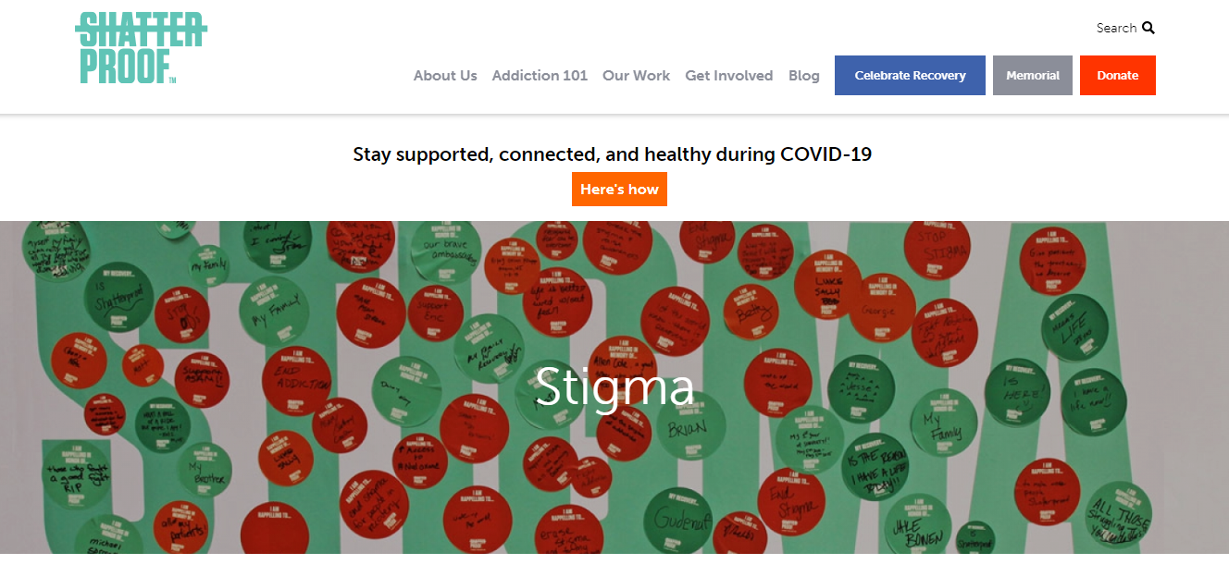
Subject Matter Expert
Matthew Stefanko https://www.shatterproof.org/about-addiction/stigma

Slide 8

Stigma
Intro to Stigma
Impact of Stigma
Stigma Reducing Language

Slide 9

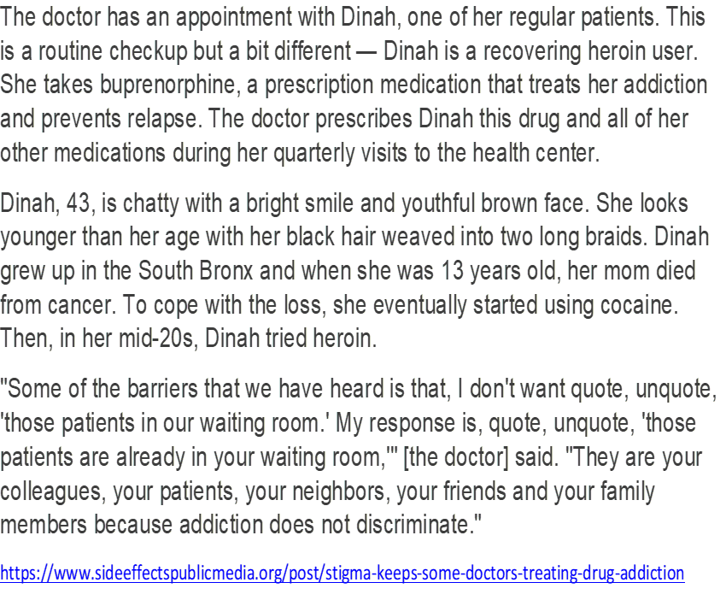
Case studies
A 23 year old pregnant woman is referred to home visiting to help prepare for her baby. She is currently on Medication Assisted Treatment (MAT) and attending meetings to help with her sobriety. Her family is pressuring her to stop taking her MAT because they think it is not safe for her baby and is the same as using drugs. What suggestions as a home visitor do you have for her?

Slide 10

Case study reflection
What resonates with you?
What do you feel would be the best way to support the family?
How could you practice dealing with stigma during this scenario?
How would you prepare yourself for the next visit?

Slide 11

Resource share
What does the literature say?
Do you have experience with this?
Have you tried a similar approach?
Does it work?
What would you do differently?
How do you think families would respond to this?

Slide 12
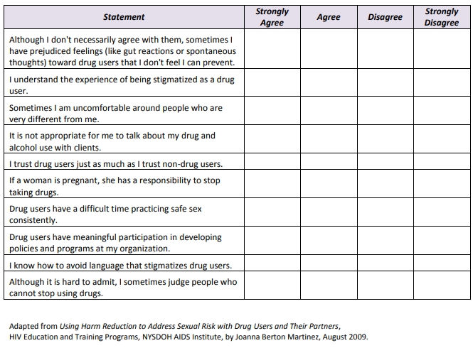
Harmreduction.org
Notes:
https://harmreduction.org/wp-content/uploads/2012/02/stigma-facilitators.pdf

Slide 13
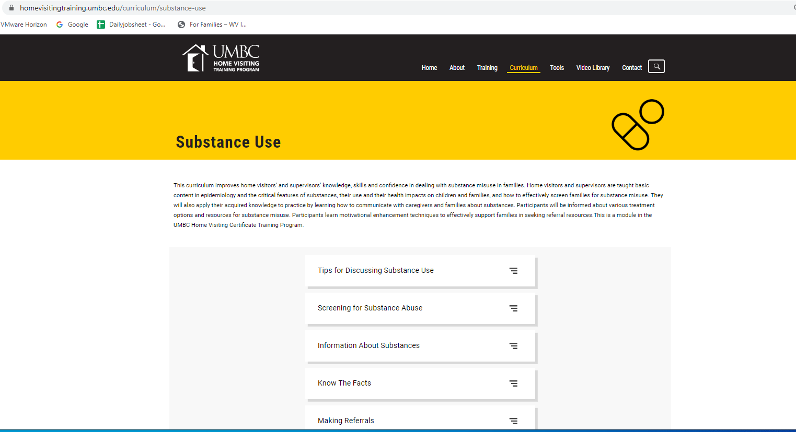
Homevisitingtraining.umbc.edu
Notes:
https://homevisitingtraining.umbc.edu/curriculum/substance-use
Tips for Discussing Substance Use

Slide 14
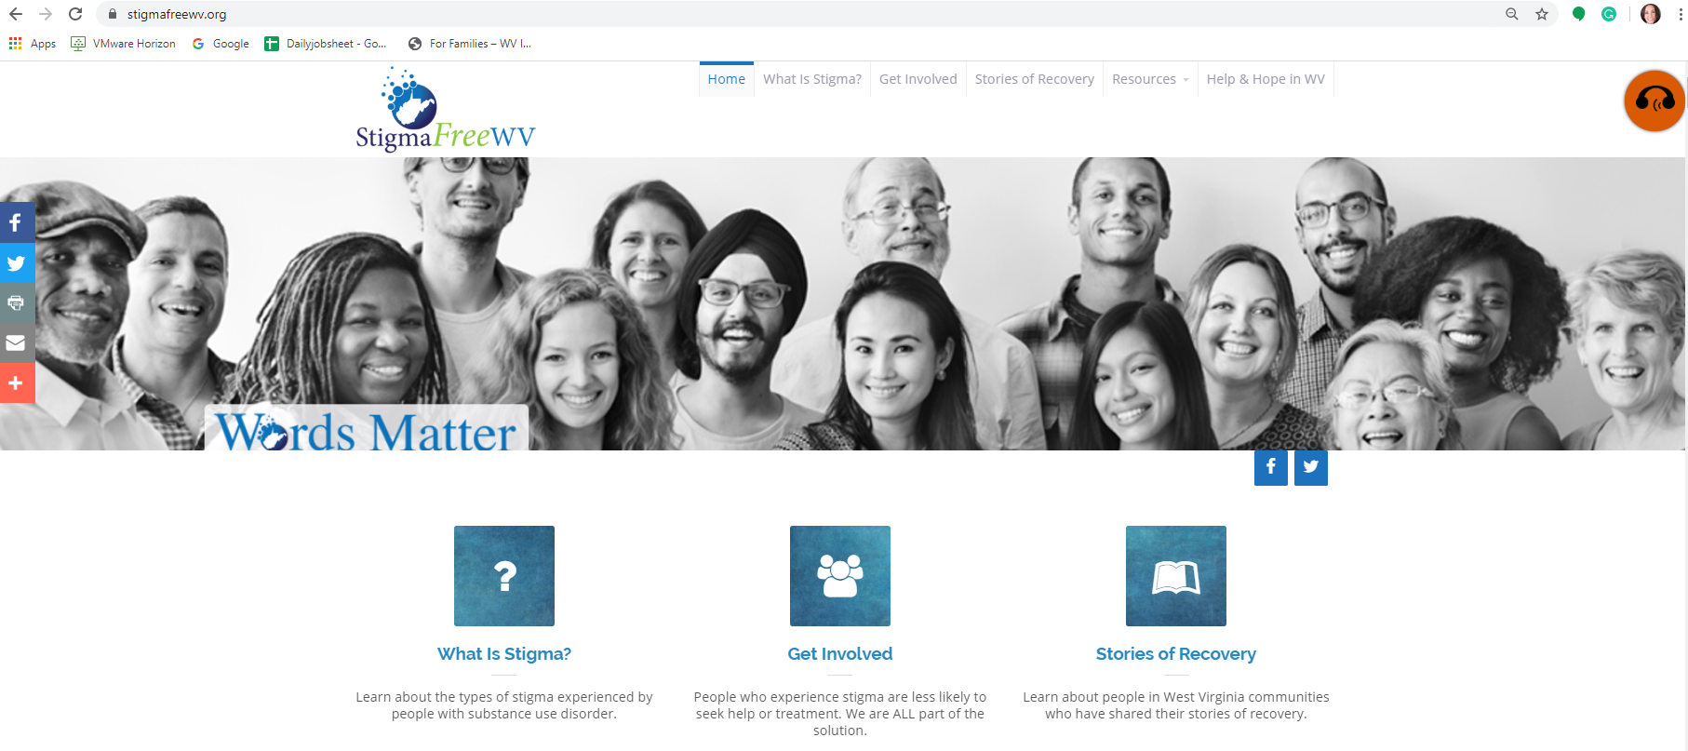
Resource share
Notes:
https://stigmafreewv.org/wp-content/uploads/2019/03/Stigma-Handout-5.pdf
Reflection Questions
https://stigmafreewv.org/wp-content/uploads/2019/03/Stigma-Handout-6.pdf

Slide 15
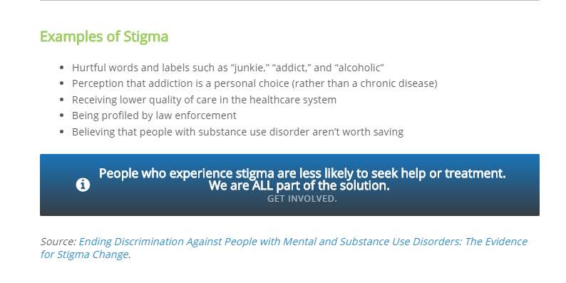
Notes:
https://stigmafreewv.org/get-involved/ - Pledge & Tips for Media

Slide 16
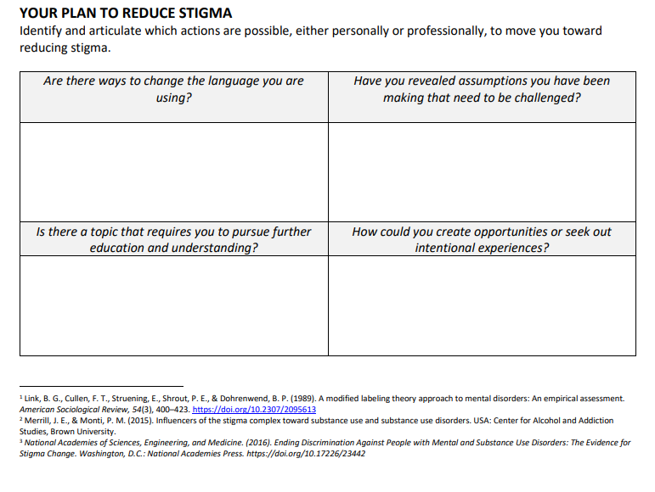
Notes:
Reflection Questions
https://stigmafreewv.org/wp-content/uploads/2019/03/Stigma-Handout-6.pdf

Slide 17

What is one skill I learned today?
How can I share this skill with a peer or a family with a baby diagnosed with NAS or exposed to substances in utero?

Slide 18
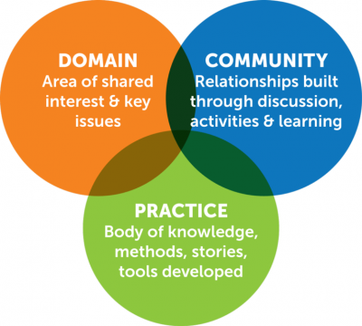
Next Communities of Practice Meetings
New topic series starts discussing STIGMA!
June 2nd @ 3 pm
July 7th @ 3 pm
August 4th @ 3 pm

Slide 19
Acknowledgements
This Appalachian Rural Health Integration Model (AHRIM) Program is supported by the Health Resources and Services Administration (HRSA) of the U.S. Department of Health and Human Services (HHS) as part of an award totaling $600,000 with 0 percentage financed with nongovernmental sources.
The contents are those of the author(s) and do not necessarily represent the official views of, nor an endorsement, by HRSA, HHS or the U.S. Government.

