Slide 1

West Virginia State University
Healthy Grandfamilies Program
An EPIDEMIC in our country an EPIDEMIC in West Virginia!
GRANDFAMILIES a new community!
Bonnie Dunn, MS
Bonnie.dunn@wvstateu.edu
Kerri Steele, MSW, PhD
ksteele1@wvstateu.edu
West Virginia State University

Slide 2
Objectives for Presentation
1. Identify state and national statistics on grandparents raising grandchildren, the impact of the phenomenon on the family, and the relationship between this family type and the opioid epidemic.
2. Define the WVSU Healthy Grandfamilies programs and services.
3. Examine the resources available for grandfamilies.

Slide 3
West Virginia State University
Healthy Grandfamilies Program
It is so much more than a program:
SUPPORT SERVICES
ADVOCACY
INTERVENTION
POINT OF CONTACT WHEN YOU NEED AN ANSWER

Slide 4
National Trends
Over 2.7million grandparents are responsible for their grandchildren – 2018
  up 7% since 2009
For every 1 child in the foster care system, 25 are being raised by grandparents or relatives outside of the system
Grandfamilies save tax payers more then $6.5 billion by keeping kids out of foster care
Source: Generation United, 2017

Slide 5
Clarification
Foster Care: a situation in which for a period of time a child lives with and is cared for by people who are not the child's parents
Foster Care System: the raising or supervision of foster children, as orphans or delinquents, in an institution, group home, or private home, usually arranged through a government or social-service agency that provides remuneration for expenses.

Slide 6
Clarification - continued
Kinship caregivers are able to apply to become foster parents and complete the homestudy process.
Kinship caregivers undergo a “home assessment” and “approval” process.
Foster parents undergo a more detailed “homestudy” and “licensure” process.

Slide 7
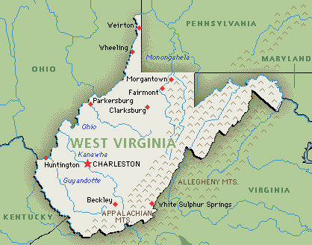
Statewide Trends
WV ranks 2nd among all states in the % of grandparents responsible for their grandchildren.
Source: Kids County 2016

Slide 8
Source: WVRHA/WV Health Data Portal

Slide 9
Conversation about the
West Virginia Data Map
Starting from Mercer in the southern part of the state and travel northwest, Raleigh, Fayette, Kanawha, Putnam, Cabell, Wayne , Mason, and Wood. South West, Logan and Wayne. Eastern panhandle Berkley and Jefferson county. North – Monongalia , Marion, and Harrison

Slide 10
Conversation about the
West Virginia Data Map
Based on this map and the county/counties you work in, do you think these numbers are overestimated or underestimated?

Slide 11
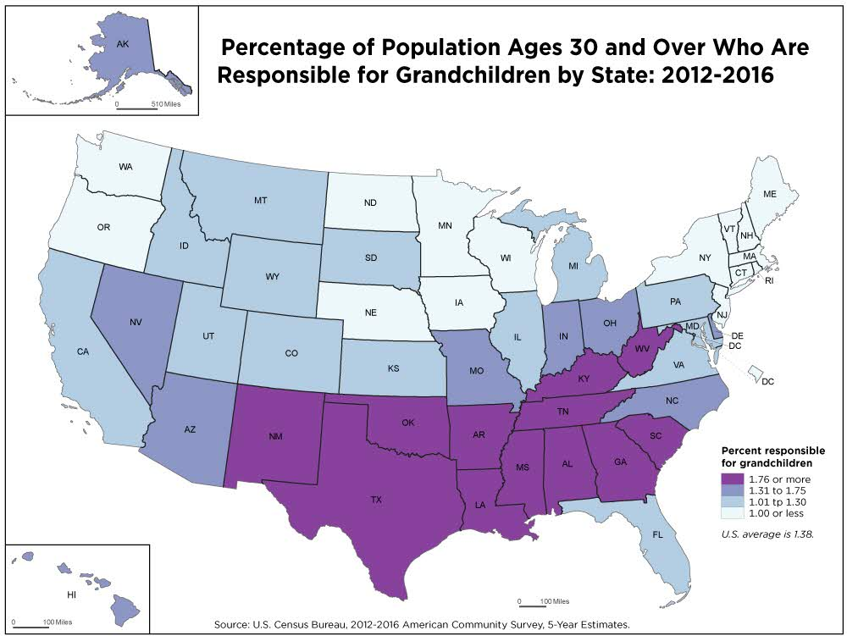

Slide 12
Conversation about the
National statistics
Dark Purple States
New Mexico, Texas, Oklahoma, Arkansas, Louisiana, Mississippi, Alabama, Georgia, South Carolina Tennessee, Kentucky, and West Virginia

Slide 13
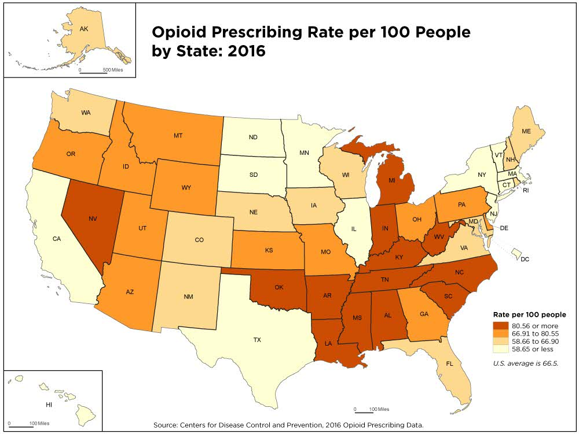

Slide 14
Conversation about the
National statistics
Dark Orange States
Oklahoma, Arkansas, Louisiana, Mississippi, Alabama, South Caroling, Tennessee, Kentucky West Virginia

Slide 15
Comparison of states by Grandfamilies
Verses the opioid crisis
Oklahoma,
Arkansas,
Louisiana,
Mississippi,
Alabama,
South Carolina
Tennessee,
Kentucky,
West Virginia
------------------------------------
New Mexico, Texas and Georgia
Oklahoma,
Arkansas,
Louisiana,
Mississippi,
Alabama,
South Carolina,
Tennessee,
Kentucky ,
West Virginia

Slide 16
Problems that grandparents have
higher-than-normal rates of depression, sleeplessness
emotional problems
chronic health problems like
hypertension
diabetes
feelings of exhaustion
loneliness, and isolation;
a sense of having too little privacy, and too little time to spend with their spouse, friends and other family members.

Slide 17

Baseline Characteristics (N=125) from the Pilot Project
2.5 Average # of
grandchildren in grandfamily household in the pilot:
Nationally the average is 5 per Grandfamily
Today National Survey AARP
Primary reasons for placement:
  Drug-related 84.8%
    Addiction
    Death of parent
    Incarcerated parent
    Child removed by DHHR
  Financial reasons 6.4%
  Parent has disability 4.0%
  Military deployment 1.6%
  Parent is a teenager 1.6%
  Other 1.6%

Slide 18
What can we
do
about
this?

Slide 19
Intervention
Grandparents receive:
Education/Action Plan (3 months)
  Weekly Discussion Groups for grandparents delivered in the community in which they live.
  Child care
  Refreshments
Family Support Follow-up (3 months following Discussion Groups)
Total Intervention = 6 months

Slide 20
Intervention
During COVID 19
Grandparents receive:
Education/Action Plan (3 months) no real timeline
  Phone calls, check in’s to inquire if they are ok, do they need any thing (food, clothing, gasoline, bills paid, etc.)
  Phone calls can be made by the coalition coordinator or social worker. Also if anyone on the coalition team would like to provide courtesy calls of encouragement.
  If you think a virtual platform would work – try conducting the regular discussion groups.
  Weekly Discussion Groups for grandparents delivered in the community in which they live.
Family Support Follow-up (3 months following Discussion Groups)
Total Intervention = 6 months
??? Until COVID is over

Slide 21


Topics:
Communication
Parenting in 21st Century
Family Relationship
Nutrition
Navigating the Legal System
Navigating the School System
Social Media/Technology
Health Literacy/Self-Care
Stress Management
Family Response to Addiction
*Longitudinal data with our pilot program showed our families overwhelmingly found the topics to be helpful years after the conclusion of the program.

Slide 22
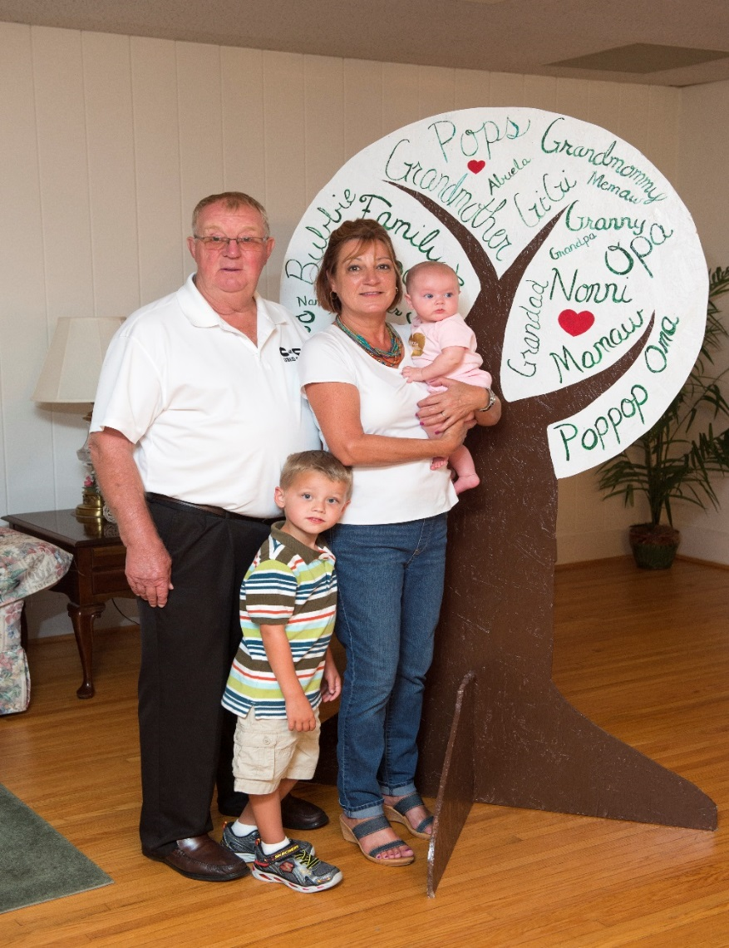
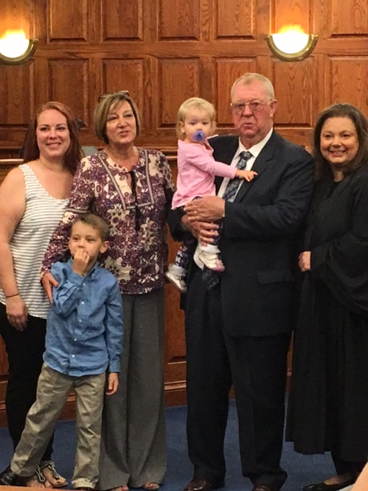
Andy and Debbie Adoption
2 Grandchildren
Ages 5 yrs - 4 months

Slide 23
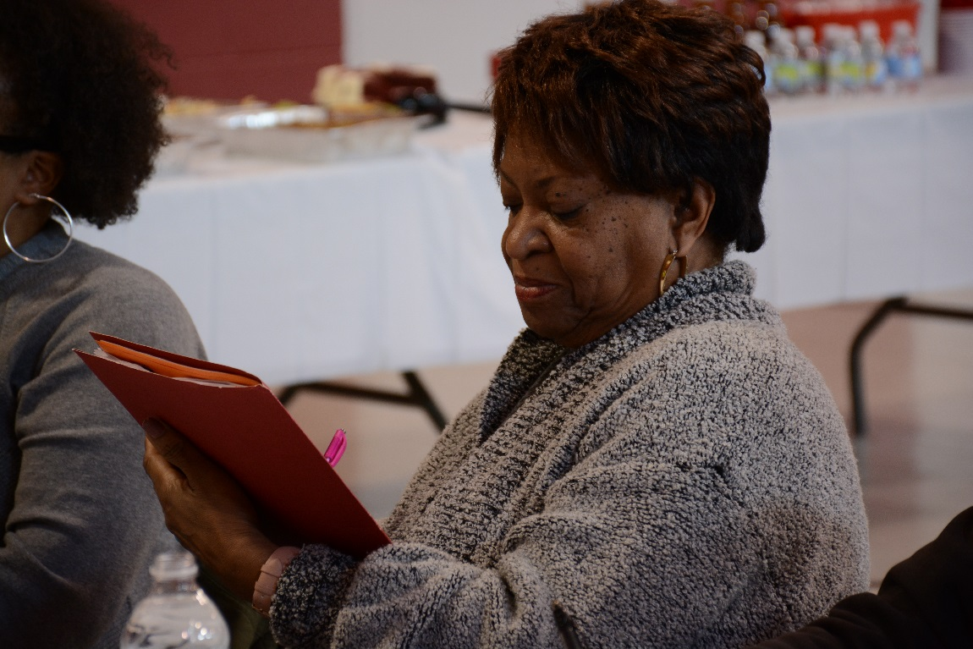
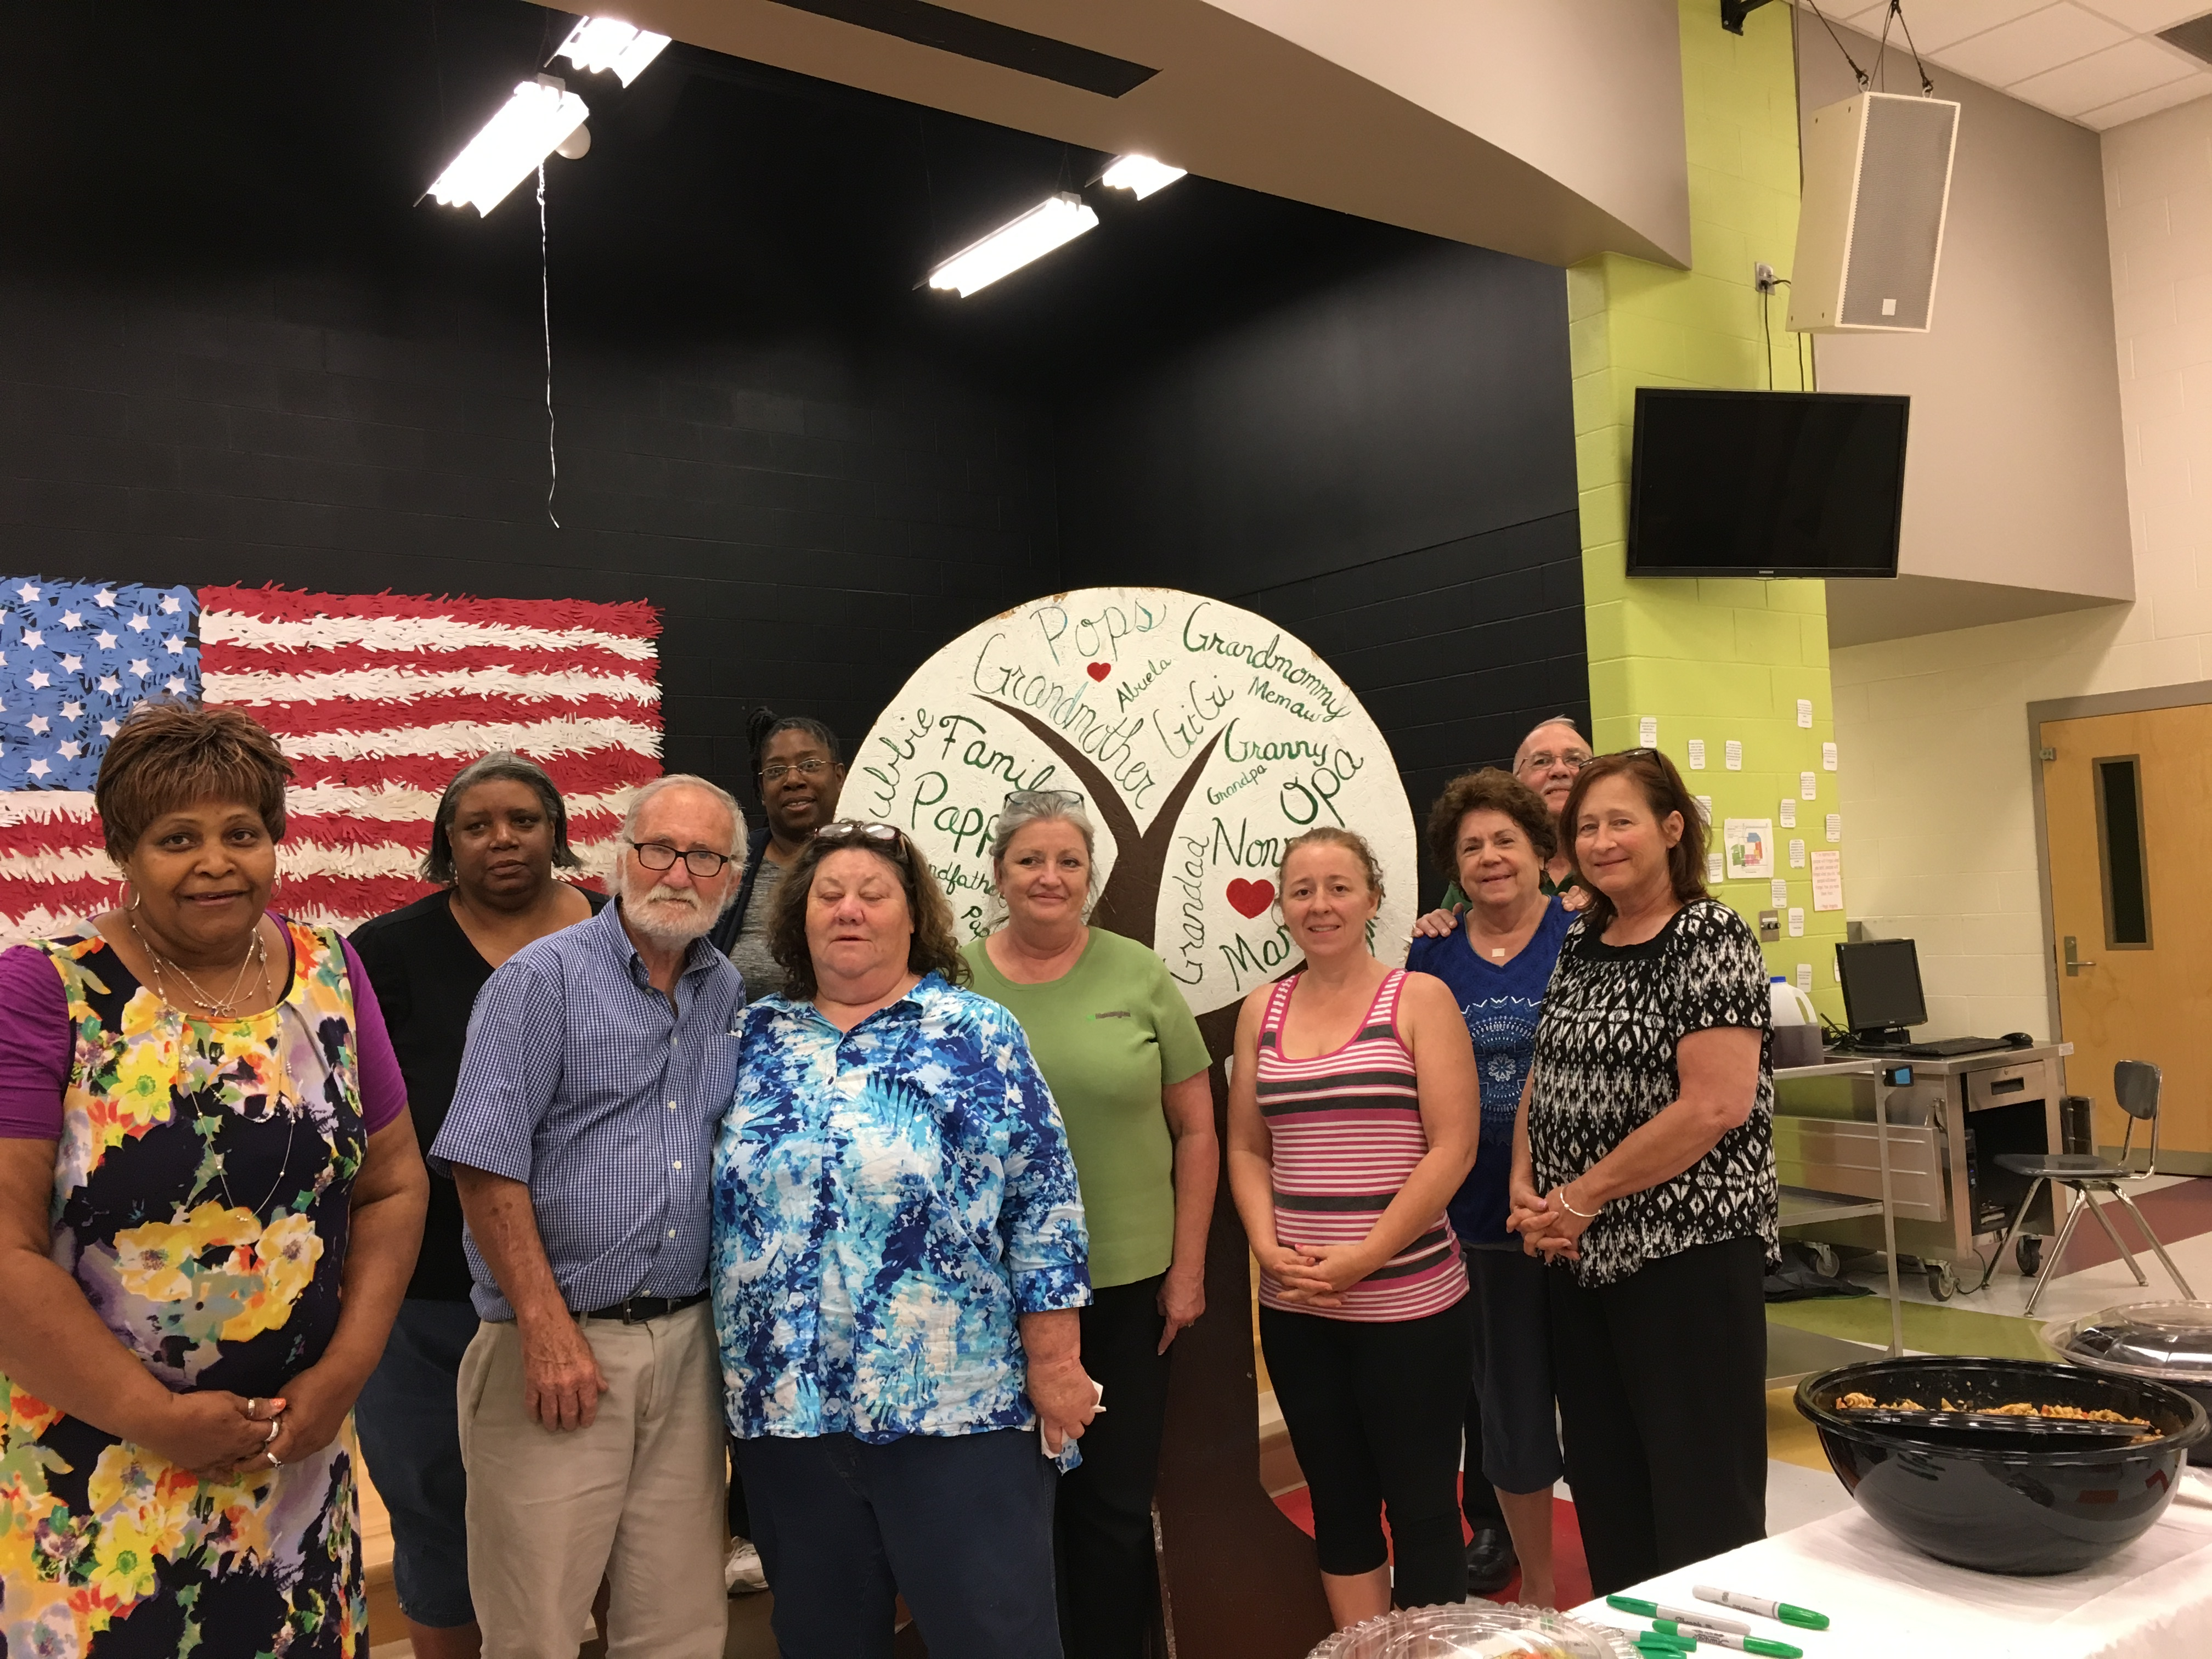
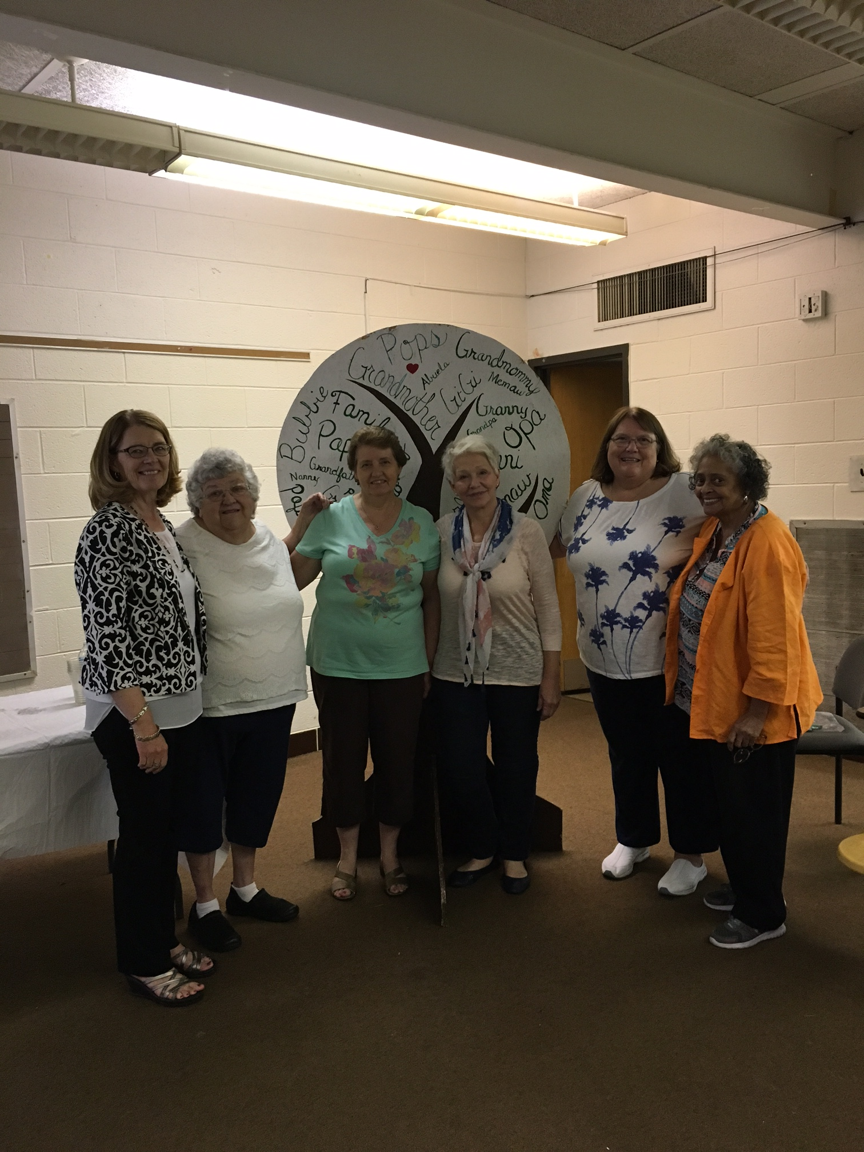
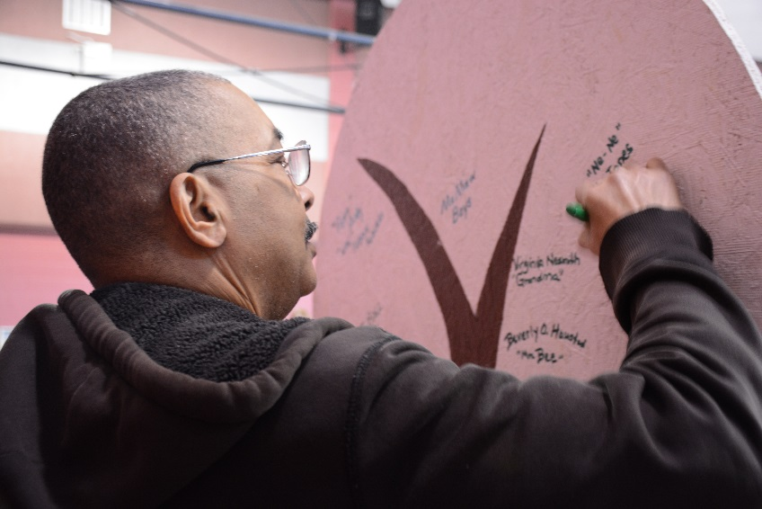

Slide 24
Resources
http://healthygrandfamilies.com/

Slide 25
WANT
MORE INFORMATION?
GO TO healthygrandfamilies.com

Slide 26
Contact Information
Bonnie Dunn, MS, Extension Specialist
Family and Consumer Sciences bonnie.dunn@wvstateu.edu
Kerri Steele, MSW, PhD
Chair of Social Work ksteele1@wvstateu.edu
West Virginia State University

