Slide 1
The Impact of Trauma in Pregnancy and Early Childhood Amanda Newhouse, LICSW, PCIT Level- I Trainer, IMH-E® Assistant Professor WVU Medicine The Department of Behavioral Medicine and Psychiatry

Slide 2
Learning Objectives
Understand substance use disorder in the family.
Understand the impact of SUD on the developing brain.
Identify the impact of early exposure to stressful situations.
How to build resiliency in a family.

Slide 3
What are your learning expectations?

Slide 4

Attachment
is a deep and enduring emotional bond that connects one person to another across time and space (Ainsworth, 1973; Bowlby, 1969).

Slide 5
Secure Attachment Matters
Self Reliance
Efficacy and persistence in task completion
Cooperation with others
Empathy
Social Competence

Slide 6
Prenatal Attachment
Mother and baby as one increases rhythms and reduces needs.
Linked to positive postnatal development.
Negatively associated with symptoms of anxiety and depression.

Slide 7
Becoming Pregnant
Planned – establishes context for a relationship with a new life.
Unintended – considerable stress and increased risk of mental health.

Slide 8
Reorganization
Moving her role from daughter to mother
Expanding Dynamic with the father

Slide 9
Object Relationship
Activated when becoming a mother
Identifies with their own mother
Intergenerational Trauma
Maternal Identity

Slide 10
Intergenerational Trauma
Diseases of parental past. (Frued)
Trauma is transferred from the first generation of trauma survivors to the second and further of the offspring.

Slide 11
Dads Matter
Fathers provide emotional and physical support to reduce aggression.
Children of involved fathers are also less likely to get in trouble at home, in school, and in the neighborhood, and they are less likely to experience depression.
Children with involved fathers tend to be more patient; and, when they are older, they can handle the stresses and frustrations easier.
Rough and Tumble play help regulate emotions.

Slide 12
Disruption in Early Attachment
Affect and regulation
Less social competence
Aggressive behavior
Decreased ability to learn
Later psychopathology

Slide 13

Add a Substance Use Disorder
This Photo by Unknown Author is licensed under CC BY-ND

Slide 14
Substance Use Disorder in the Family
Parallel Process
Denial - Change – Relapse – Recovery
Recovery is ongoing…

Slide 15
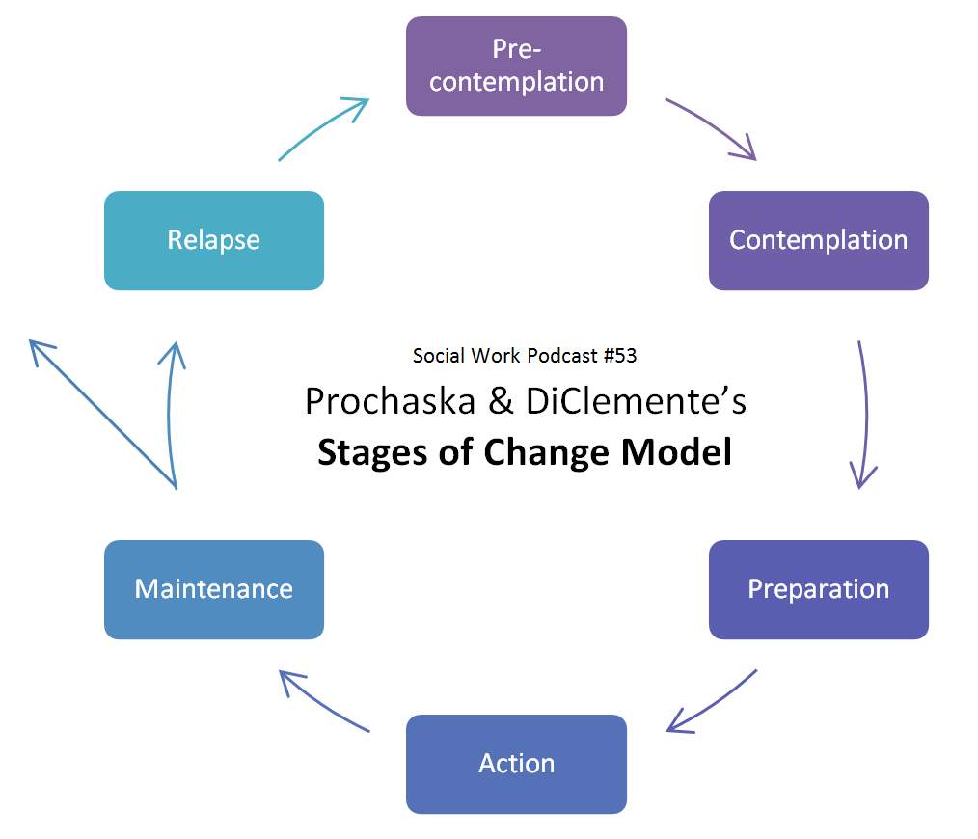

Slide 16
Women and Substance Abuse
Higher percentage of mental health problems.
Need for evening and weekend appointments.
Lack social supports.
Experience more negative influences from drug using romantic partners.
Are more likely to live in poverty.
Child Care.

Slide 17
Parental Substance Abuse
12 % of children are living in home with parent who is dependent on drugs and/or alcohol.
10% of infants are exposed prenatally; some estimates report rates as high as 30%.
Children with parents who abuse drugs and/or alcohol are at 2.7 greater risk of abuse and 4.2 greater risk of neglect.
(Child Welfare Gateway Information, 2015; National Drug Court Initiative, 2003)

Slide 18
Risk Factors in Families with SUD
Impaired Attachment
Economic Hardships
Supports
Legal Problems
Emotional Distress

Slide 19
Risk Factors
Poverty
Exposure to Violence
Exposure to Substance Abuse
Multiple Caregivers
Parental Mental Health
Caregiver Stress
Genetics

Slide 20
Exposure to Violence
60 – 70% of Domestic Violence cases are characterized by drug and alcohol abuse.
Domestic Violence increases stress reactivity.
(National Drug Court Initiative 2003)

Slide 21

Women/ SUD/ Complex Trauma
80 % of Women
Caregiver Betrayal
Maltreatment
Loss
Exposure to Violence
Trauma is linked to Emotional Attunement
This Photo by Unknown Author is licensed under CC BY-ND

Slide 22
Types of Trauma
Early Childhood Trauma
Domestic Violence
Traumatic Grief
Sexual Abuse/ Physical Abuse
Medical Trauma
Complex Trauma
Community Violence
Substance Use

Slide 23
Caregivers in Recovery
Disrupted Attachment
Parenting Stress
Less Rewarding
Low Self-Esteem/ Self Worth
Economic Pressure
Despair
Hopelessness

Slide 24
What Can this Mean for Babies and Children?
Disrupted attachment
Early life stressors
Increased risk for early adverse experience
Inconsistent parenting
Unpredictable routines
Multiple caregivers

Slide 25

The Developing Brain
Basic Physical Needs
Communication
Relationships
Stimulation

Slide 26
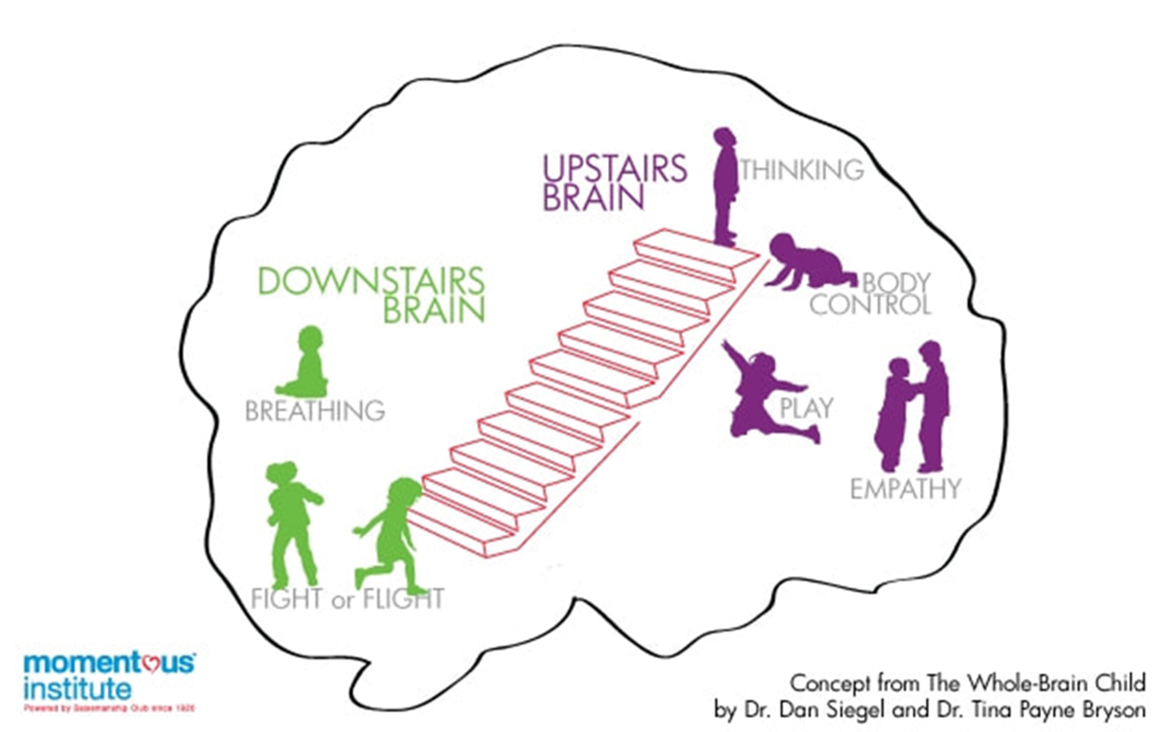

Slide 27
Fight - Flight- Freeze
Threats to an infant’s survival whether it is direct or to the caregiver system will result in activation of the fight – flight – freeze response. This response is associated with fear conditioning.

Slide 28
What Happens
Responding to cues can reduce fear and build resiliency.
Failure to extinguish fear response leads to stress reactivity. (Zeanah, 2009.)

Slide 29
Self Regulation
Self Regulation of Emotions under 3 years depends on:
Receiving external support from caregivers.
Developing internal skills in domains of memory and language.
Behaviors that can be used in emotional arousing situations.(Gross, 2008)

Slide 30
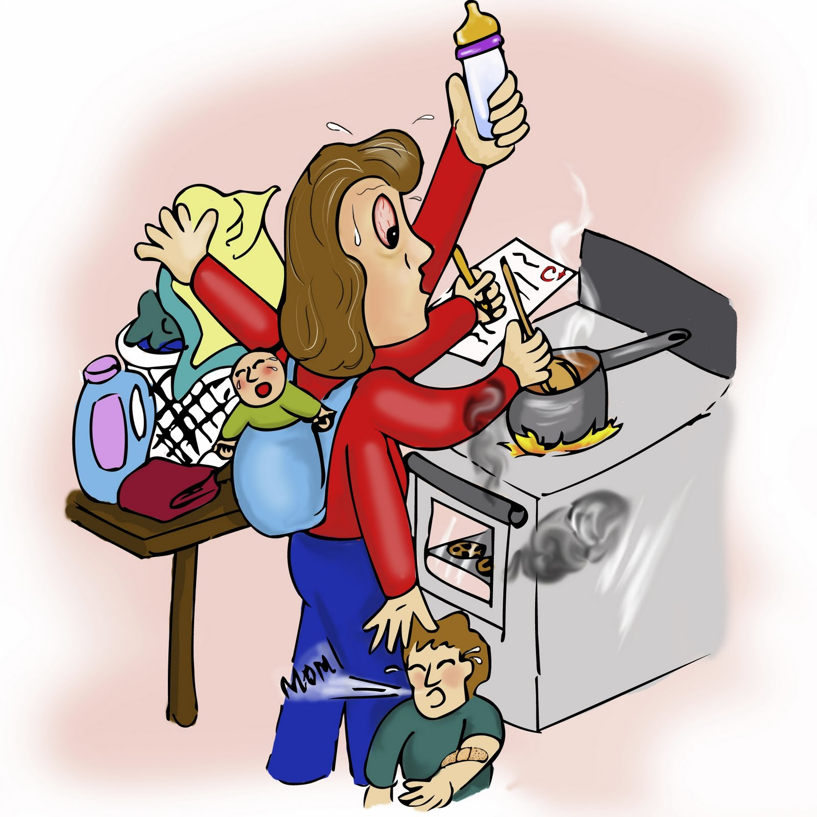
Increased risk based on caregiver/infant/early childhood stress levels.

Slide 31
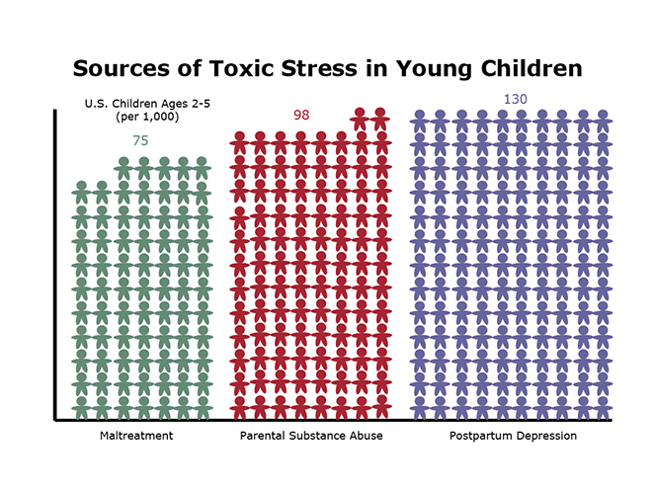
Modified from www.samhsa.gov 2002

Slide 32
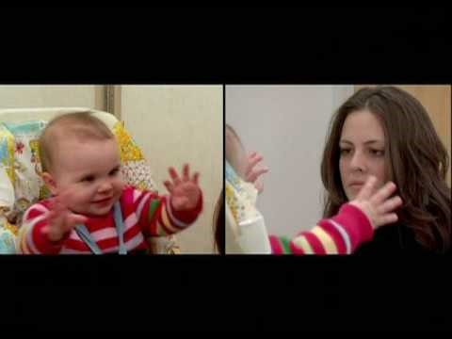

Slide 33
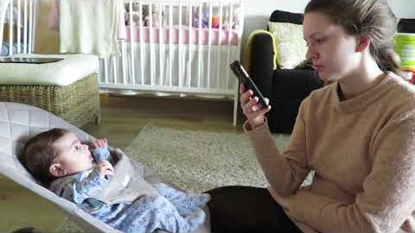

Slide 34

Reflect
What resonates with you?
What do you feel would be the best way to support the dyad?
How would you prepare yourself for the next visit?

Slide 35
How a Caregiver can Reduce Stress Levels
Keep routine
One on one time
Singing and rocking
Verbalize emotions
Limit media exposure to violence
Don’t leave the child with strangers
Utilize transition statements

Slide 36
How Providers Can Help
Identify what feelings your bring
Authentically engage
What does your body language say
Build a trusting relationship
Positive thoughts promote positive interaction
Reassure Confidentiality

Slide 37
Therapeutic Alliance
Refers to the relationship between a healthcare professional and a client (or patient). It is the means by which a therapist and a client hope to engage with each other, and effect beneficial change in the client.

Slide 38
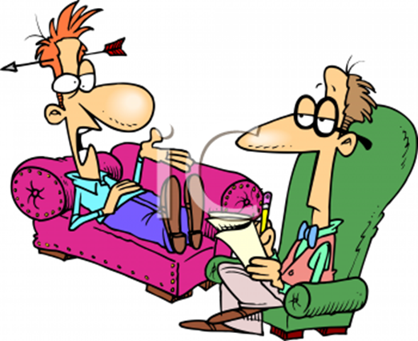
Engagement
Warm
Respectful
Openness
Guidance
Trust
Taking responsibility
Familiarity

Slide 39


Slide 40
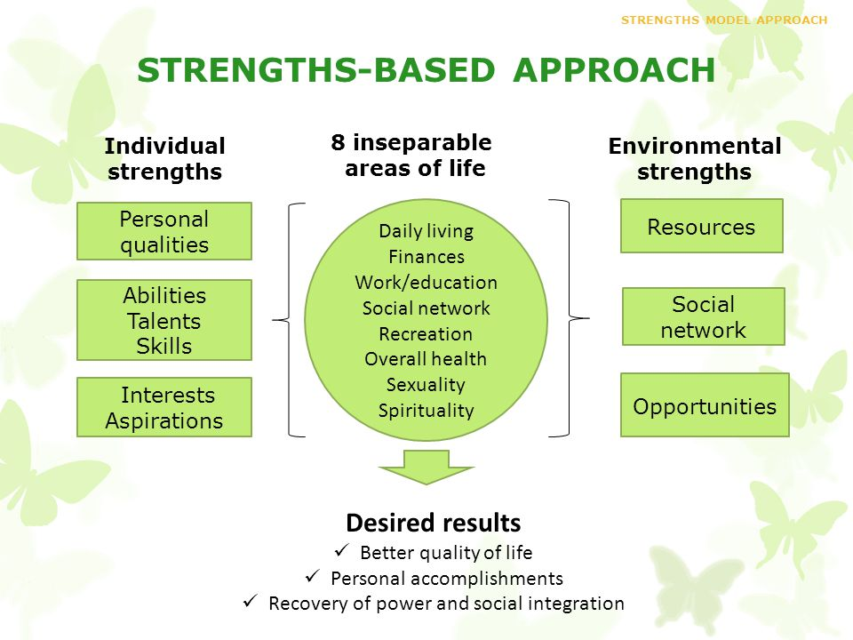

Slide 41
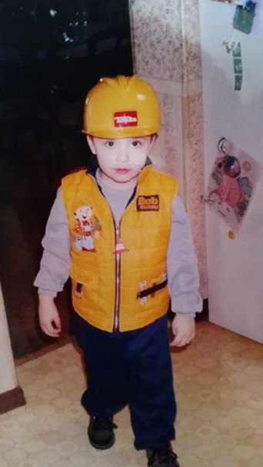
Explore and Build
Mother Sensitivity
Parenting Behaviors
Internal Working Model
Parenting from a Distance
Mend and Repair
Trusting Relationship

Slide 42
Teach Techniques
Provide parental support – Take time to listen
Teach social stimulation – Teach them to talk to their babies, swaddle, rock, sing, ect.
Secure caregiver/infant bonding – Allow and offer the caregiver to integrate into routine
Meet emotional needs – Identify emotions
Understand cues – If you see a parent struggling to respond verbalize cues
Provide comfort for distress – Support parents when distressed to support babies when distressed
Learn to tolerate ambivalence – Help parents understand the worry of unsure feelings in parenting

Slide 43
“I needed someone to love me when I could not love myself. This helped me love my baby more.”
Anonymous Mother

Slide 44
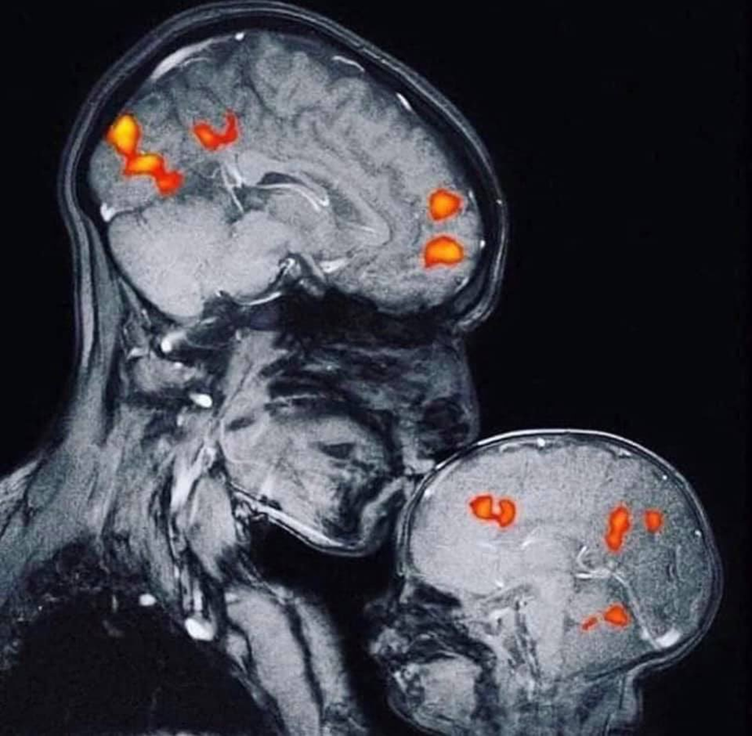

Slide 45
Protective Factors to Build Resiliency in Families
Concrete Resources;
Food
Housing
Transportation
Child Care
Employment

Slide 46
Protective Factors to Build Resiliency in Families
Strengthen The Support System;
Reduce Isolation
Help Identify Supports
Link to Schools and Community Activities
Encourage Family Connections
Encourage Support Groups

Slide 47
Protective Factors to Build Resiliency in Families
Emotional and Psychological Resilience of Caregiver;
Discuss Problem Behaviors
Discuss Benefits to Treatment
Remain Emotionally Available

Slide 48
Protective Factors to Build Resiliency in Families
Parenting Education, Tips, and Courses for Caregivers;
Provide resources on social emotional as well as physical development.
Provide access to parenting courses and techniques.
Positive Parenting Programs – information, advice, and professional support.

Slide 49
Protective Factors to Build Resiliency in Families
An Understanding of the Child’s Social Emotional and Cognitive Capacities;
Sensory Rich Experiences
Emotionally Attuned Experiences
Safe Environment

Slide 50
Building Resiliency Can Increase the Following
Trusting Adults
Motivation to learn
Initiate or invite play
Focus
Sitting still
Pro – Social Behaviors
Recognizing thoughts and feelings
Regulating emotion

Slide 51

Reflect
What is one skill I learned today?
What will I change when working with pregnant women struggling with SUD?

Slide 52
“It is easier to build strong children than to repair broken men.”
Frederick Douglas

Slide 53

Questions

Slide 54
Resources
Webster-Stratton, Carolyn. (2011). Incredible Babies. Washington: Incredible years Inc.
Zeanah, Charles. (2009). Handbook of Infant Mental Health Third Edition. The Guilford Press.
Gross, Dana. (2008). Infancy, Development from birth to 3. Pearson Education, Inc.
Dawe, Harret, Hans. (2007). Journal of Substance Abuse Treatment. 32, 381-390.
Child Welfare Gateway Information, 2015; National Drug Court Initiative, 2003

Slide 55
Resources
Greenfield, S.F, Brooks, A.J., Gordon, S.M., Green, C.A., Kropp, F., McHigh, R.K., Lincoln, M., Hein, D., & Miele, G.M. (2007). Substance abuse treatment entry, retention, and outcome in women. A review of literature. Drug & Alcohol Dependence, 86, 1-21.
https://www.zerotothree.org/
U.S. Department of Health and Human Services Substance Abuse and Mental Health Services Administration Office of Policy, Planning, and Innovation. (2012). HHS Publication No. SMA (12-4726).
Lander, Laura, Howsare, Janie, and Byrne, Marilyn. The Impact of Substance Use Disorders on Families and Children: From Theory to Practice. Social Work in Public Health.
Cohen, LR. (2006). Treatment Outcomes for Women With Substance Abuse and PTSD- NCBI.
The National Institute on Drug Abuse
World Health Organization

