Slide 1

PREGNANCY, SUBSTANCE USE AND STIGMA
HARM REDUCTION COALITION

Slide 2

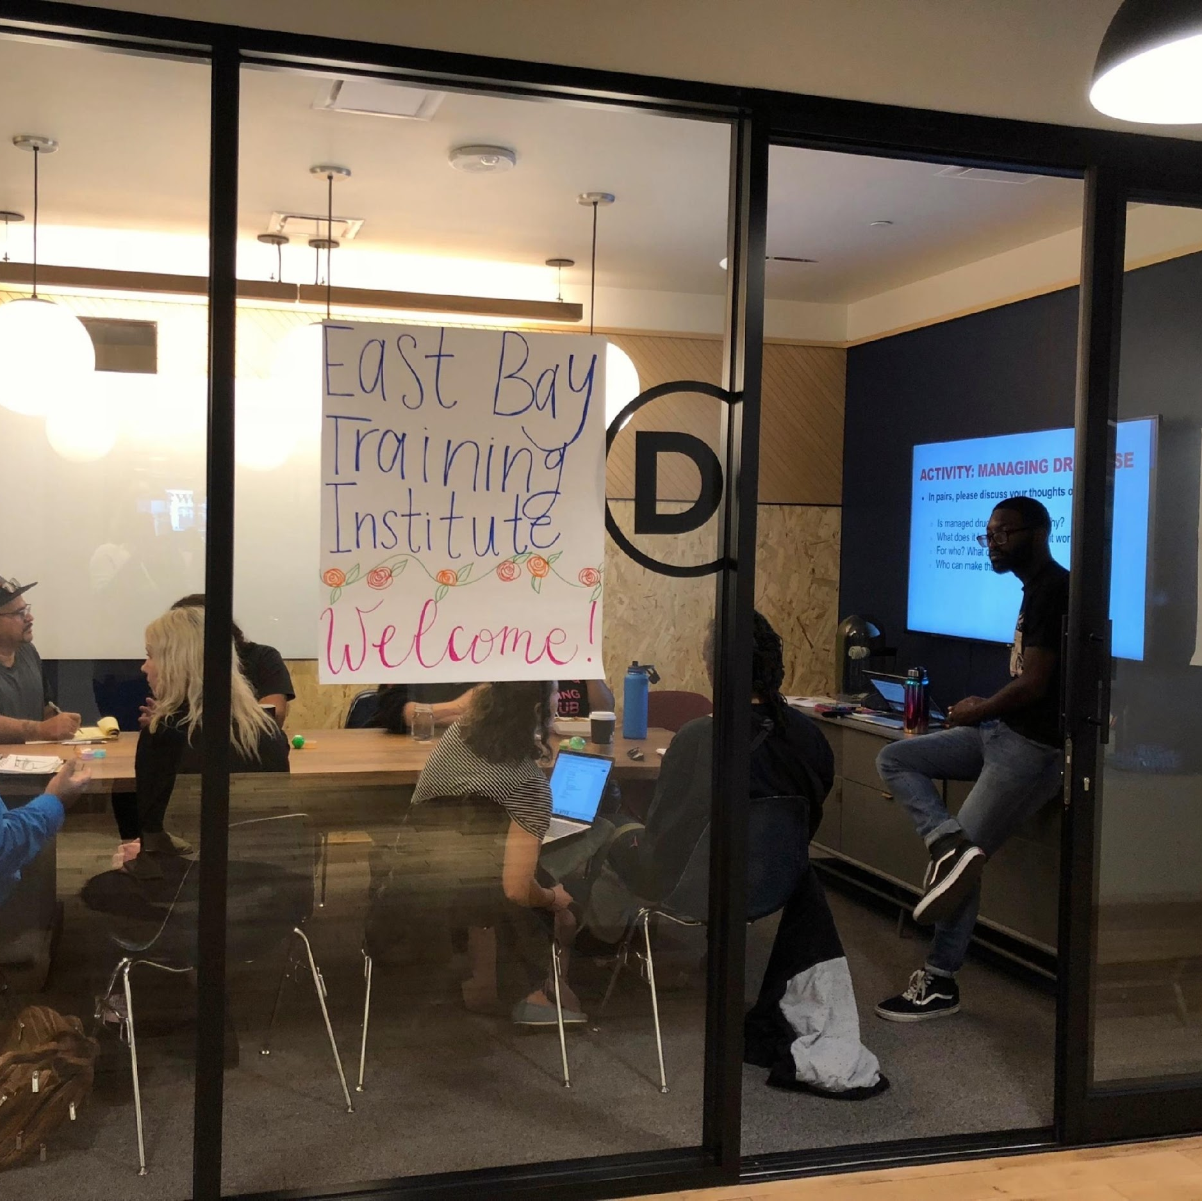
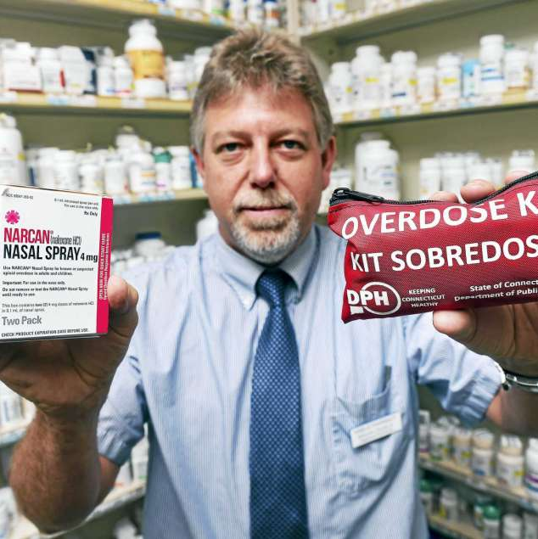

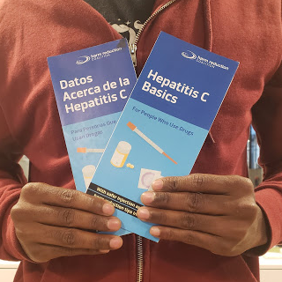
Harm Reduction Coalition
Policy &
Advocacy
Trainings &
Technical Assistance
Overdose
Prevention
National & Regional
Conferences
Resources &
Publications
Notes:
Quickly run through Functions, Transition to Conference Slide

Slide 3
ZOOM HOUSEKEEPING
Please turn your camera on if possible, and mute your mic unless you are speaking.
Add your name and email in the chat box so we can know who is joining us!
Add your Pronouns to your name.
Click the “Chat” menu so you can comment and see people's responses to questions
Use “Reaction” functions to let us know how you are feeling!
We are going to take a couple breaks, but feel free to take care of yourself
Tech issues happen, let’s just roll with them!

Slide 4
PURPOSE
To provide a foundational understanding of harm reduction and the ways that we internalize and perpetuate stigma towards pregnant people who use drugs.
The goal of this training is to enhance the ability of doulas and other support people to serve people who use drugs.

Slide 5
AGENDA
Workshop Overview
Harm Reduction Philosophy
Pregnancy and Substance Use
Stigma
Case Studies
Notes:
Explain Flow of Training in narrative form

Slide 6
GLOSSARY
PWID People Who Inject Drugs
PWUD People Who Use Drugs
PLWHA People Living with HIV/AIDS
STI Sexually Transmitted Infection
SAS Syringe Access Services
SSP Syringe Services Programs
NEX Needle Exchange

Slide 7
Sexual Orientation
To whom we are sexually attracted
Gender Identity
Sense of self as a man, woman, non-binary, without a gender, or as a combination of genders
Gender Expression
An individual’s physical characteristics, behaviors, and presentation that are commonly linked to femininity, masculinity, or androgyny.
GP
Gender Pronoun
Notes:
KEY MESSAGES
Sexual Orientation: To whom we are sexually attracted: An individual's physical and/or emotional attraction to the same and/or other gender(s).
Gender Identity: Sense of self as male or female, neither or both; ; A person's innate, deeply felt psychological identification as a man, woman, combination of both or some other gender which may or may not correspond to the sex assigned to them at birth.
Gender Pronoun: How we address someone in place of that person’s name (he, him, she, hers, they, their, them)
Gender Expression: An individual’s physical characteristics, behaviors, and presentation that are commonly linked to femininity, masculinity, or androgyny.
Examples:
My sexual orientation is Gay, my gender identity is Male, my gender pronoun is he, his, they
My sexual orientation is Bisexual, my gender identity is Trans Female my gender pronoun is she, her, theirs
NOTES
To learn more about current LGBTQ terminology, cultural competency and creating an accessible environment, visit www.gayalliance.org and SafeZone Programs.
LGBTQ: Lesbian, Gay, Bisexual, Transgender, Queer, Questioning
TGNC: Transgender or Gender Non-Conforming
Integrate staff training on LGBTQ health, rights, and vocabulary with the SSP team.
‹#›

Slide 8
GROUP AGREEMENTS
Step Up, Step Back
Use “I” Statements
WAIST (Why Am I Still Talking)
Vegas Rule
Say It Ugly!
Notes:
Walk through each one, asking participants to explain/give examples

Slide 9
WHY DO PEOPLE USE DRUGS?
Notes:
Group discussion - Write on whiteboard or chart paper, being sure to group things and draw connections between why people use illicit and licit drugs (this would include drugs like cannabis, party drugs, street drugs, caffeine, and alcohol)

Slide 10
WHY DON’T PEOPLE JUST STOP USING DRUGS?
Notes:
Group discussion - Write on whiteboard or chart paper, being sure to group things and draw connections between why people don’t just stop using illicit and licit drugs (this would include drugs like cannabis, party drugs, street drugs, caffeine, and alcohol)

Slide 11
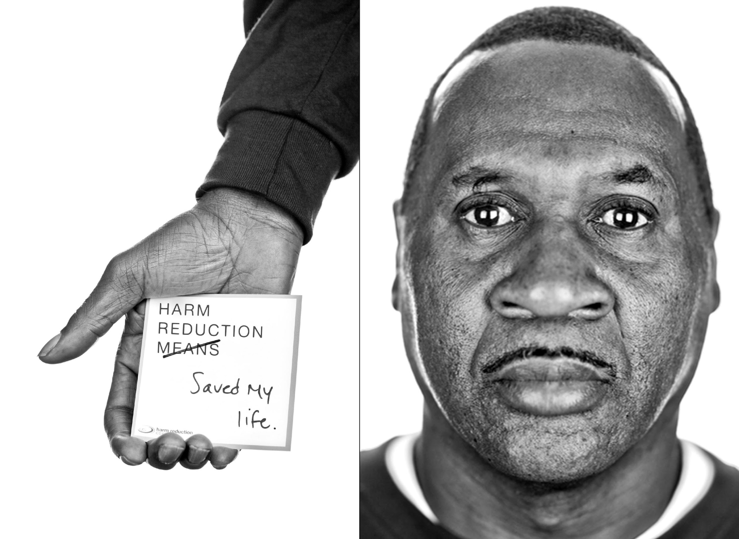
HARM REDUCTION…
A philosophical and political movement focused on shifting power and resources to people most vulnerable to structural violence
Incorporates a spectrum of strategies including safer drug use strategies, managed use, and abstinence.
Meets people “where they're at” but doesn't leave them there.
Notes:
Tanagra

Slide 12
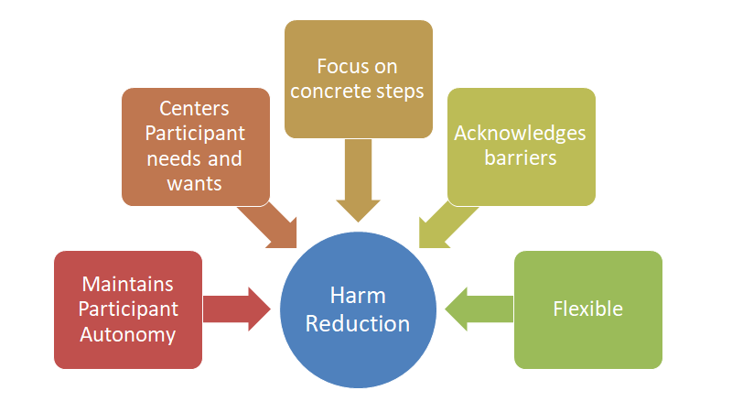

Slide 13
UNDERSTANDING CULTURES AND CONTEXTS
One size does NOT fit all
Consider Accessibility
Go beyond curiosity!
Capture their lived experience
Notes:
‹#›
solutions and understandings of youth drug use cannot be simply reduced to ‘curiosity’
Outreach often needs to be scaled up and adapting to the needs of young people –utilizing their social networks
Often time young people don’t identify with older users or feel stigmatized when they access existing harm reduction services - Development of youth spaces and youth led programming is ESSENTIAL
we need to look deeper than “availability and curiousity” replicating a certain program without a cultural analysis may not work – also this makes the case for youth engagement

Slide 14
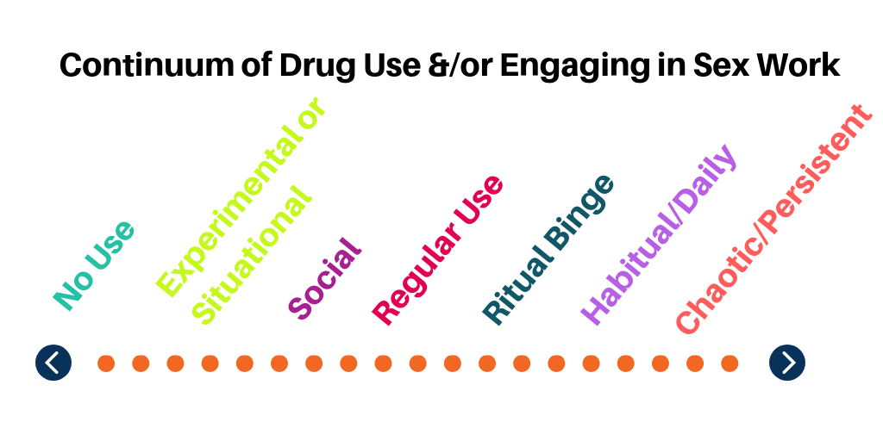

Slide 15











Harm Reduction Services
Syringe
Access
Syringe
Disposal
Safer Drug Use
Naloxone
Medication Assisted Treatment
Supervised Consumption Services
Drop-In Centers
Housing
First
Pharmacy Access
Referrals

Slide 16
PREGNANCY AND SUBSTANCE USE

Slide 17
CANNABIS
WHAT DO YOU KNOW ABOUT PREGNANCY AND SUBSTANCE USE?
WHAT DO YOU SEE IN YOUR WORK?
ALCOHOL
ALCOHOL
TOBACCO
OPIOIDS
METH
COCAINE/CRACK
Notes:
Ask the group what stigma is

Slide 18
FIRST THING’S FIRST:
MOST OF OUR DRUG EDUCATION IS WRONG
Notes:
Ask the group what stigma is

Slide 19
ALCOHOL
Increases risk of:
  Miscarriage or still-birth
  Fetal Alcohol Spectrum Disorder (FASD)
    Organ defects ■ Smaller head size
    Intellectual limitations ■ Low birth weight
    Temporarily abnormal facial features
IMPACT ON BREAST/CHEST FEEDING:
Passes into milk
When you sober up, so does your milk
HARM REDUCTION TECHNIQUES:
Talk about alcohol related goals during pregnancy
Pump before drinking
Notes:
Drinking alcohol while pregnant increases the chance of miscarriage or stillbirth. Pregnant people who drink a lot of alcohol during pregnancy are at higher risk of having a baby with symptoms of Fetal Alcohol Spectrum Disorder (FASD). No one knows exactly how much alcohol is safe to drink during pregnancy and it is probably different for each person. Not every person who uses alcohol during pregnancy will give birth to a child with symptoms of Fetal Alcohol Spectrum Disorder. Some of the permanent effects of FASD include organ defects, limitations in thinking, reasoning, and learning. In addition, there are physical effects such as low birth weight, smaller head size, and temporary abnormal facial features, which fade away by adolescence.
Alcohol passes into human milk and is absorbed by babies. If you have plans that may include alcohol consumption, pump and store enough milk beforehand to feed the baby while intoxicated, or plan to use formula. While intoxicated, if your breasts become painful or engorged, pump or hand express enough milk to relieve the pressure. Then discard it. You do not need to fully empty, because the body continually filters alcohol out of milk, just like it does with blood, so when you sober up, the milk does too. Recommendations for the time it takes for your milk to be safe for the baby range from 2-4 hours per drink. If you are only going to have one standard drink, it is ok to feed the baby, have a drink, wait a few hours, and feed baby again without doing anything special. If you still feel drunk or hungover, even if the recommended time has passed, wait until you feel better before providing milk to the baby. If you want to be 100% sure, alcohol test strips for breast milk are available in drugstores.

Slide 20
Benzodiazepines
Potential increased risk of:
  Cleft lip or palate
  Lower birth weight
Newborns have shown withdrawal signs after birth
Could increase severity of NAS
IMPACT ON BREAST/CHEST FEEDING:
Babies exposed can show signs of sedation
HARM REDUCTION TECHNIQUES:
Do not quit cold turkey!
Address underlying needs
Skin-to-Skin contact is important for easing withdrawal
WHAT IS HARM REDUCTION?
Notes:
Benzodiazepines might slightly increase the risk of having a baby with cleft lip or palate, but there is no link to other birth defects. Some studies found an increased risk of lower birth weight, and other studies did not. Possible lower birth weights among people who take these medications could be related to sleep deprivation, and not the drugs at all, because many people take benzodiazepines for sleep problems. Newborns exposed during pregnancy have shown withdrawal signs after they are born. Long term outcomes are thought to be similar to other children in the same peer group.

Slide 21
CANNABIS
Some evidence :
  cannabis users had higher rates of preterm birth than nonusers (12.0% compared to 6.1%)
No Evidence of:
  Link to stillbirth, preterm labor, significantly low birth weight, birth defects, cancer, or feeding problems
IMPACT ON BREAST/CHEST FEEDING:
Roughly 1% passes into human milk
Likely to be only partially absorbed in the infant’s stomach
No good data about cannabis exposure via human milk
HARM REDUCTION TECHNIQUES:
Safest method is to stop recreational use
Next: to continue using while breast- /chestfeeding
Least: Using and formula feed.

Slide 22
COCAINE/CRACK
Evidence of:
  Decreased blood flow to placenta
  Link to premature rupture of membranes (PPROM)
Some evidence of:
  Link to placental abruption
No evidence of:
  Withdrawal after prenatal exposure
  Link to placental insufficiency
IMPACT ON BREAST/CHEST FEEDING:
Can decrease amount of milk produced or longevity of supply
Safe for consumption 24 hours after cocaine use
HARM REDUCTION TECHNIQUES:
Lots of sleep
Eating before using
Notes:
Stimulants may cause less blood flow to the placenta. There is currently no direct link between stimulant use and placental insufficiency (lack of a good supply of nutrients and oxygen delivered to baby through the placenta). Placental abruption (the separation of the placenta from the uterine wall) has not been linked to methamphetamine or caffeine, but there is some evidence linking it to cocaine. Stimulants can be linked premature rupture of membranes (PPROM). PPROM occurs when the sac that contains the amniotic fluid breaks before 37 weeks of pregnancy. Tell your healthcare provider right away if you think your water might be leaking. There is no evidence of stimulant withdrawal in infants with prenatal exposure. Long term outcomes are similar to other children in the same peer group.

Slide 23
OPIOIDS
Not associated with any birth defects
May change gestational parent’s tolerance
Newborns have shown withdrawal signs after birth
IMPACT ON BREAST/CHEST FEEDING:
Safe to consume if utilizing MOUD
Makes baby’s withdrawal less severe
HARM REDUCTION TECHNIQUES:
Don’t quit cold turkey!
Keep Narcan readily available and use it if needed
Notes:
During pregnancy, the body goes through changes that can make drugs work differently. This means drugs may hit harder or less hard than they used to. For many pregnant people, the methadone dose will need to be adjusted if you experience withdrawal symptoms or oversedation. Report any withdrawal, cravings, or changes in sleep patterns. Opioid use in pregnancy is not associated with birth defects. Some studies find normal birth weights, and some find weights in the lower end of normal. Long term outcomes are similar to other children in the same peer group.
It is safe to breastfeed on opioids. In fact, it can actually make baby’s withdrawal less severe. We are not sure whether this is related to the opioids passed into human milk, or the fact that baby feels better and closer to you while breastfeeding, or both! (7) With heroin, it is best not to breastfeed, since we can’t know the exact dose and there may be cut that isn’t safe. It’s not the heroin itself, but the other factors that makes safety an unknown. When we study other opioids like methadone, we find that only about 2% of the total dose makes it into human milk. This is usually not enough to treat the baby’s withdrawal symptoms, but might help a little.

Slide 24
STIGMA

Slide 25
STIGMA: A social process which can reinforce relations of power and control.
Leads to status loss and discrimination for the stigmatized.
Link and Phelan
Conceptualizing Stigma, 2001

Slide 26
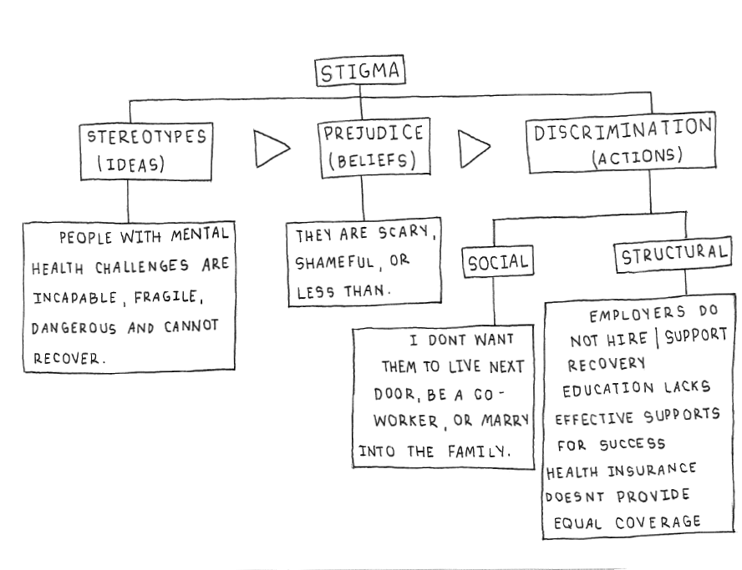
WHAT IS STIGMA?
Image Credit: wisewisconsin.org/blog/what-is-stigma/
Notes:
Process of stigma involves severe social disapproval of a person’s characteristics or their beliefs which are considered to be unacceptable to dominant cultural norms. The outcomes are the result of a series of diminishing returns that keeps people on the outside
PWUD are among the most marginalized & invisible people in society. They’re socially stigmatized & criminalized population. Blame and moral judgment: ‘just say no;’ your own fault for getting HIV/HCV; lacking willpower; you’re selfish and don’t care about anyone but yourself. We stereotype and criminalize drug users. We pathologize drug users—something is wrong with them. Our most popular solution is “tough love.”
Fear and isolation: drug users are ‘scary;’ fear-based public education campaigns; people are afraid to talk about drug use, HIV/HCV; people become isolated, hide their behavior, or aren’t honest with their support circle (family, friends, doctor, counselor, etc.).
The cycle of drug-related stigma reinforces stereotypes & labels; which in turn reinforces stigma, which sets expectations about roles. These expectations lead to limited opportunities based on what people think a drug user is capable of doing, which in turn leads to internalized/reinforced expectations. Each step of the way power is taken away.

Slide 27
HOW DO PREGNANT PEOPLE WHO USE DRUGS FACE STIGMA?
Notes:
Break into four groups
Stigma from individuals
Self-Stigma (internalized)
Stigma through association
Institutional Stigma
Have each group brainstorm how each form of stigma functions and what it looks like

Slide 28
HOW DO PRIVILEGE AND OPPRESSION IMPACT EXPERIENCES OF STIGMA?

Slide 29
CASE STUDY

Slide 30
CASE STUDY
GY has placenta previa. She had been using heroin throughout her early pregnancy but stopped after joining a methadone program. Shortly after getting stable at the program, she moved back in with the father of the baby to try to make things work. Getting to the methadone clinic from her partner’s place was a little bit difficult and she stopped attending and started using heroin again. After a split from her partner, things got a little chaotic and she decides to go to a detox facility for assistance. While there she has some unexpected bleeding and is immediately transferred to a hospital for an evaluation for a cesarean birth. You meet them the day before their birth where they inform you they might be interested in buprenorphine or returning to a methadone program and will do anything they can to keep their baby. They previously had a child taken by ACS and expresses not knowing how they would cope if this baby is taken.

Slide 31

Thank you for participating in this workshop!
training@harmreduction.org

