Slide 1

Communities of Practice
Self Care: Secondary Trauma
May 5, 2020
“The expectation that we can be immersed in suffering and loss daily and not be touched by it is as unrealistic as expecting to be able to walk through water without getting wet.” -Dr. Rachel Remen
Notes:
Voiceover: Developed through a partnership with IMPACT WV and the WV Home Visiting Program to help participants exchange technical information and share experiences about a variety of topics related to serving clients currently experiencing or who have past experiences with substance use

Slide 2

Role of Impact WV
Use the Communities of Practice structure to:
  Focus on areas that directly impact home visiting providers, other service providers, and families
  Examine needs and services specifically for children diagnosed with Neonatal Abstinence Syndrome (NAS) Defined or exposed to substances in utero and their families

Slide 3

Role of WV HVP
Use the Communities of Practice structure to:
  Encourage home visitors to engage in self-reflection and strengths-based practices for supporting families exposed to substances
  Develop additional supports and resources specifically for children diagnosed with Neonatal Abstinence Syndrome (NAS) Defined or exposed to substances in utero and their families

Slide 4

Getting the most out of this Meeting
Prior to the meeting review: How Do I Join A Zoom Meeting
While in the Meeting:
  Be sure to mute your line if you are not talking
  Use your video if you can – its more personable for us as a team to work together
  Widen the screen or zoom in to see more
  Participants – know who is part of the team and on the call
  Chat – ask a question or make a note during a discussion
  Polling – the facilitator may use this to get your thoughts outside of the discussion

Slide 5
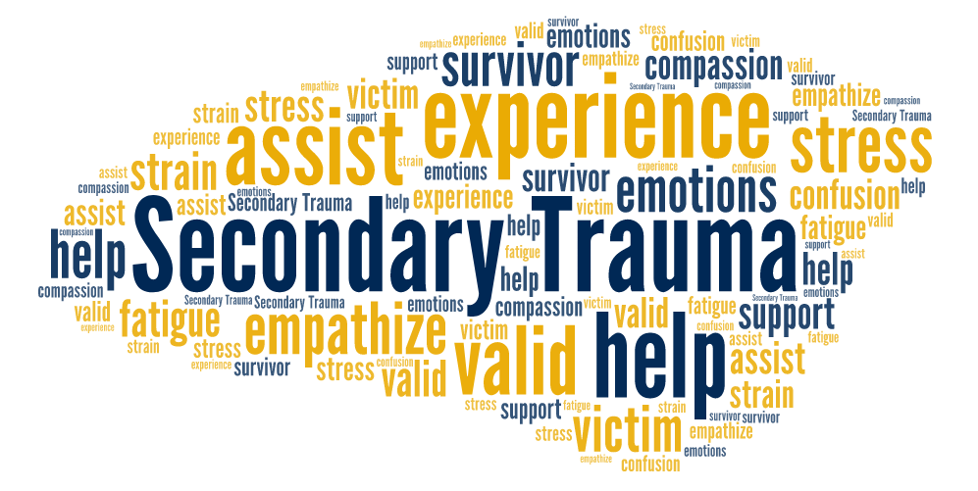

Slide 6

What will I learn today?
By the end of this session, each of you will be able to…
Compare and contrast burnout, secondary trauma, and compassion fatigue;
Share, discuss, and apply shared experiences regarding work with Moms and Babies with NAS and what approaches have been successful for dealing with secondary trauma in the literature and within our team; and
Identify, discuss, and practice ways to deal with secondary trauma when working with Moms and Babies with NAS

Slide 7

Subject Matter Expert
Michelle Romanek, CQI Consultant for the WVHVP, has 12 years of experience in home visitation. She has worked as a MIHOW home visitor and as a member of the state leadership team. During the completion of her Masters degree in Social Impact at Claremont Lincoln University, her research and CAPstone project led to a workshop titled Amplify Empathy: A Tool for Building Better Relationships aimed toward social service providers. Her passions include promoting mindfulness, dialogue, collaboration, and empathy for building social worlds.

Slide 8
Compare and Contrast
Secondary Trauma, Burnout, and
Compassion Fatigue

Slide 9
Burnout is a distinct construct that includes “a prolonged response to chronic emotional and interpersonal stressors on the job” and is typically identified within “the three dimensions of exhaustion, cynicism, and sense of inefficacy”.
Secondary traumatic stress presents as a cluster of symptoms nearly identical to PTSD, which results from the stress of working with or intimately knowing somebody who has been traumatized or is suffering.
Compassion fatigue is often referred to as the formal caregiver’s reduced capacity or interest in being empathic or bearing the suffering of clients, and is the natural consequence of behaviors and emotions resulting from knowing about a traumatizing event experienced or suffered by a person and consists of two parts: burnout and secondary trauma.

Slide 10
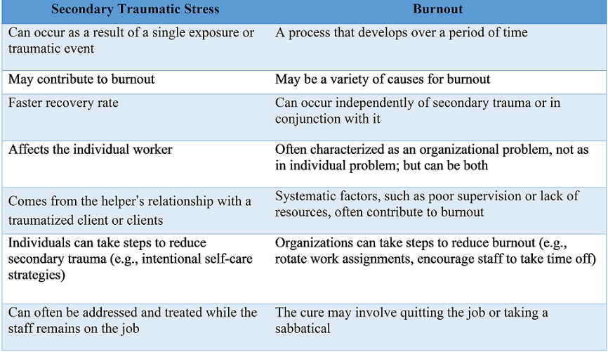
Notes:
Burnout occurs in organizations typified by high demands and low personal rewards, and it is the increased workload and institutional stress, (not trauma), that serve as the precipitating factors

Slide 11
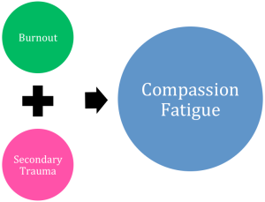
Compassion Fatigue involves both Secondary Trauma and Burnout
https://www.aginglifecarejournal.org/addressing-secondary-trauma-and-compassion-fatigue-in-work-with-older-veterans-an-ethical-imperative/

Slide 12

Case studies
Case Study #1
Home visitor is working with a pregnant mother and her 2 children (ages 2 and 5). Mom has a history of substance use and had tested positive for illegal substances during her pregnancy. Child protective services are involved with the family. Mother was not compliant with physicians request for Medication Assisted Treatment and upon birth of the infant, the infant was placed with the mother’s grandparents. The other two children were placed with the their father’s grandparents(different fathers then the infant). There is some interaction with the father of the 2 and 5 year old. The grandparents are overwhelmed and requested the home visitor to continue services with the children in their home. The home visitor is feeling torn between trying to support the mom and infant (in one home) and the two children (in a separate setting). This is the 8th family in a caseload of 16 that substance use is the primary risk factor. She’s feeling like this was not how she envisioned home visiting when she initially started and feels like substance use is not only taking over her work world, but her community as a whole.
Case Study #2
Home visitor has a background in early childhood (worked in a day care previously). She is very positive and loves the idea of working with families in their home. As her caseload expands, more families are considered high risk and the number of screenings and referrals to be made is much higher then she had expected. One family in particular is very high risk and has several ACEs related to abuse, family history of substance use, and intimate partner violence. The mother reminds her of herself in many ways and find it very challenging to do some of the screenings and discuss the topic areas without feeling very emotional. She didn’t realize how having some of the discussions would bring up hidden emotions within herself. She doesn’t want to share with supervisor but is feeling so stressed and emotionally drained, she begins cancelling the visits and rethinking her choice to work with families. She ends each day feeling drained and simply does not enjoy the initial passion she had.

Slide 13

Case study reflection
What resonates with you?
What do you feel would be the best way to support the family?
How could you practice dealing with secondary trauma during this scenario?
How would you prepare yourself for the next visit?

Slide 14

Resource share
Secondary traumatic stress (STS) is now viewed by many as an occupational health hazard of working with traumatized populations.
When measured with the Secondary Traumatic Stress Scale (STSS) criteria for PTSD-like symptoms due to the indirect exposure to traumatic events through clinical work with traumatized populations were met by:
20.8% of providers treating family or sexual violence
34% of child protection workers
39% of juvenile justice education workers

Slide 15
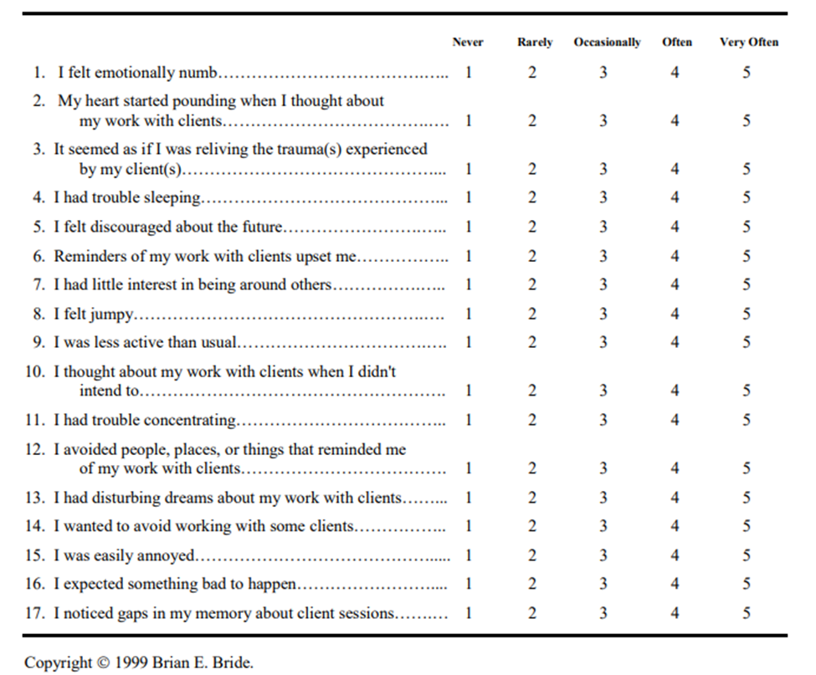
STSS
https://www.naadac.org/assets/2416/sharon_foley_ac15_militarycultureho2.pdf
This is a list of statements made by persons who have been impacted by their work with traumatized clients. Read each statement then indicate how frequently the statement was true for you in the past seven (7) days by circling the corresponding number next to the statement.
The 17 items are organized in three subscales: intrusion, avoidance, and arousal. The STSS total score is calculated by summing up the item scores, with a higher score indicating a higher frequency of symptoms.
A total score below 28 corresponds to “little or no STS,” a score between 28 and 37 means “mild STS,” between 38 and 43 “moderate STS,” between 44 and 48 “high STS,” and beyond 49 “severe STS”.

Slide 16
Resource share
Risk Factors
Young worker with less experience
Helping professionals who experienced childhood trauma
A combination of secondary trauma, burnout, and compassion fatigue is one of the primary reasons why many helping professionals leave the field.

Slide 17
Resource share
By the same token, secondary trauma and compassion fatigue can impact case outcomes.
Specifically, compassion fatigue is believed to impair the ability of professionals to effectively help those seeking their services.
Professionals experiencing compassion fatigue are potentially at higher risk of making poor professional judgments such as misdiagnosis, abuse of clients, or poor treatment planning than those not experiencing vicarious traumatization.

Slide 18
Resource share
The process of secondary trauma recovery mirrors this process and is referred to as trauma integration.
In order to integrate the experience, or make sense of the situation, it’s important to:
manage your emotions and not be emotionally overwhelmed by the information;
be aware of body and emotional reactions to trauma;
keep yourself open and not shut down to protect yourself;
connect to your support systems; and
identify some transformational meaning associated with the trauma.
How can this event be understood from a big picture perspective? Why did this happen to you at this point?
This manner of processing and self-reflection helps us to re-encode and reshape our memory so that we gain control over the traumatic memory and establish a new meaning (what we learned versus what was done to us).

Slide 19
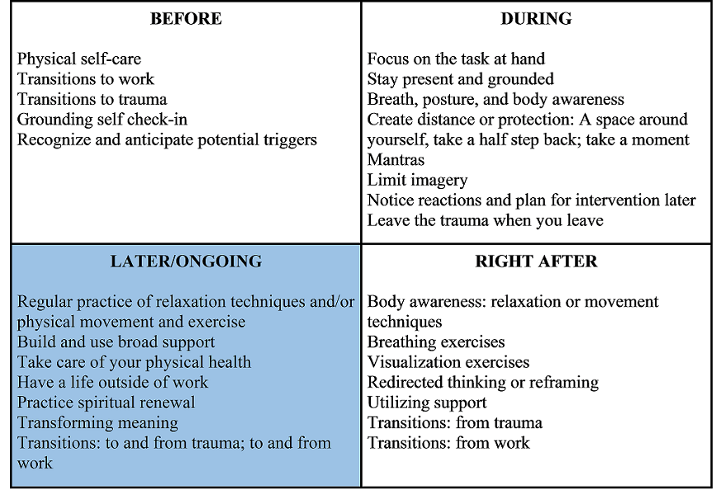
Resource share

Slide 20
Resource share
As part of transitioning to work or to a traumatic exposure event, it is also helpful to conduct a self “check-in” in order to ground yourself and focus on the task at hand.
In order to adapt this framework for self check-ins, you ask yourself the following three questions:
How am I feeling today?
What is my goal for today/for this interaction?
Who can help me with this?
The outcomes of this deliberate and repetitive transition ritual are increased awareness of feelings, improved ability to focus on the future rather than dwell on the past, and a stronger sense of community and support.

Slide 21
Resource share
In that moment, it is important for the professional to focus on the task at hand, stay present and grounded, and be aware of their physical responses such as breathing, posture, and body awareness.
In order to minimize the body’s chemical reaction in-exposure (e.g., cortisol dump), helping professionals can create distance or protection by taking a half step back or facing their palms forward in what is commonly referred to as a non-defensive stance.
This subtle change sends a signal to the brain that you are safe and can immediate halt the fight, flight, or freeze reaction that may have been initiated due to a perceived threat.

Slide 22
Resource share
Immediately after exposure to a traumatic event or traumatic material, while still at work, is another important time (quadrant) to employ intentional self-care strategies in order to successfully process the recent exposure.
Positive self-care strategies include:
body awareness, relaxation, movement techniques (e.g., simply go for a walk);
breathing exercises (focus on breathing fully from your belly);
visualization exercises (particularly those related to letting go of images;
transitions to and from the trauma);
redirected thinking or reframing.
Even something as simple as drinking water can help to dilute the effect that the in-exposure chemical dump may have on your mind and body.

Slide 23
Resource share
Support in the workplace may include:
supervision with your assigned supervisor,
supervision with a colleague,
collaborative supervision,
less formal debriefing,
learning circles,
case reviews.
The three key words that are most important for a colleague or supervisor to facilitate recovery from STS are: listen, listen, and listen.

Slide 24
Resource share
Following these four rules will help you to successfully integrate your traumatic memory into one that you have top-down control over, and also avoid contagion and “burning out” your support system:
1. Ask for permission: this will allow your colleague (or loved one) to plan, prepare, and have input regarding what happens next.
2. Avoid bombardment.
3. Focus on your reaction to the traumatic material, versus the actual material itself.
4. Use a structured self-reflection framework (e.g., what went well, what did not go well, what I would do differently next time).

Slide 25
Resource share
Self-care strategies that can be implemented later (outside of work) and in an ongoing fashion are typically the most commonly described self-care activities:
regular practice of relaxation techniques (e.g., meditation) and/or physical movement and exercise;
building and using broad support;
taking care of your physical health (e.g., healthy eating, sleeping);
having a life (and friends) outside of work;
practicing spiritual renewal;
focusing on the positive ways you have been impacted by your work, by creating transformational meaning and identifying vicarious resilience.

Slide 26
Resource share
Resources:
https://www.nctsn.org/trauma-informed-care/secondary-traumatic-stress
http://www.academyofneonatalnursing.org/NNT/CompassionFatigue.pdf
http://www.figleyinstitute.com/documents/Workbook_AMEDD_SanAntonio_2012July20_RevAugust2013.pdf

Slide 27
Resource share
What does the literature say?
Do you have experience with this?
Have you tried a similar approach?
Does it work?
What would you do differently?
How do you think families would respond to this?

Slide 28

What is one skill
I learned today?
How can I share this skill with a peer or a family with a baby diagnosed with NAS or exposed to substances in utero?

Slide 29
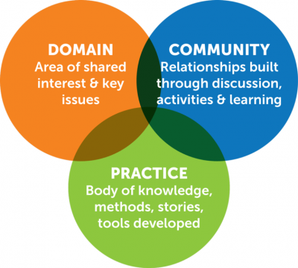
Next Communities of Practice Meetings
  New topic series starts discussing STIGMA!
June 2nd @ 3 pm
July 7th @ 3 pm
August 4th @ 3 pm

Slide 30
Acknowledgements
This Appalachian Rural Health Integration Model (AHRIM) Program is supported by the Health Resources and Services Administration (HRSA) of the U.S. Department of Health and Human Services (HHS) as part of an award totaling $600,000 with 0 percentage financed with nongovernmental sources.
The contents are those of the author(s) and do not necessarily represent the official views of, nor an endorsement, by HRSA, HHS or the U.S. Government.

