Slide 1

Communities of Practice
Self Care: Resiliency
April 7, 2020
“The secret of health for both mind and body is not to mourn for the past, worry about the future, or anticipate troubles, but to live in the present moment wisely and earnestly.”
-Buddha
Notes:
Voiceover: Developed through a partnership with IMPACT WV and the WV Home Visiting Program to help participants exchange technical information and share experiences about a variety of topics related to serving clients currently experiencing or who have past experiences with substance use

Slide 2

Role of Impact WV
Use the Communities of Practice structure to:
  Focus on areas that directly impact home visiting providers, other service providers, and families
  Examine needs and services specifically for children diagnosed with Neonatal Abstinence Syndrome (NAS) Defined or exposed to substances in utero and their families

Slide 3

Role of WV HVP
Use the Communities of Practice structure to:
  Encourage home visitors to engage in self-reflection and strengths-based practices for supporting families exposed to substances
  Develop additional supports and resources specifically for children diagnosed with Neonatal Abstinence Syndrome (NAS) Defined or exposed to substances in utero and their families

Slide 4

Getting the most out of this Meeting
Prior to the meeting review: How Do I Join A Zoom Meeting
While in the Meeting:
  Be sure to mute your line if you are not talking
  Use your video if you can – its more personable for us as a team to work together
  Widen the screen or zoom in to see more
  Participants – know who is part of the team and on the call
  Chat – ask a question or make a note during a discussion
  Polling – the facilitator may use this to get your thoughts outside of the discussion
Notes:
Lesley can go through the Zoom screen briefly to note where all of these area and how to do it for those who don’t watch the video prior to the session.

Slide 5
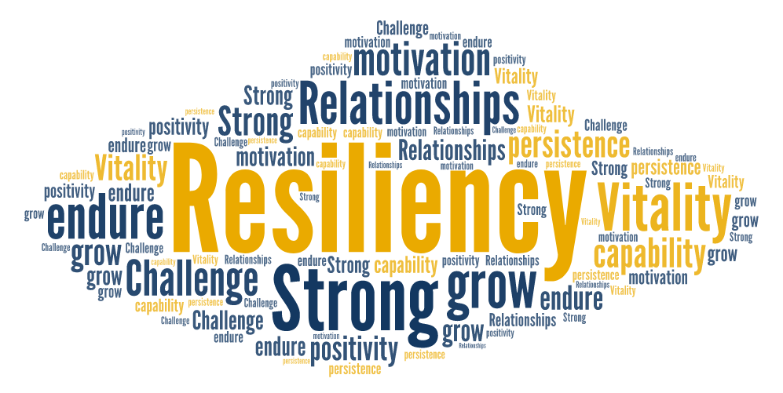

Slide 6

What will I learn today?
By the end of this session, each of you will be able to…
Compare and contrast Peer Recovery Coach and Recovery Coach models
Share, discuss, and apply shared experiences regarding work with Moms and Babies with NAS and what approaches have been successful for establishing resiliency in the literature and within our team; and
Identify, discuss, and practice ways to be resilient when working with Moms and Babies with NAS;

Slide 7
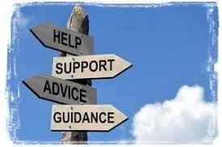
Subject Matter Expert Peer Recovery Coach
KRISTA WHITE
Intake Coordinator/Women's House Manager
Krista was born in Webster Springs, WV and grew up in Cowen, WV. She is the mother to her daughter Brittany, and grandmother. Krista managed a 16 bed halfway house, and 10 apartment complex women and children’s residence in Charleston WV, for women struggling with substance use disorders. She is a state certified peer support specialist, program manager, is active in her recovery community, and a leader amongst her peers. Krista is also a person in long term recovery.
krista@westvirginiasoberliving.com

Slide 8
Compare and Contrast
Peer Recovery Coach and Recovery Coach

Slide 9

NAWS Online Meeting List
https://www.na.org/meetingsearch/text-results.php?country=Web&state&city&zip&street&within=5&day=0&lang&orderby=distance
Intergroup Video Meetings
http://aa-intergroup.org/directory.php
Online AA Chat Room
http://aaonline.org/
In the Rooms – Global Recovery Community
https://www.intherooms.com/home/
WV 2-1-1
https://prd.icarol.com/landing.html?token=1ae3b4f7-3057-4ae7-a501-6d78d8c9de57&cssMode=Publish&orgNum=126088&db=126088
2-1-1 COVID-19 Information – Includes Internet Services
http://www.211.org/services/covid19
Refuge Recovery online meetings
https://refugerecovery.org/meetings?tsml-day=any&tsml-region=online-english
Smart Recovery Online Meetings
https://www.smartrecovery.org/community/calendar.php
She Recovers Online Community
https://sherecovers.co/

Slide 10

Case studies
Case Study #1
The family has a unexpected death due to an overdose and does not have a strong support system other than the home visitor. The family has asked the home visitor to help with funeral arrangements. In addition, the mother is unsure of how she is going to support the children. The apartment was paid for by the father of the children that passed away. She is unsure of how to explain to her children about the death of their father. She is texting the home visitor throughout the night and on weekends. The mother has a history of depression and since the death of the father, is becoming completely dependent on her home visitor.
What suggestions would you have for the home visitor?
Case Study #2
A young mom with two children live in a home with two other people. The mom has a history of substance use, but has been in recovery for the last two years since her last child was born. She was on Medication Assisted Treatment, but has transitioned off MAT appropriately based upon the program she was enrolled. However, over the last 3 months, the mom has not been going to group meetings and does not appear to have a peer recovery coach. Although the home visitor does not believe the mom has relapsed, she does have concerns about the other two adults living in the house. She feels that they may have a negative influence on her. However, mom does not have anywhere else to live.
What suggestions would you have for the home visitor?

Slide 11

Case study reflection
What resonates with you?
What do you feel would be the best way to support the family?
How could you practice resiliency during this scenario?
How would you prepare yourself for the next visit?

Slide 12

Resource share
Building emotional resilience includes:
Building self-acceptance
Improving stress management strategies
Building self-esteem
Being mindful and focused on the present
Expressing emotions wisely
Choosing to react to stress in a way that won’t harm the self or those around

Slide 13
Resource share
Emotional Resilience Self-Assessment
Statement
1. I trust myself
2. I am proud of my achievements
3. I have the power to overcome difficulties
4. I have people who love me
5. I can handle criticisms
6. I am respectful towards myself and others
7. I enjoy being part of a community
8. I am aware of my strengths and my weaknesses
9. I focus on solutions more than problems
10. I love my life
Total Score
Notes:
Below are ten statements that define you. Rate each statement from 0 to 5 where ‘0’ means ‘Strongly Disagree’ and ‘5’ means ‘Strongly Agree’.
Score
Interpretation
0-15
Low resilience (over-sensitive to stress, poor coping skills. Guidance recommended if the score lies in this range.
16-30
Average resilience (ability to combat stress and bounce back is there, but can still be improved with training and practice)
31-50
High emotional resilience (should be the target for all. Well-balanced emotional reactivity and perception of stress)

Slide 14
Resource share
Resilience Through The Power of Positivity
Negative Thoughts | Alternative Positive Thoughts
1. This shall never pass | 1. I have seen worse times passing
2. I am losing my hold on life | 2. I can get back the control
3. I can never move on | 3. Maybe I should give it some time
4. I won’t be able to adjust here | 4. Let me try to be friends with some people here
5. Better to stay quiet lest they judge me | 5. It is worth giving a try
Notes:
Set aside some minutes to list any 5 thoughts that are currently bothering you. Write them down on a piece of paper, or in your device notebook. Beside the column where you have listed the negative thoughts, try replacing the negative thoughts with positive ones.
For example, “I am having a tough time handling my finances” can be replaced with “Let me get try some financial guidance from friends and family”. Simply by replacing the thoughts on paper, you can see how things can actually be perceived differently.
Some examples of thought replacement are shown in the table.

Slide 15
Resource share
Resilience Through Gratitude
I am grateful to | Mon | Tues | Wed | Thu | Fri | Sat | Sun
Things I have that many people don’t
5 Goals that I accomplished this week
5 People who made me happy this week
To my family because
5 Good things that have happened to me this week
Note to Self:
Notes:
Gratitude is one of the most powerful emotions that we are capable of developing. When we learn to appreciate what we have, rather than complaining and stressing about what we don’t have or what we lost, we are already more resilient than before.
Gratitude is all about ‘Stop, Look, and Go.’ (Rast). Lack of gratitude stops us from moving forward and brings down our strength to recoil.
We can keep a gratitude journal where we list everything that we are thankful for, even during times of stress. Filling in the columns of the journal will be a gentle reminder to ourselves of all the good things in life. A weekly journal can look something like this:

Slide 16
Resource share
Resilience Through Self-Awareness
Stressors | Antecedent (what made this happen) | Behavior (How I reacted to it) | Consequence (What was the effect of my reaction)
1. | 1. | 1. | 1.
2. | 2. | 2. | 2.
3. | 3. | 3. | 3.
4. | 4. | 4. | 4.
5. | 5. | 5. | 5.
Notes:
Basically, self-awareness is about knowing the A-B-C of our mind, where A is the Antecedent or the cause that has led to the current situation, B is the behavior or the way we have chosen to react to it, and C is the consequence that our actions and emotions are likely to bring.
Identifying the A-B-Cs of every stressful encounter makes a person more resilient and gives the power to deal with adversities effectively. A simple daily exercise for practicing this is illustrated on the slide.

Slide 17
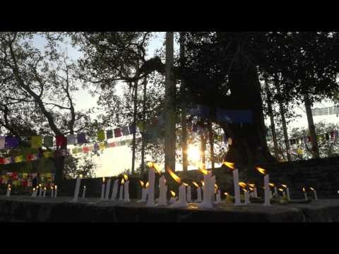
Resource share
Simple meditation exercises for managing stress
Guided meditation and mindfulness practices have been positively connected to emotional resilience. The emotional turmoils that follow a stressful experience can be purposefully resolved through practicing simple meditation every day (2016).
Notes:
Courtney Clark, in her famous Ted Talk on emotional resilience, mentioned that emotional resilience begins when we are able to use those coping mechanisms which we know exists but have never used before. Here is a 12-Minute Meditation Guide For Building Resilience
https://www.youtube.com/watch?v=PX0P3RSzXeU

Slide 18
Resource share
What does the literature say?
Do you have experience with this?
Have you tried a similar approach?
Does it work?
What would you do differently?
How do you think families would respond to this?

Slide 19

What is one skill
I learned today?
How can I share this skill with a peer or a family with a baby diagnosed with NAS or exposed to substances in utero?

Slide 20
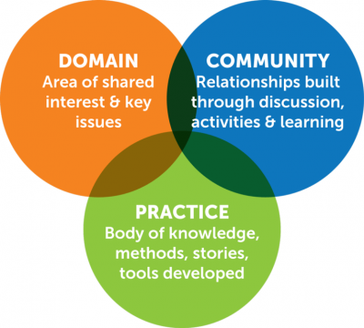
Next Communities of Practice Meetings
Reflection Meeting Face to Face April 15th
  If held, will be via Zoom Meeting
Self Care: Secondary Trauma May 5th

Slide 21
Acknowledgements
This Appalachian Rural Health Integration Model (AHRIM) Program is supported by the Health Resources and Services Administration (HRSA) of the U.S. Department of Health and Human Services (HHS) as part of an award totaling $600,000 with 0 percentage financed with nongovernmental sources.
The contents are those of the author(s) and do not necessarily represent the official views of, nor an endorsement, by HRSA, HHS or the U.S. Government.

