Slide 1
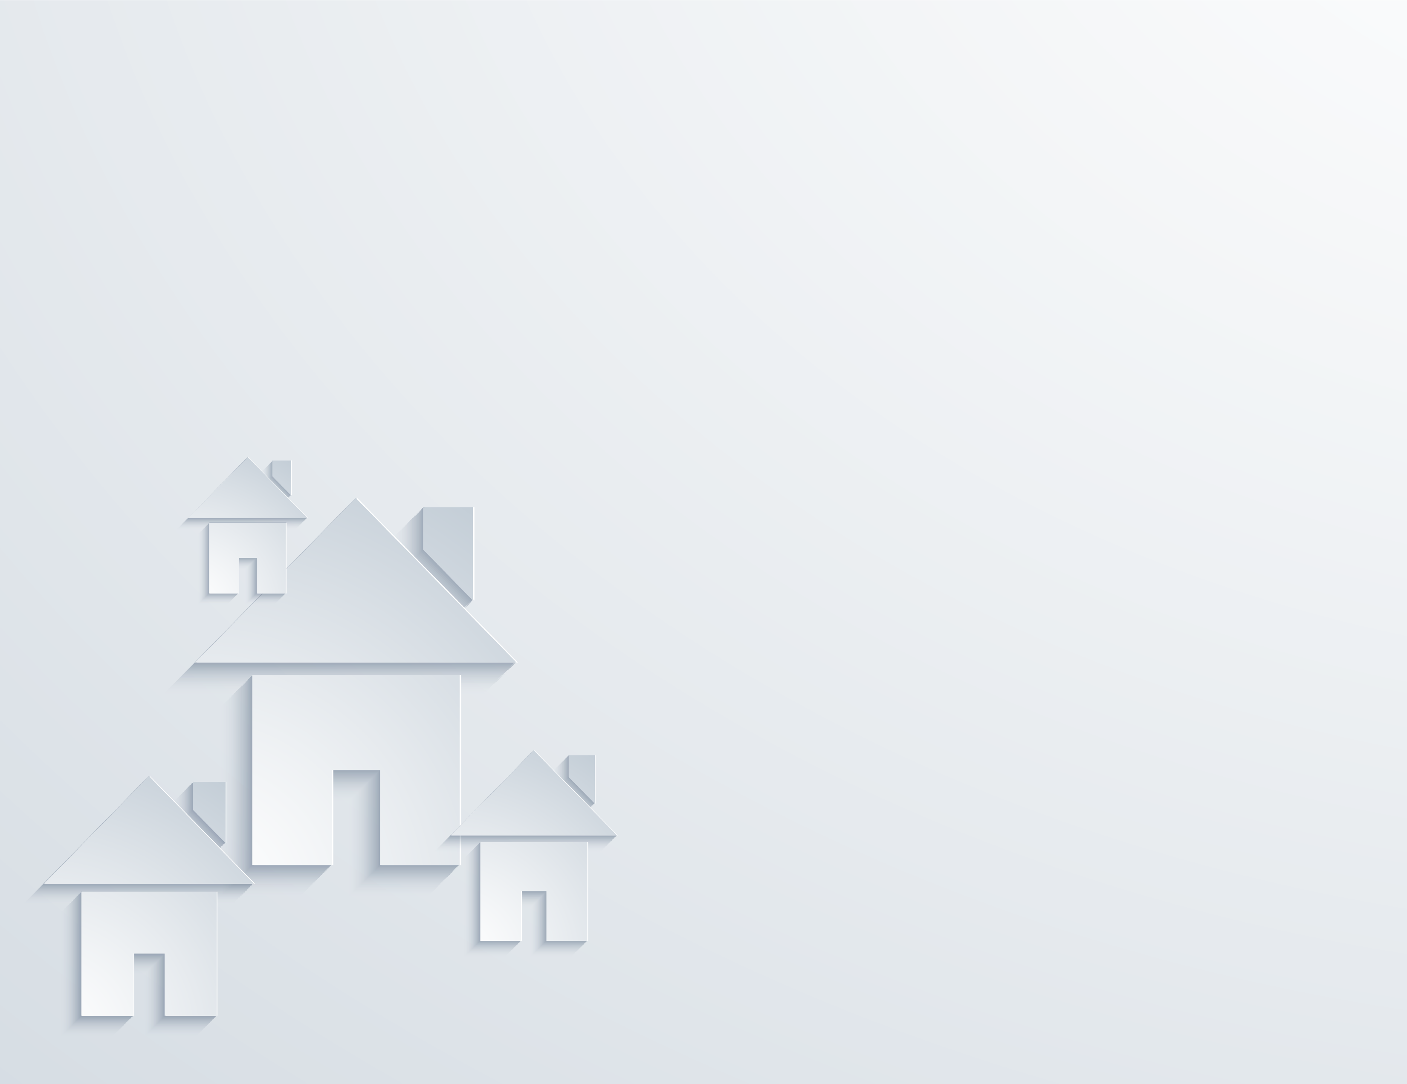


Meeting Kinship Families
Where They Are
Notes:
Both

Slide 2
Glad to meet you…
Lydia D. Cooper
Lead Trainer
Jay Kadash
VP Communications, Content and Systems Engagement
Where are you from?
Use the chat feature to let us know!
Notes:
Both

Slide 3
Objectives
Describe how the family hierarchy impacts relationships in kinship care.
Recognize how family loyalties influence conversations in kinship care.
Identify strategies for inclusive family engagement in kinship care.
Notes:
Jay

Slide 4

First Impressions…
How quickly does a caregiver judge you after meeting you?
7 seconds
Did you know, research suggests whenever we meet someone for the first time, that judgment about the other person will be formed in only the first few seconds?
This happens with anyone, even a random person on the street.
In those first several seconds, we as humans are primed to judge the other person’s friendliness, cooperation and competence.
https://www.kevinmd.com/blog/2018/05/your-patient-has-judged-you-7-seconds-after-meeting-you.html
Notes:
Jay

Slide 5
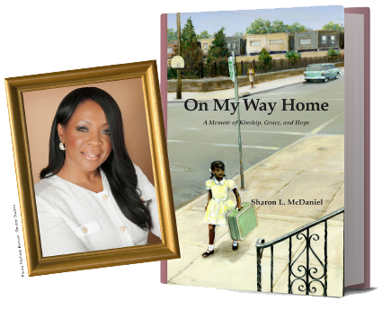
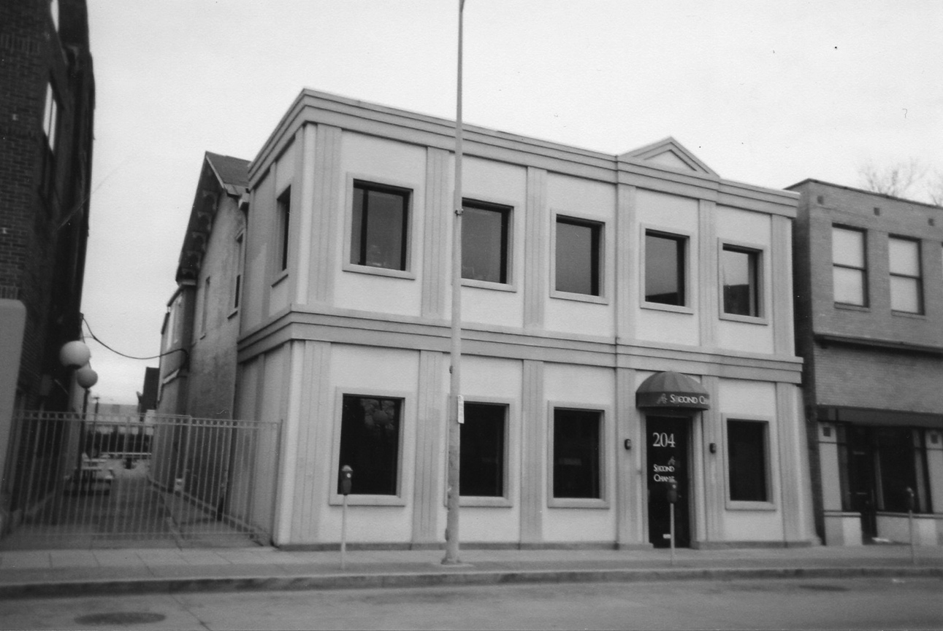
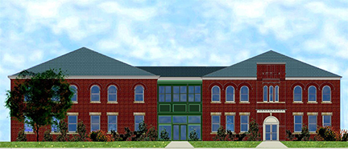
About A Second Chance, Inc.
We began our kinship care purpose in 1994.
We are a founder brand of kinship care.
A Second Chance, Inc. made kinship care the strategy, not just a strategy, in Allegheny County (Pittsburgh, PA).
Notes:
Jay

Slide 6
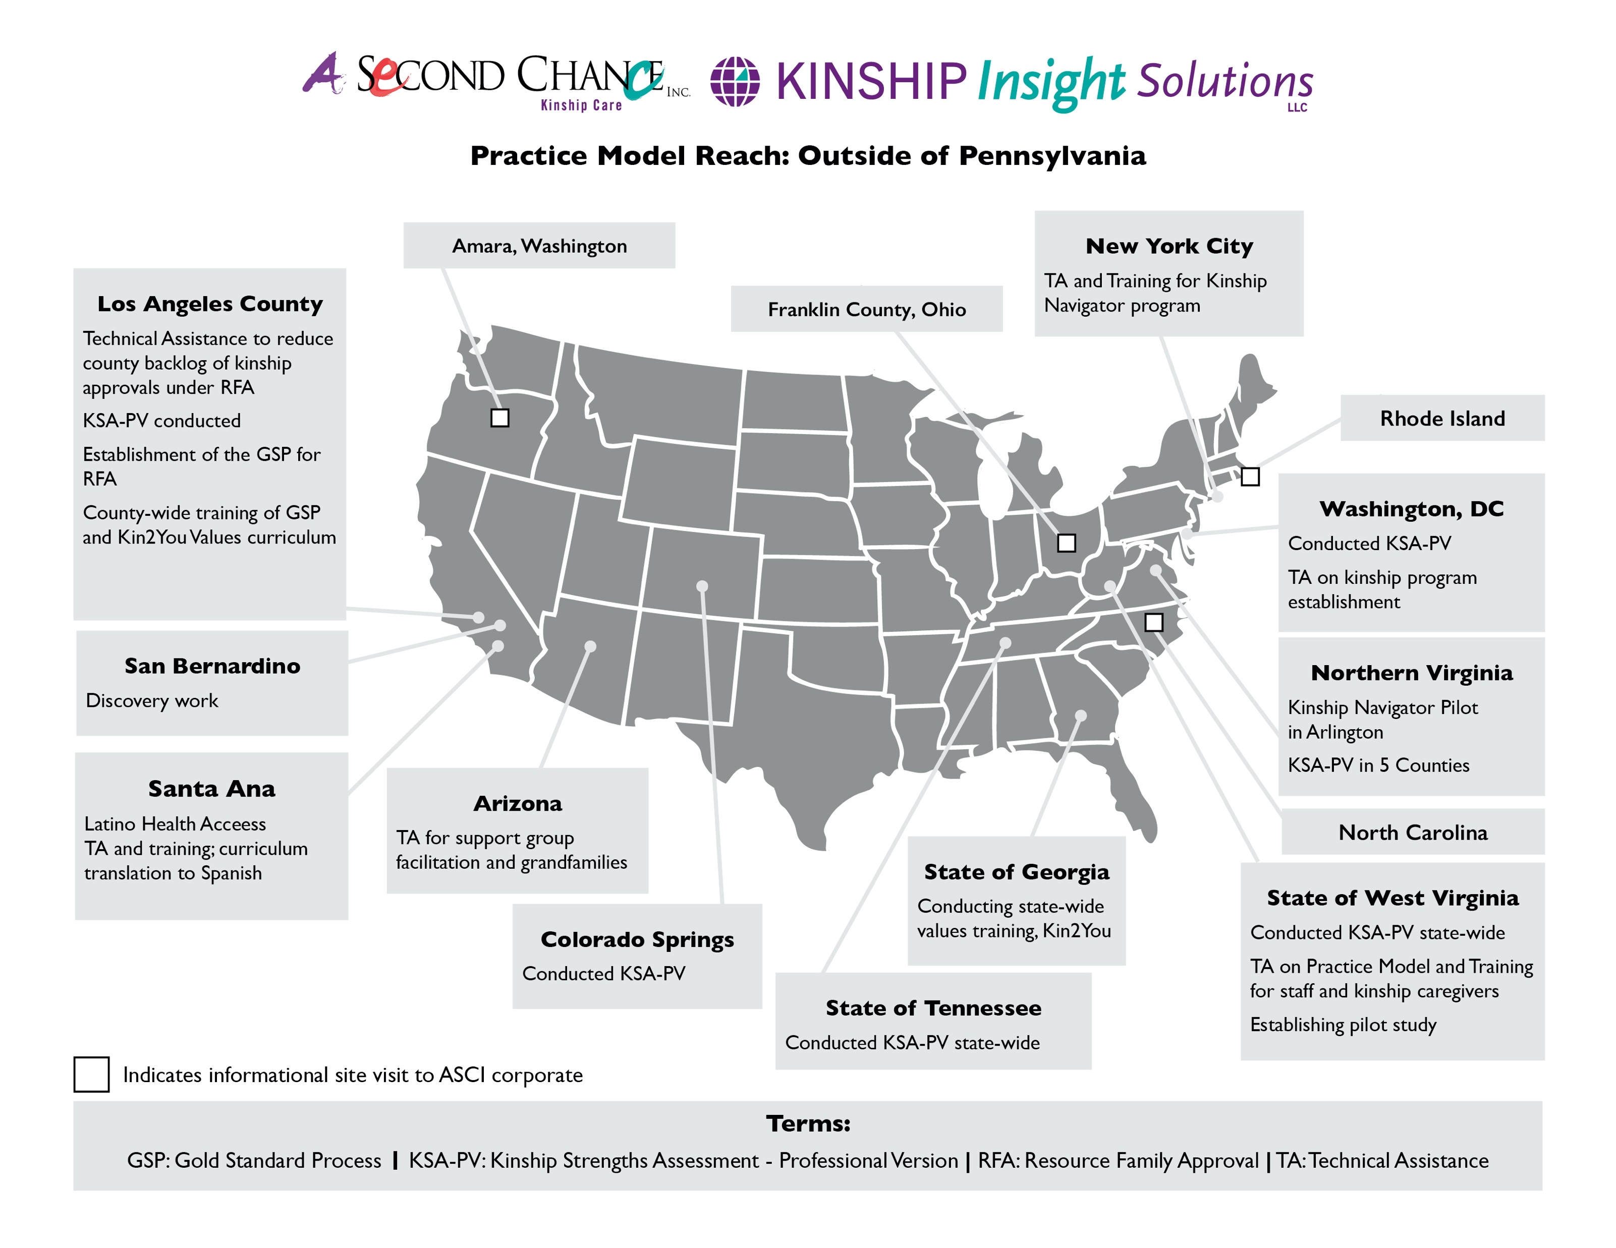
Notes:
Jay

Slide 7

Are you on board with kinship care?
32% of children in care resides in kinship
56% of children who left foster care in 2018 were reunited with their parents or primary caretakers
64% of youth spend between 1 month and 24 months in care
Notes:
Jay

Slide 8
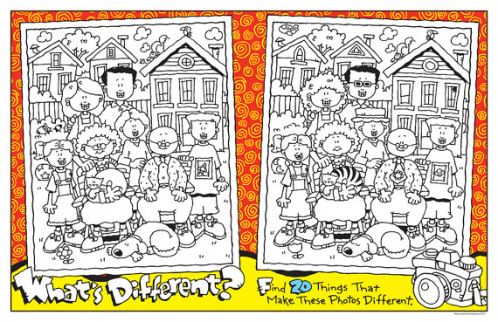
On a scale of 1- 10, with one being not very similar and 10 being very similar…
How similar is kinship care to traditional foster care?
Notes:
Jay

Slide 9
Traditional Foster Care = 2-3 Years
Kinship Care = 2-3 Minutes
http://centervideo.forest.usf.edu/video/qpi/cuyahoga/kinshipcare/start.html
Notes:
Lydia

Slide 10
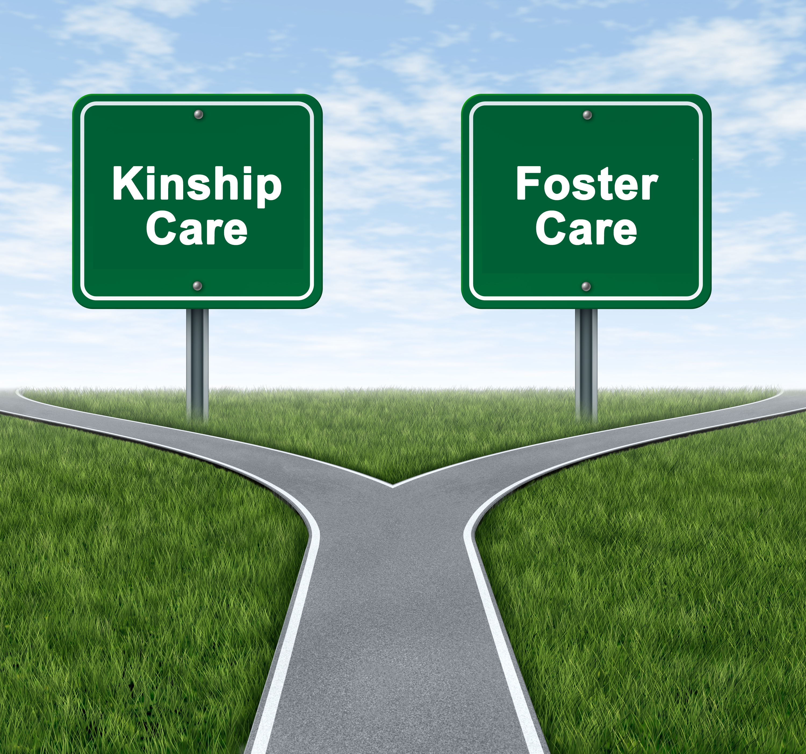
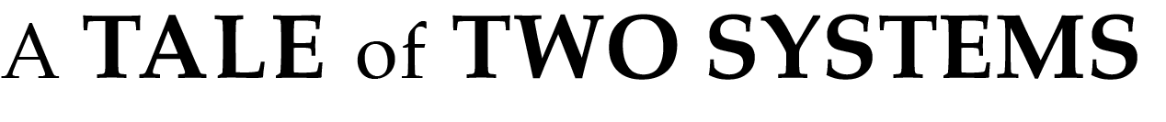
In principle, yes. However, we believe that we must recognize the unique needs of the kinship family in child welfare.
Traditional foster care and kinship foster care are on the same path.
10
Notes:
Lydia

Slide 11
Traditional Foster Care
Planned
Kinship Care
Unplanned
Unexpected
Kinship triad (child/youth, birth family, caregiver) is under surveillance.
Loyalty may be challenged within the family.
There is a shift in family dynamics.
Shifting hierarchy and changing roles
Notes:
Tara 3-5 mins

Slide 12
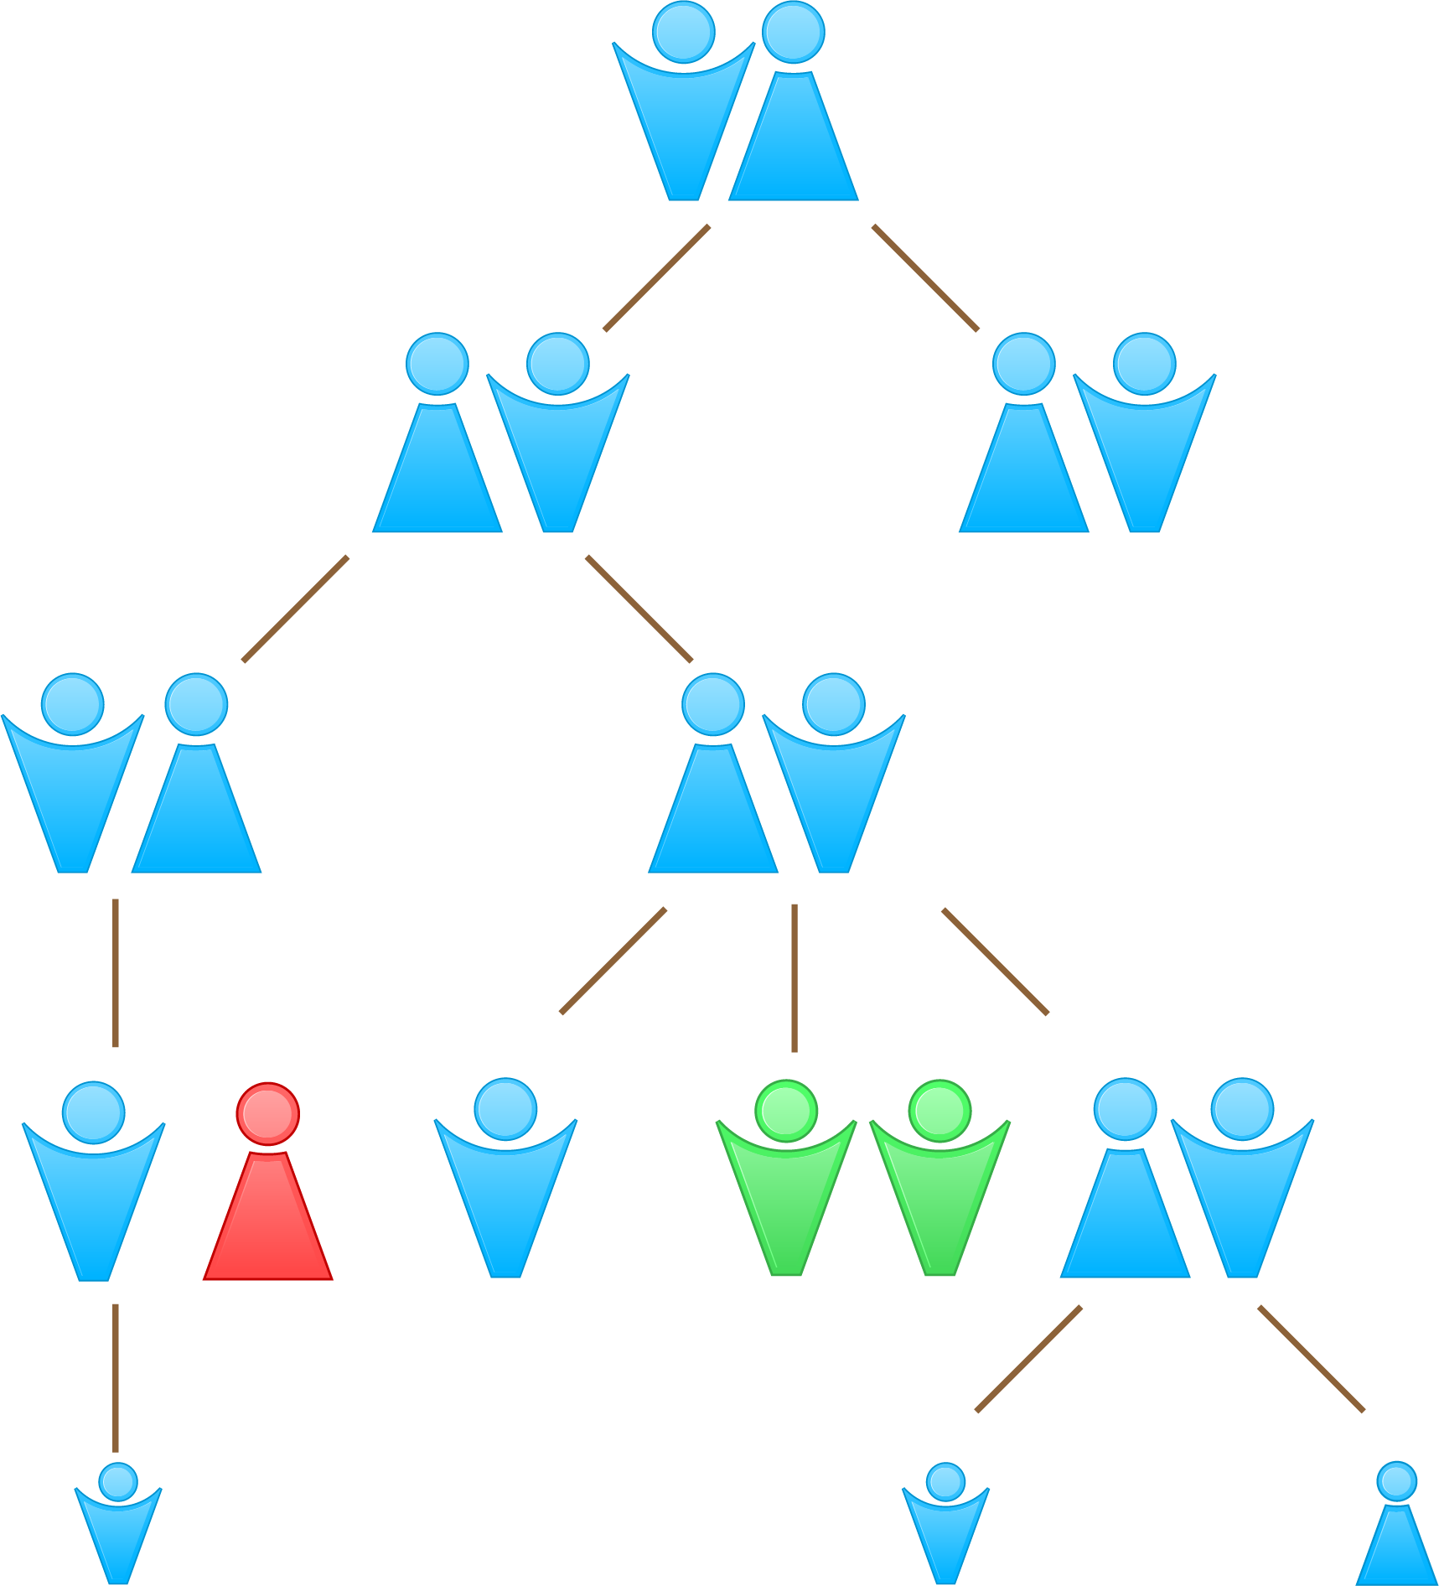


Every family has a hierarchy – a game plan.
Notes:
Lydia

Slide 13

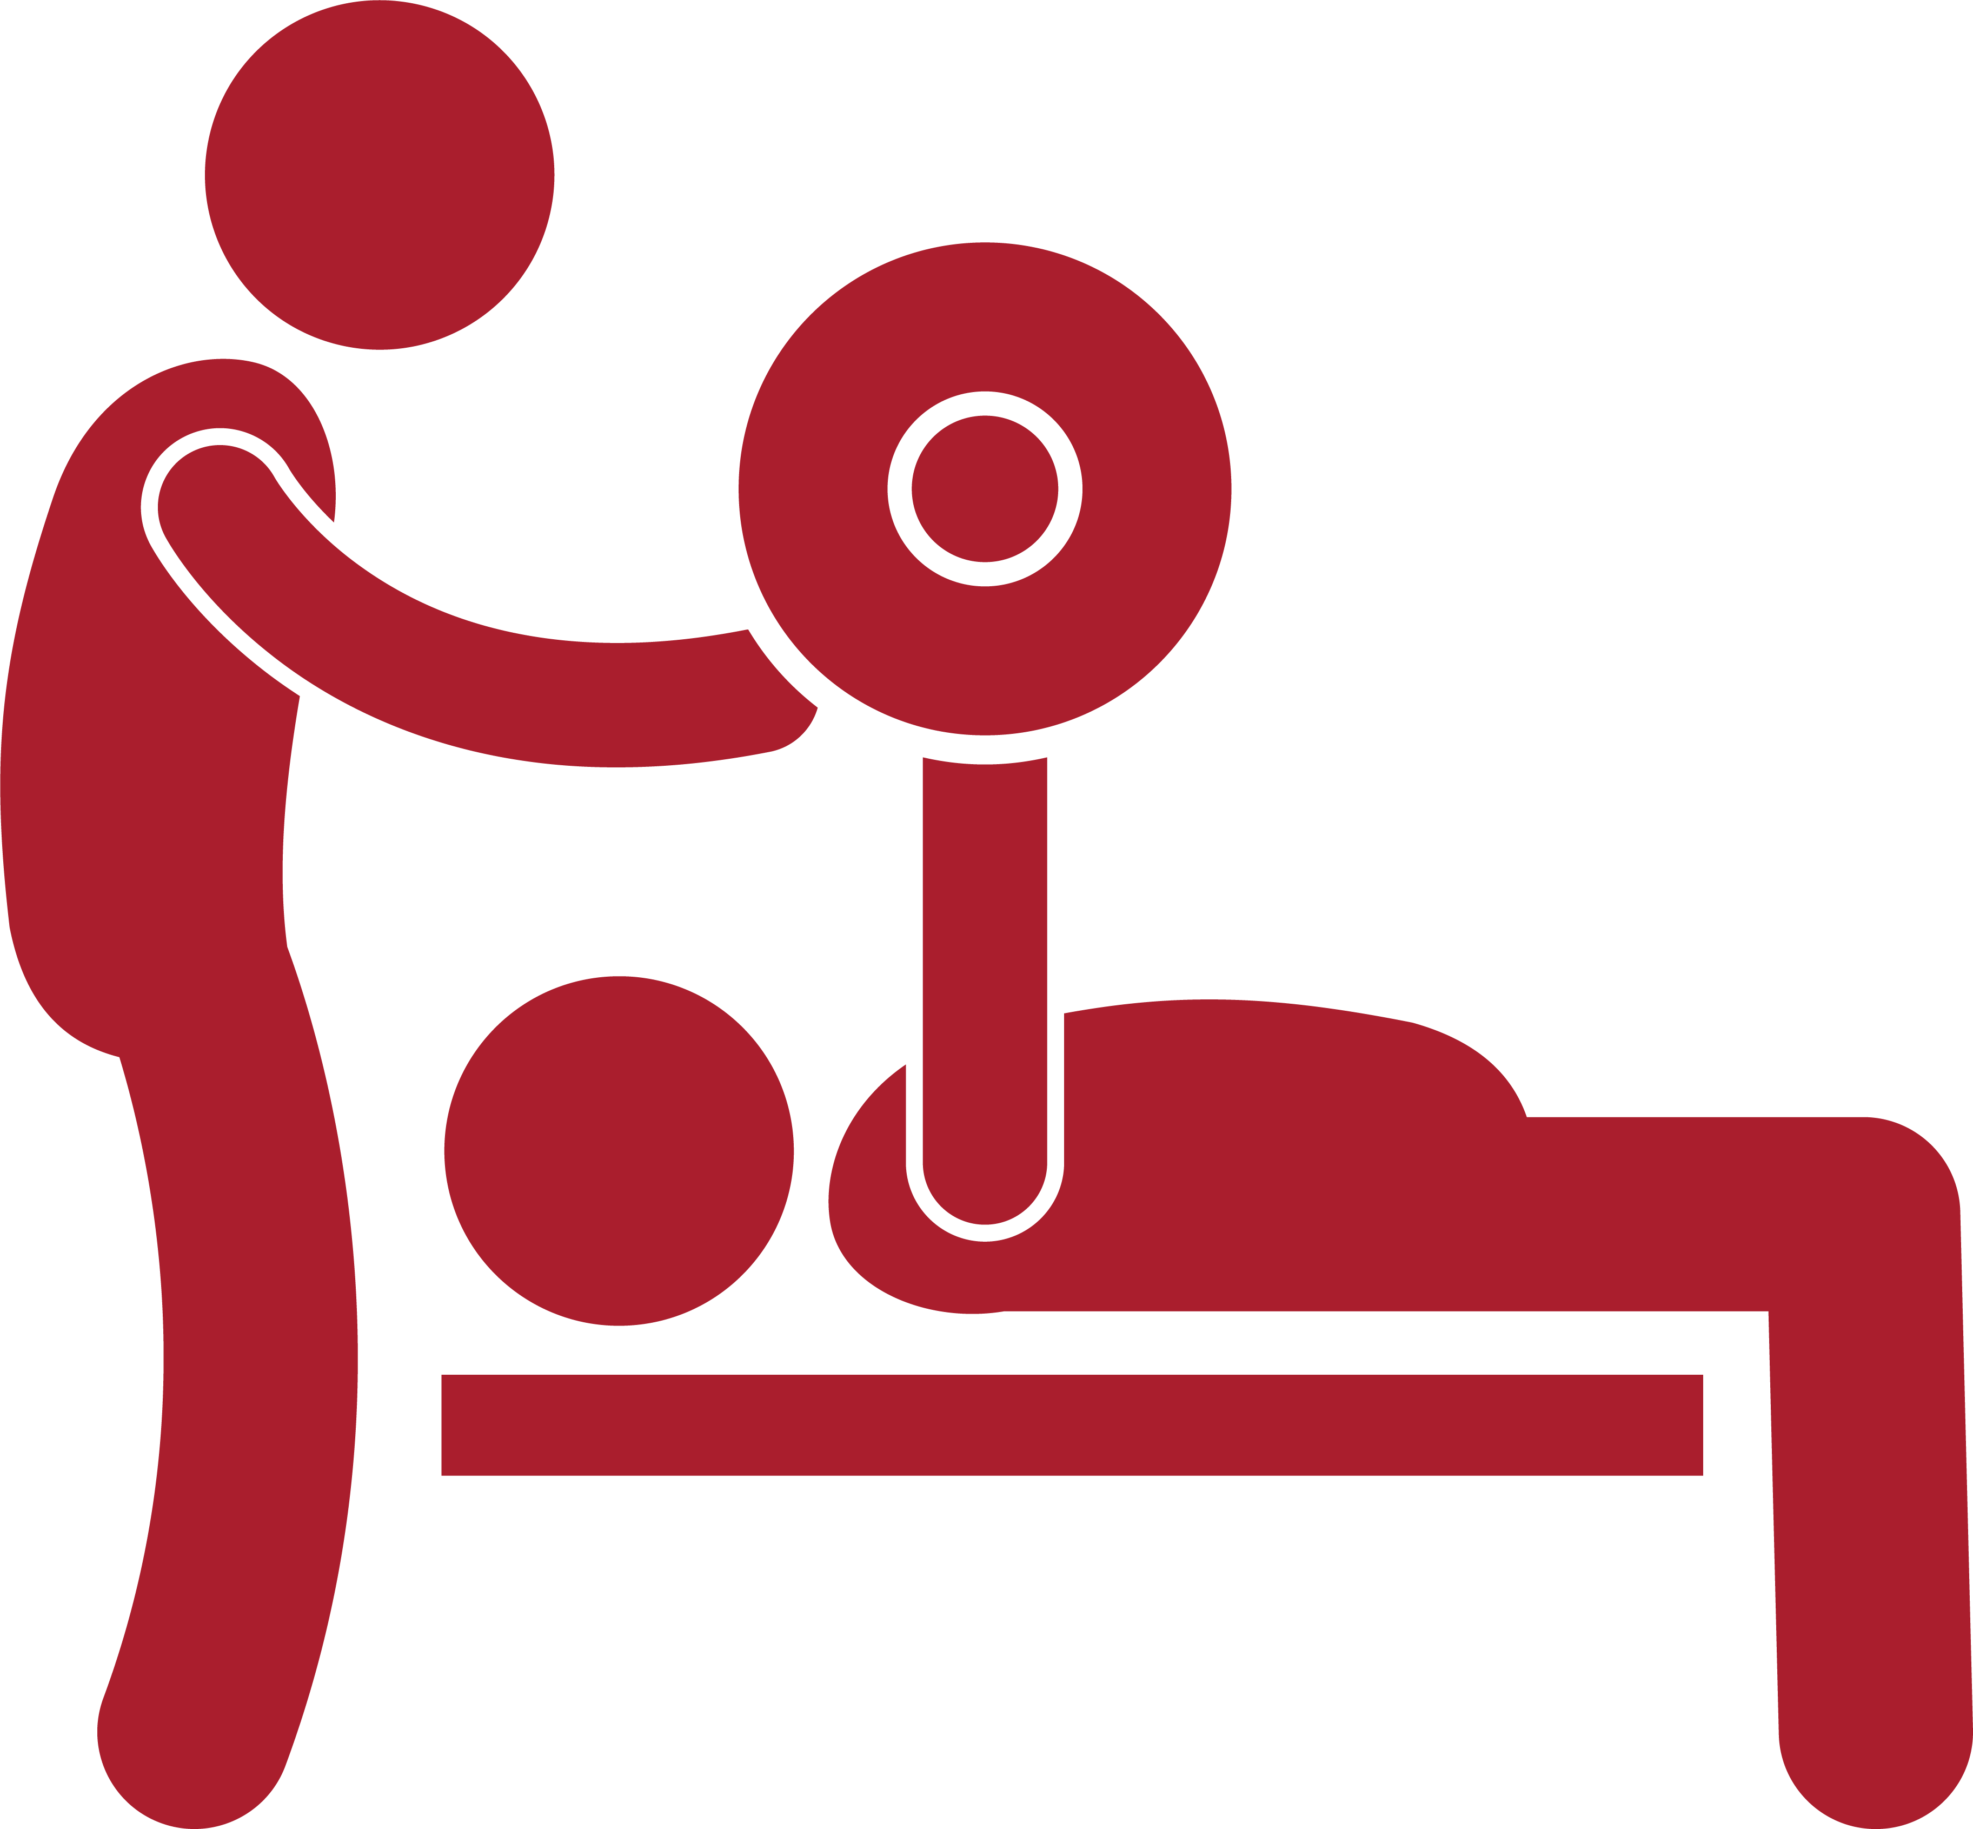
Notes:
Lydia

Slide 14
Using the analogy of the family being on a journey, the caseworker’s role is that of a tour guide, providing direction on the trip but leaving the itinerary up to the patient. Advice can be given, and facts can be presented to educate the family about guideposts along the way, but the caseworker follows the lead of the family. The journey may involve detours, pit stops, and backtracking, but the guide is there to lead the family to the final destination – permanency.
https://journalofethics.ama-assn.org/article/meeting-patients-where-they-are/2013-04
Notes:
Lydia

Slide 15
As an alternative analogy, the caseworker is a coach who is there to inspire and motivate the family. The challenge comes in knowing when to push the family, when to comfort and console, and when to cheer. A good coach or team manager may have his or her own style of managing, but also needs to adapt to the needs of the players over the course of a game or season. For the caseworker, this entails knowing the family well enough to know what strategy will work in which instance.
https://journalofethics.ama-assn.org/article/meeting-patients-where-they-are/2013-04
Notes:
Lydia

Slide 16

Building Empathy What happened before?
How would you answer?
What family members are you close to?
Who can you rely on?
Who helps you when you are stressed out?
Who do you trust?
Do you visit your relatives?
What do you consider home?
Who do you consider family?
Are you involved with any church or community group?
In times when you have needed help in the past, who was there for you?
Are there people who are special to your children?
Do your children have friends or supports through school or activities? Is this someone you can turn to?
Notes:
Jay

Slide 17
How do you meet families where they are?
Triad Centric Engagement
Notes:
Jay

Slide 18
Building Empathy What happened before?
When you think about your family going through tough times, what are some of the experiences you have had? What helped you get through those times? Is any of that still in place or available to you now (personal strengths, family supports, etc).
Notes:
Alexandria- Share one way that you engage with youth. Put it in the chat.

Slide 19

What shape best represents kinship care?
Child
Birth Family
Kin Caregiver
Maternal, Paternal, Community
Notes:
Jay

Slide 20

5 STRATEGIES when Engaging Kinship Families
PEARR
To look keenly
Purposefully engage with the entire triad.
Empower the triad.
Adhere to agenda-driven engagement.
Build a rapport.
Be open to receive.
Notes:
Jay

Slide 21
PEARR
To look keenly
Purposefully engage with the entire triad.
Include the voice from all parties (youth, birth parent, kinship parent)
Be intentional with communication and inclusion
Notes:
Tara

Slide 22
PEARR
To look keenly
Empower the triad.
Ask the family what they need and want
Be transparent with the triad
Build trust with family through consistency and reliability
Notes:
Lydia

Slide 23
PEARR
To look keenly
Adhere to agenda-driven engagement.
Being prepared for the visit with a purpose and follow up/ talking points
Being creative with engagement
Talk about things the family is interested in
Consider doing an activity with the family
Notes:
Jay

Slide 24
PEARR
To look keenly
Build rapport with the family.
Meeting family with understanding the case history but check your biases regarding their story
Be consistent
On going process (strengthen vs fracture)
Notes:
Jay

Slide 25
PEARR
To look keenly
Be open to receive.
Check your body language, your tone, and your response
Assess your own interactions and see if there is anything you can do differently
Do you treat all clients the same? Are you able to pivot (change your approach, actions, behaviors to get a different result?
Notes:
Jay

Slide 26
What’s the philosophy behind strategy?
Notes:
Jay

Slide 27
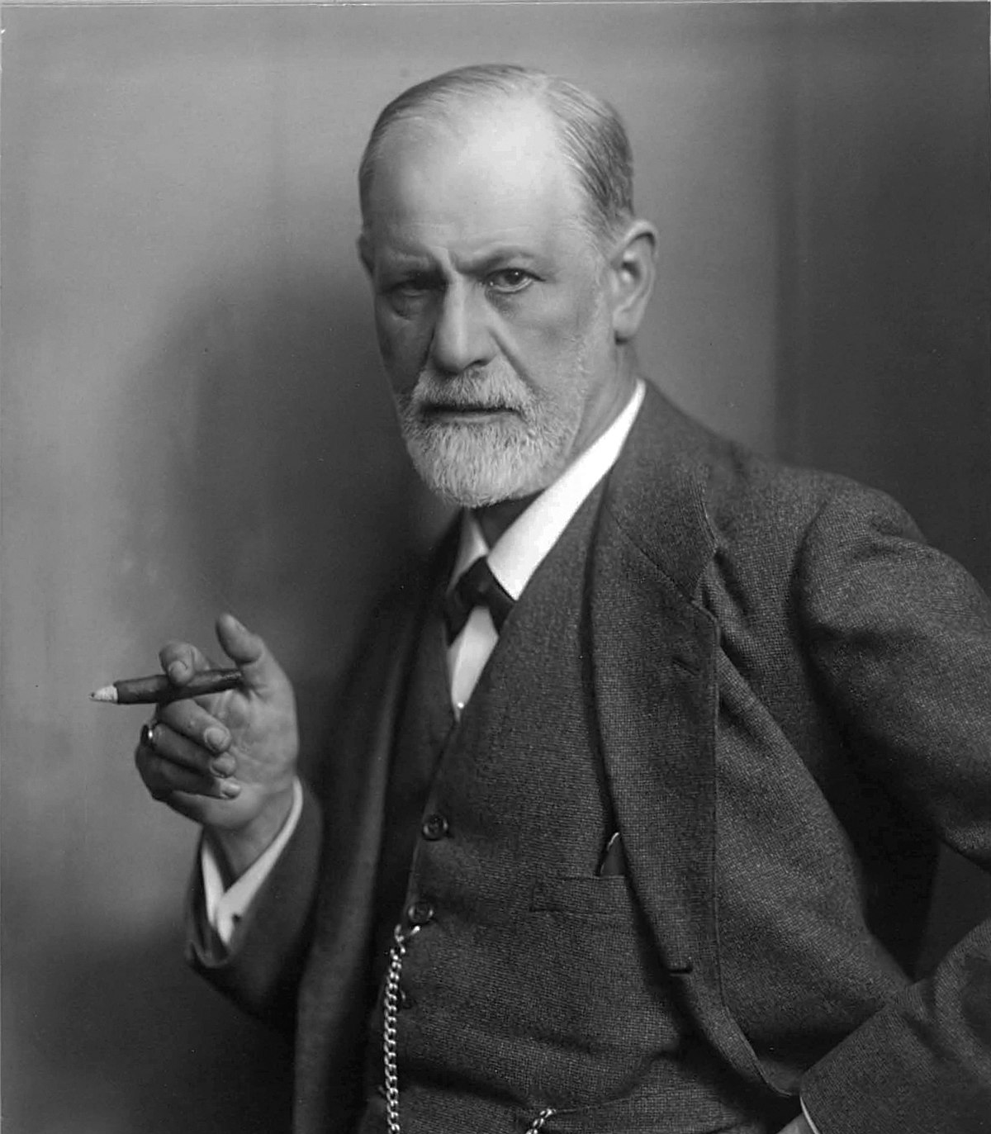
How do we
see kinship
families?
Sigmund Freud noted that people tend to remember and value the differences between ourselves and others more than we do the similarities.
Notes:
Jay

Slide 28
Family scientists define power in terms of who is able to influence others in the family, and who is able to block others.
https://family.jrank.org/pages/1316/Power.html
Notes:
Jay

Slide 29
In some families, an uncle who tries to impose his will on his nieces and nephews might be viewed as a meddler who is trying to exercise illegitimate power.
In other families, uncles are accorded legitimate power over nieces and nephews and might be respected for this kind of guidance.
https://family.jrank.org/pages/1316/Power.html
Notes:
Lydia

Slide 30
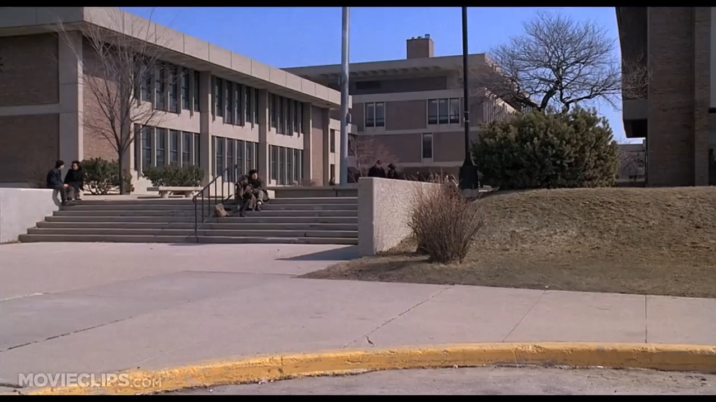
Notes:
Lydia

Slide 31
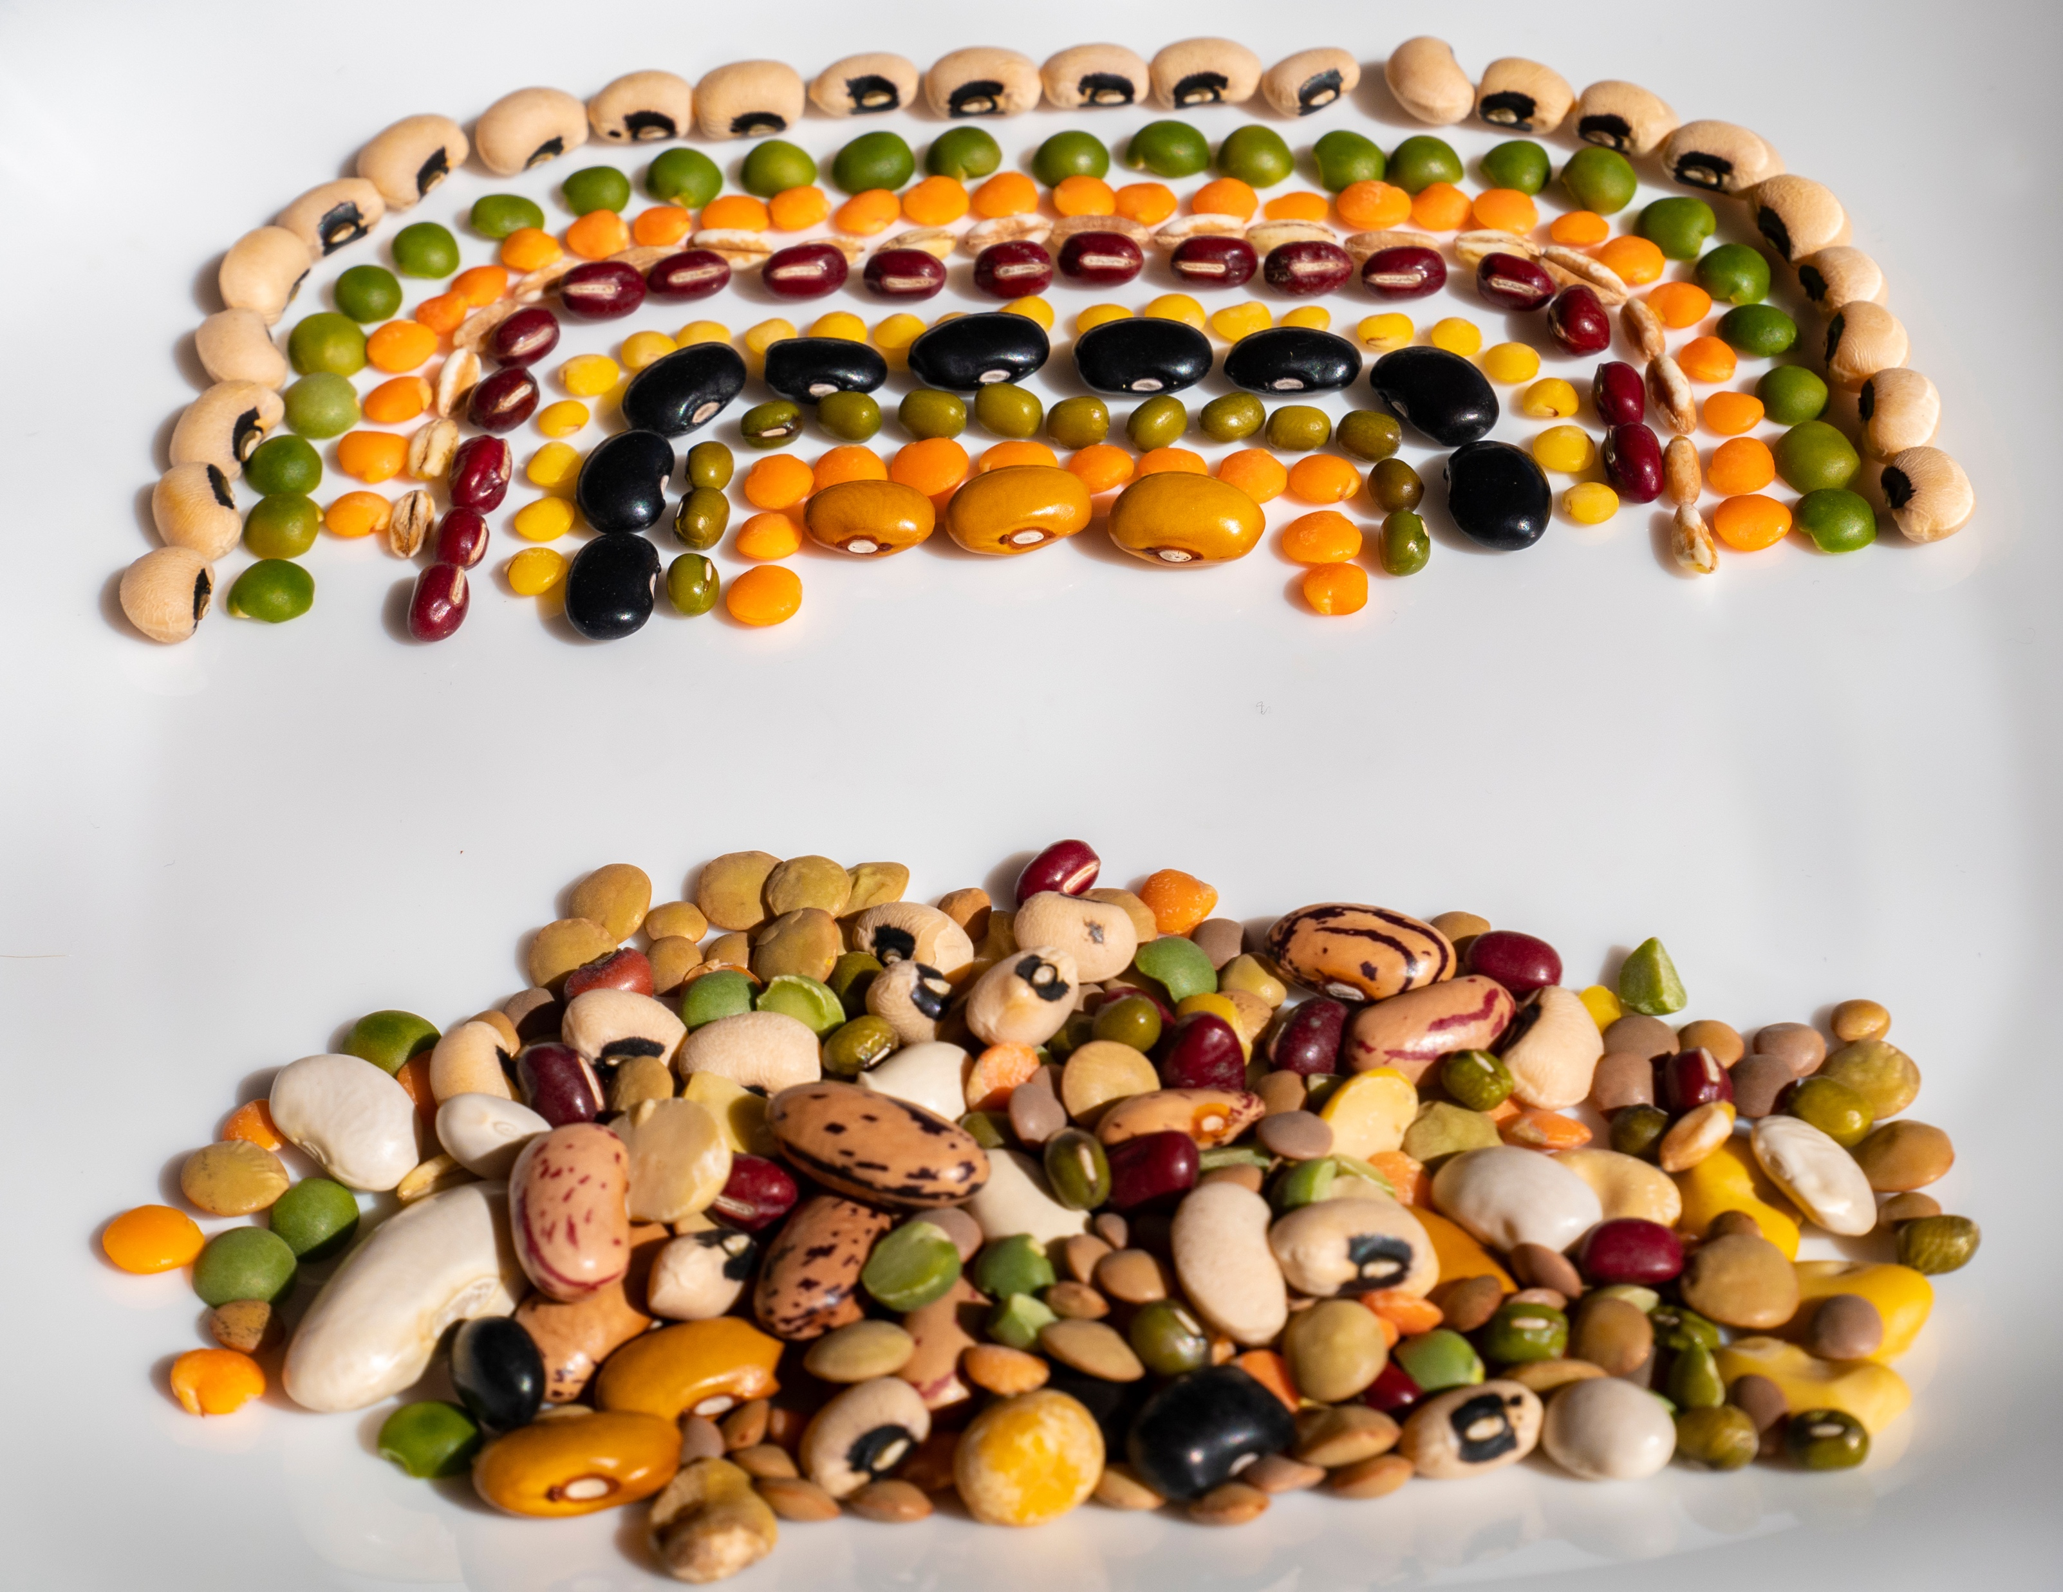
Meeting kinship families where they are means there is no starting line.
Notes:
Lydia

Slide 32
Guilt
Anger
Doubt
How does the family feel about you (the system) now in their family?
Jealousy
What can you do show the family you consider them to be valuable?
Embarrassment
Fear
Notes:
Jay

Slide 33
Every child that is living in a relative caregiver situation has moved to a new location on the family genogram.
Parenting
Routine
Relationships

Slide 34
First steps in meeting caregivers where they are
Using silence - providing space for the caregiver to speak.
Using reflection and ask questions with genuine curiosity, to better understand needs. (Genuine curiosity means you assume that other people may have information that you don't have.)
Slowing down pace and bringing my focus to being in the moment, improved the sincerity of each interaction, and increased my awareness if the patient became disengaged, or demonstrates signs of resistance.
https://thischangedmypractice.com/meet-my-patient-where-they-are/
Notes:
Jay

Slide 35
Who Gets My Heart?
Kinship Care & Divided Loyalties
Is co-parenting a strategy?

Slide 36

There is no such thing as a structureless family.
Child/youth position has changed – in the home currently or coming into the home
Family structure is based on a hierarchy.
The decision-making members are at the top of the hierarchy followed by members separated by boundaries.
The hierarchy allows members to communicate with each other and make decisions about how to move and grow as a family.
https://foundationsfamily.com/parenting-family-structure/
Notes:
Lydia

Slide 37

Choice
Affected
Challenges
OVER
Other
Me
Abuse
WITH
We
Us
Agreement
EM-
Me
Me
Trust
Notes:
Jay

Slide 38
Hierarchy Is Not the Problem… It’s the Power Dynamics
Maximize power-from-within: everyone feels empowered; they are confident to speak up, knowing their voice matters; good ideas can come from anywhere; people play to their strengths; creativity is celebrated; growth is encouraged; anyone can lead some of the time.
Make power-with transparent: we’re honest about who has influence; pathways to social power are clearly signposted; influential roles are distributed and rotated; the formal org chart maps closely to the informal influence network.
Minimize power-over: one person cannot force another to do something; we are sensitive to coercion; any restrictions on behavior are developed with a collective mandate.
https://blog.p2pfoundation.net/hierarchy-is-not-the-problem-its-the-power-dynamics/2019/03/20
Notes:
Jay

Slide 39
He that conceals his grief finds no remedy for it.
Turkish Proverb

Slide 40

Preparing for Trauma
Trauma
Engaging in Trauma
Traditional Foster Care
Kinship Care
Motivation
What would be your personal motivation for kinship care?

Slide 41
Add tactics to strategy

Slide 42
4
The Habit Model (Kaiser)
Creating rapport and collaboratively setting the agenda
Eliciting the client perspective
Demonstrating empathy
Delivering information in a manner that the client can understand it at this point-in-time
Using the model above as best practice…
On a scale from 1- 5, with 5 being the best, how do you rate your current framework when engaging kin? And why?

Slide 43




Emergency, Urgency, Engagement…
Emergency
Urgency
Immediate Threat
Threat in the very near future
Well-being
Perspective
Reactionary
Proactive

Slide 44

RECAP!
5 STRATEGIES when Engaging Kinship Families
PEARR
To look keenly
Purposefully engage with the entire triad.
Empower the triad.
Adhere to agenda-driven engagement.
Build a rapport.
Be open to receive.
Notes:
Lydia

Slide 45
Thank You!
Q
A
&
Notes:
Both- ask in chat

Slide 46

Lydia Cooper LydiaC@asecondchance-kinship.com
Jay Kadash JayK@asecondchance-kinship.com

Slide 47
Tony was placed on probation for missing so much school, and eventually the courts ordered drug counseling services.
He went to an inpatient program for one month and then transitioned to a partial-day program. After being off drugs for some time, he started thinking more about his friend’s horrific death and began to experience survivor guilt.
His nightmares and hyperarousal returned and felt so unbearable that he soon began using again to gain temporary relief.

